Slide 2
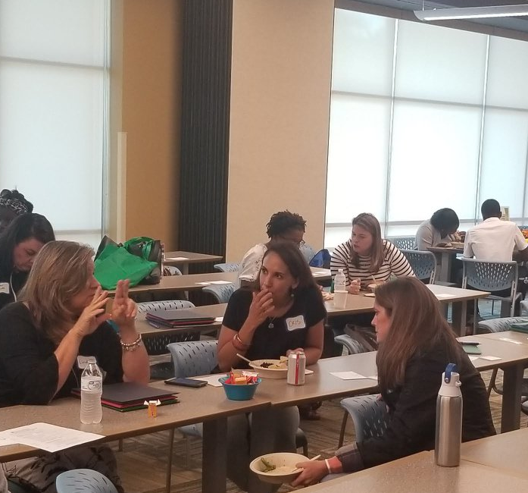
Parents and Teachers Talking Together PT3

Slide 3

Meet the presenters
History of PT3
Breakout questions
Large group discussion
Resources
Contact us
Agenda for the Hour

Slide 4

40 Years
The Prichard Committee is celebrating 40 years in 2023.
​The Prichard Committee team believes that education is the path to a larger life for all Kentuckians. We work to help citizens become informed and engaged advocates for excellence in our state’s educational endeavors. Insight forged from our diverse experiences, our collaboration and commitment to education’s role in creating successful people and communities propel everything we do.

Slide 5
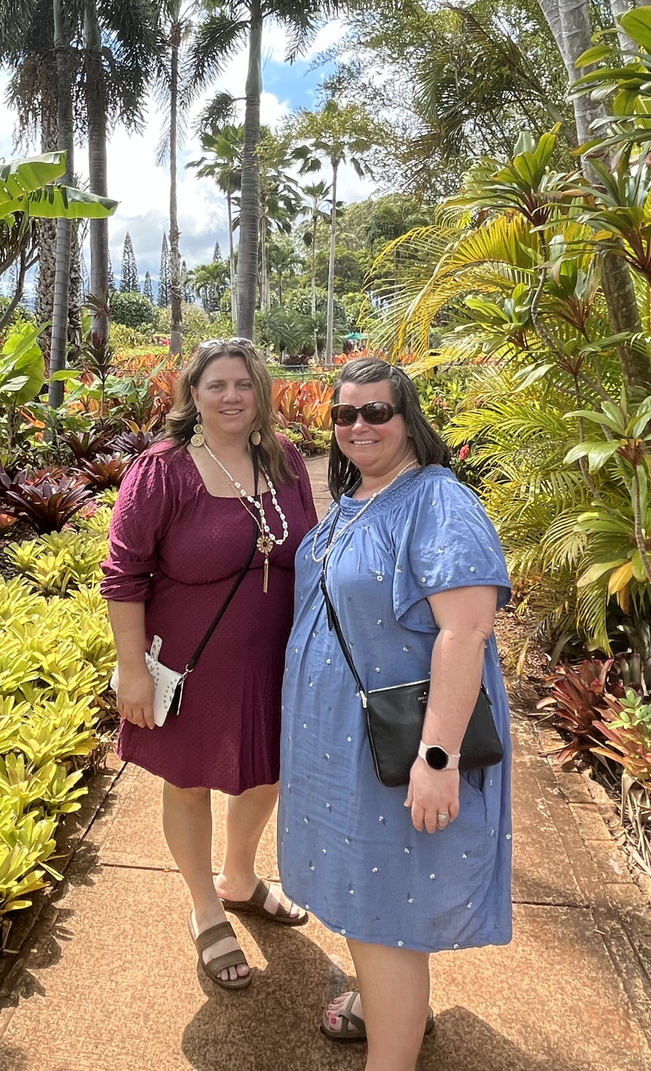

Meet the Presenters (sample slide)
Laura
joined the Prichard Committee staff 2019 and serves as the Director for the Commonwealth Institute for Parent Leadership. Laura has more than 15 years of experience leading family engagement initiatives. Laura previously served as the Family Consultant for the Department for Public Health and the Lead Family Contact for two System of Care SAMSHA grants. Laura has three children, serves on her local FRYSC Advisory Council.
Melody
joined the Prichard Committee staff in February 2000 as the Grants & Finance Coordinator. She has served in a variety of roles on several PTA boards and has also served numerous terms on two school-based decision making (SBDM) councils. Melody is the mother of four children.

Slide 6


Parent Teacher Conferences
Text Message
Email
Phone Calls
Social Media
Click icon to add picture
Current Communication tools

Slide 7
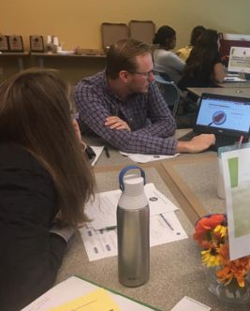
PT3 Introduction
Commonwealth Institute for Parent Leadership
EdOptions Digital Playbook-for everyone
Back to School Basecamps-for families
Parents and Teachers Talking Together (PT3’s)- for families and educators
Education Cafes-for families
Champions for Our Children,6-week program-for families
Family Friendly School Initiative and certification-for schools
Groundswell Gatherings and Community Profiles-for families, schools, and communities
CIPL Fellowship-for family leaders
Commonwealth Institute for Parent Leadership
EdOptions Digital Playbook-for everyone
Back to School Basecamps-for families
Parents and Teachers Talking Together (PT3’s)- for families and educators
Education Cafes-for families
Champions for Our Children,6-week program-for families
Family Friendly School Initiative and certification-for schools
Groundswell Gatherings and Community Profiles-for families, schools, and communities
CIPL Fellowship-for family leaders

Slide 8
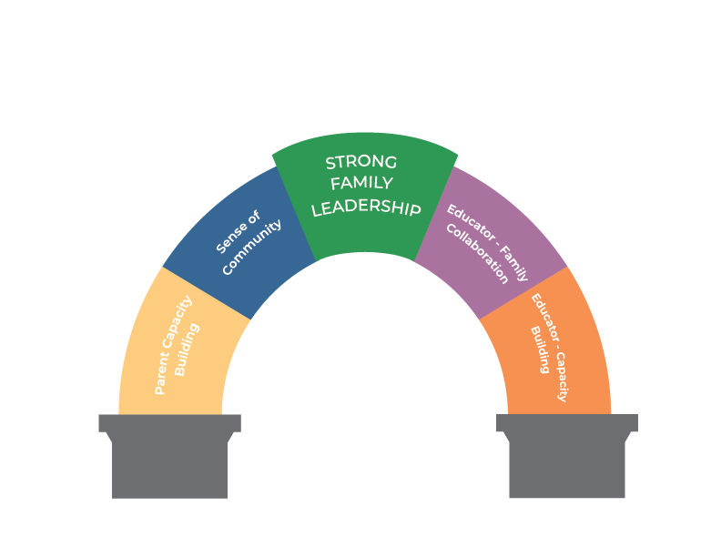
Family Leadership
Foundations and key building blocks

Slide 9
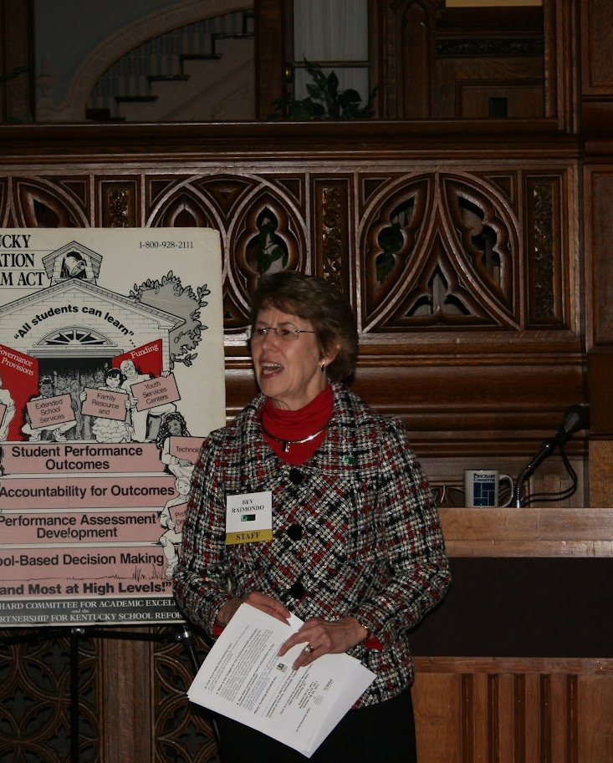
PT3 History
Since 1994, the Prichard Committee for Academic Excellence, has supported the PT3 platform as an essential relationship building conversation that leads to change in Kentucky schools.
Parents and teachers who participate in Parents and Teachers Talking Together sessions report increased understanding and concern for each other. In fact, facilitators talk about the “magic” that occurs during the session when parents and teachers begin to understand each other better.

Slide 10
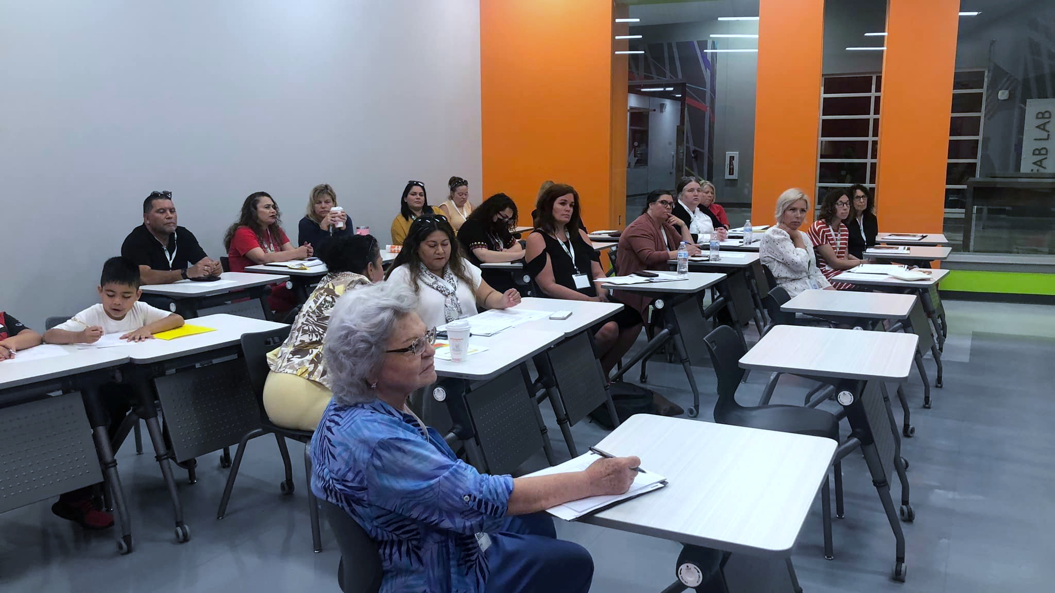
“We realized we share the same concerns and desires,” and “You know, they really do care about our children.” ​

Slide 11

Group 1: Families
Group 2: Teachers
Let’s Get Started in the Breakout

Slide 12
Question 1
What do we want for our students?
List some wishes for our students (use NOUNS). Your facilitator should record your wishes on the flip chart

Slide 13
Question 2
​How do we get what we want?
These should be action words (VERBS). What can you DO to get what you want?

Slide 14
Consolidation
We will look at the first list, What do we want for our students? The facilitators will read each group’s list, and we will consolidate (combine) the like items.
Several rules for consolidation:
Not everything on the list has to be consolidated. Some things will and should stand alone
If one person objects to something being combined, then it won’t be.
We ask for clarification, if we don’t understand an item.
We are all back together

Slide 15
Consolidation Again
Several rules for consolidation:
Not everything on the list has to be consolidated. Some things will and should stand alone
If one person objects to something being combined, then it won’t be.
We ask for clarification, if we don’t understand an item.
You will use 14 sticky dots to decide how important these items are to you. You can use all 14 on one item or spread them out among items.
We are now going to look at the second list, How do we get what we want?

Slide 16

The Action Plan
Look at each group’s priorities. What do they have in common?
Who had the most control over these items?
Which issue could students in your school benefit most from, if it were addressed?
What can THIS group do about this item?

Slide 17

Presentation Information and Resources ​
www.prichardcommittee.org
Laura Beard laura.beard@prichardcommittee.org
Melody Brooks melody.brooks@prichardcommittee.org

Slide 18
