Slide 1


Slide 2


Everyone Needs a Champion
Module 6
Champions For Our Children
Everyone Needs a Champion
Module 6
Notes:
Facilitator Talking Points:
Welcome participants to the final meeting of Champions for Our Children
This module is titled Everyone Needs a Champion
But before moving forward, let’s take a look back as usual.

Slide 3

A Look Back
A Look Back
What did you discover about your child’s mindset?
Did anyone else in the family take the quiz?
What was the result?
How did your child or family respond to what you shared about Fixed and Growth Mindsets?
How did it feel to practice growth mindset statements?
Anything else?
Notes:
Facilitator Notes:
10 minutes
Facilitator Talking Points:
Last week we learned about Fixed and Growth Mindsets and the impact of mindset on learning focus, effort, challenges, and achievement?
Ask for volunteers to share the results of their at home work on growth mindset.
The slide provides some questions to guide them in sharing. Additional questions could include:
Did their child already know about Fixed and Growth Mindset?
Where they surprised at the outcome of their child’s quiz or anyone else’s in the family?
Do they have a different or new perspective now that they’ve tried growth mindset statements for a week?
It’s still very new, but have they noted any changes in their child’s behavior?
Thank everyone for their responses.

Slide 4
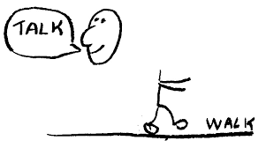

Setting the Example:
Walking the Talk of What We Value
Champions in Review
Setting the Example:
Walking the Talk of what we value
Notes:
Facilitator Notes:
3 minutes
Refresh everyone’s memory of the topics covered over the past five weeks.
Facilitator Talking Points:
Six weeks ago at the first session everyone completed the program’s pre survey. Well now, its just about post survey time.
Explain that before distributing the post survey you want to provide a quick overview of what was covered over the last 5 weeks.
Session 2 was titled Setting the Example, Walking the Talk of What We Value
We discussed the personal value we find in education, the various ways value can be shown, and we looked at what we could add to what we already do. Several resources were distributed to take home – a fact sheet about education and employment, another about education and salary, and a handout with tips and questions for speaking with school staff.

Slide 5
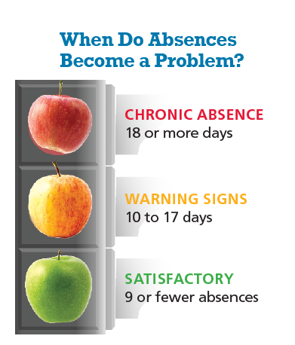
Champions in Review
What’s so important about the number 9?
Chronic absence is missing 18 days of school over the course of a year, or just 2-3 days each month
When Do Absences Become a Problem?
Chronic Absence
18 or more days
Warning Signs
10 to 17 days
Satisfactory
9 or fewer absences
Notes:
Facilitator Talking Points:
Module 3 was titled What’s So Important about the Number 9?
In that session we learned about the severe impact of a high number of yearly absences on academic achievement, behavior, and even high school graduation.
We learned that chronic absenteeism doesn’t care if the absence is excused. That it’s the number of absences that matter, not the reason for the absence, and that the reach of chronic absenteeism extends beyond the individual student if the number of students chronically absent is large.
We learned that 9 or less absences per school year is the goal and that a plan will help us to achieve that for our children.

Slide 6


Champions in Review
Student Assessments :
Everyone Has a Stake
Notes:
Facilitator Talking Points:
Module 4 – School Assessments: Everyone Has a Stake
We tackled the state assessments, the excitement they bring, and the ways we can help our children get prepared and reduce anxiety so that they can do the best they can.

Slide 7
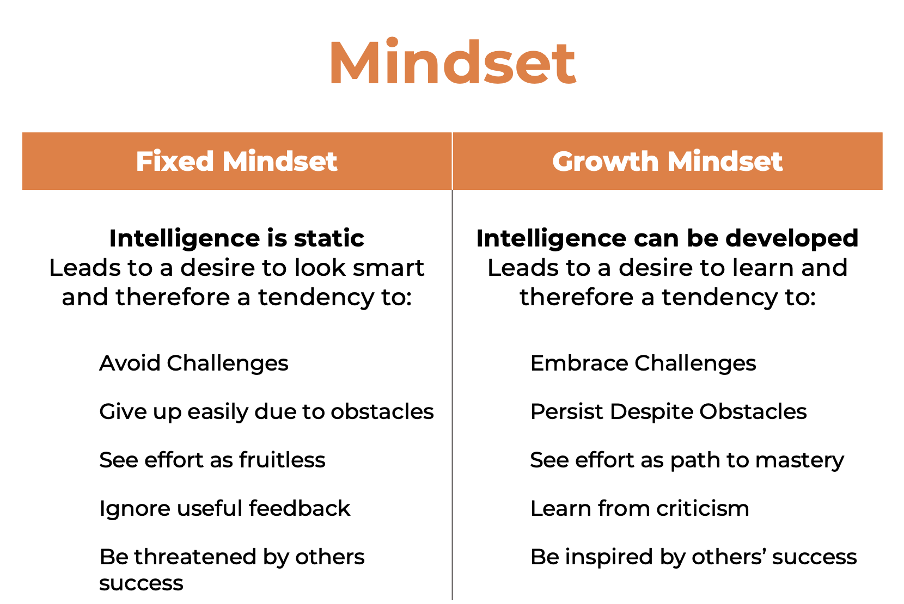

Champions in Review
Growth Mindset: The Power of Yet
Notes:
Facilitator Talking Points:
Finally, last week Module 5 – Growth Mindset: The Power of Yet!
We learned about Fixed and Growth Mindset and that “the best they can” is not “the” best. That best is until the next best and the next best because intelligence can move and achievement moves with it.
We learned that a fixed mindset tells our child they don’t know how to do something, and that a growth mindset tells our child “they don’t know how to do something…… yet”.
And we learned to change how we praise. To focus on the effort our children put in, the hard work, and to see mistakes as not evidence of not knowing but rather a learning opportunity necessary for moving intelligence.

Slide 8

Survey Time
Notes:
Facilitator Notes:
15 minutes
Distribute post survey. Provide as much time as needed.
Facilitator Talking Points
Remind everyone that the information from the pre and post survey will be used to evaluate the program and make the program stronger. Encourage everyone to be sure to give their forthright responses to all questions.

Slide 9


Champions in Review
Why Champions of our children?
Notes:
Facilitators Notes:
Brief 5 minute or less discussion about why “Champions”
Skip this slide if 15 minutes or less remain
Facilitator Talking Points:
Ask participants, “Why do you think the curriculum was titled Champions for Our Children? Specifically, the use of the word “champions”.
When we think of a champion we think of a person or a team that is successful, at the top that has reached a goal.
While a Champion is usually alone at the podium, they did not achieve success without help. Who else is usually there, even if they are off to the side?
(CLICK) Behind every Champion is usually someone or even a team of persons serving as a champion of them. Persons pushing, believing, coaching and cheering them along.
So the title refers to the work of parents/caregivers as champions of their children- advocating, protecting, promoting and supporting them.
However, to do that well we know we must also be champions for our schools and each other because our schools can’t do it alone and neither can we.

Slide 10
Now What
What information was most important? Why?
What was the most surprising thing learned?
Is there anything else you’d like to know about the topics covered?
Are there other topics you want to learn about?
Are there next steps you’d like to take individually or as a group to share information with other parents or support our school?
Notes:
Facilitator Notes:
Use the remaining time to lead participants in a discussion about their experience with the program
Use this time to also thank participants for their participation
Collect the information and ideas shared on poster board
Distribute Prichard Committee handout
Facilitator Talking Points:
What information was most important? Why?
What was the most surprising thing learned?
Is there anything else you’d like to know about the topics covered ?
Are there other topics you want to learn about?
Are there next steps you’d like to take individually or as a group to share information with other parents or support our school?
Distribute Prichard Committee handout and review the two offerings listed.
State to the group that you will share the “now what” information collected and thank participants for their active and thoughtful participation.

