Slide 1


Slide 2


Growth Mindset:
The Power of Yet!
Module 5
Champions For Our Children
Notes:
Facilitator Talking Points:
Welcome participants to the fifth meeting of Champions for Our Children
This module is titled Growth Mindset: The Power of Yet!
But before moving forward, let’s take a look back as usual.

Slide 3

A Look Back
What did you learn?
Did anything surprise you?
Did your child add anything to the list of test-taking strategies that they’d also like you to do?
font
Notes:
Facilitator Notes:
5 to 8 minutes
Facilitator Talking Points:
Participants were asked to speak to their child about testing and get their feedback about test-taking strategies their parents/caregivers could employ to help them with preparedness. Ask for a few volunteers to share what they did and what they learned.
The slide provides some questions to guide them in sharing.

Slide 4

What would you do if you could not fail?
Notes:
Facilitator Notes:
This slide and the next two introduce this week’s topic
With this slide, the stage is set for thinking about the impact of mindset on effort
Spend no more than 5-6 minutes introducing the topic (2 minutes on this slide; no more than 2 minutes each on the two that follow)
Facilitator Talking Points:
Note that this quote is on their table and hung around the room.
Read the quote out loud or ask someone else to.
Ask for thoughts on the quote. What was Robert Frost saying to anyone reading it? Allow for responses. If not mentioned, remark that two takeaways include:
Failure or the fear of failure may hold us back and stop us from even trying.
If our mind was not filled by thoughts of not succeeding we would keep trying, keep attempting because we would not be concerned with the end point.
Ask, Do our children sometimes decide not to do something because “it’s hard” or quit because it’s a struggle? Allow for responses. (CLICK)

Slide 5

Great News!
Great News!
What would our children say if we told them that making stumbles, mistakes, and facing obstacles is great news?
What would our children say if we told them every time you work hard, stretch yourself and learn something new, your brain forms new connections, and over time you actually become smarter?
Notes:
Facilitator Talking Points:
Our kids spend a lot of time avoiding “looking dumb”. What would our children say if we told them that making stumbles, mistakes, and facing obstacles is great news?
Explain that it’s fitting that this topic on Mindset comes after a look at assessments. It’s easy to get bogged down in looking at assessments as though they tell us everything, possibly even predict the future about achievement, but they don’t. Test are important because they provide insight into what our children know and can do. But its important that we know assessments focus on the now, the present moment! (CLICK)
Read the second question or ask someone to do so.
Point out that assessments do not do tell the story of potential, the story of yet, and yet is powerful!
Explain that over the last several years there’s been a lot of research and understandings about how mindset impacts achievement. (CLICK)

Slide 6

What is mindset?
It’s our frame of mind. It’s our collection of thoughts and beliefs that shape our thought habits which in turn affect how we think, what we feel, and what we do.
Mindset is a
Big Deal!
Notes:
Facilitator Notes:
- Growth Mindset is the work of Carol Dweck, a professor of psychology at Stanford University.
Facilitator Talking Points
And mindset is a big deal!
Read the provided definition and ask the group if it makes sense that our mental attitude plays a huge role in how we see and respond to situations.
Ask the group if they’ve heard the phrases Growth Mindset or Fixed Mindset before? If yes, what do they know about it?
Explain that the understanding of Fixed and Growth Mindset has been eye opening for students and schools and parents.
Explain that you’re going to play a video titled The Power of Belief. Explain that you’ll stop it at a few points so the group can discuss what the speaker is teaching about growth and fixed mindset.

Slide 7
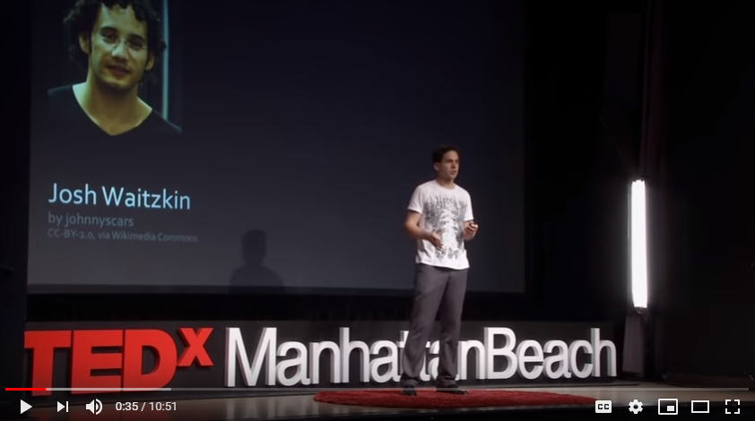
Watch
Notes:
Facilitator Notes:
15 to 20 minutes for video and discussion (https://youtu.be/pN34FNbOKXc)
The video, The Power of Belief is part of a TedTalk. It is 10:51 in length, but only 7:55 of it will be used here.
The viewing guide is to be used in conjunction with the video to engage parents/caregivers in discussion about what they are learning and also encourage them to listen carefully. The viewing guide has 4 designated start/stop points.

Slide 8
Mindset
Fixed Mindset | Growth Mindset
Intelligence is static Leads to a desire to look smart and therefore a tendency to: | Intelligence can be developed Leads to a desire to learn and therefore a tendency to:
Avoid Challenges | Embrace Challenges
Give up easily due to obstacles | Persist Despite Obstacles
See effort as fruitless | See effort as path to mastery
Ignore useful feedback | Learn from criticism
Be threatened by others success | Be inspired by others’ success
Notes:
Facilitator Notes:
This slide provides a visual reference of the key points made in the video.
Use this slide only if there is extra time (more than 15 minutes remaining) as the next slide shows Fixed & Growth Mindset in action and will also reinforce the key points.
Note: This slide can be used to explain Fixed and Growth Mindset if the video does not play. The information on the video viewing guide regarding the 7th grade study should also be used.
Facilitator Talking Points:
Fixed Mindset:
No matter how much you learn or how hard you work your intelligence stays the same
Learning should come naturally.
Growth Mindset:
Intelligence is a quality that can be changed and developed. The brain is like a muscle that gets stronger and works better the more it is exercised.
Effort is a part of learning

Slide 9
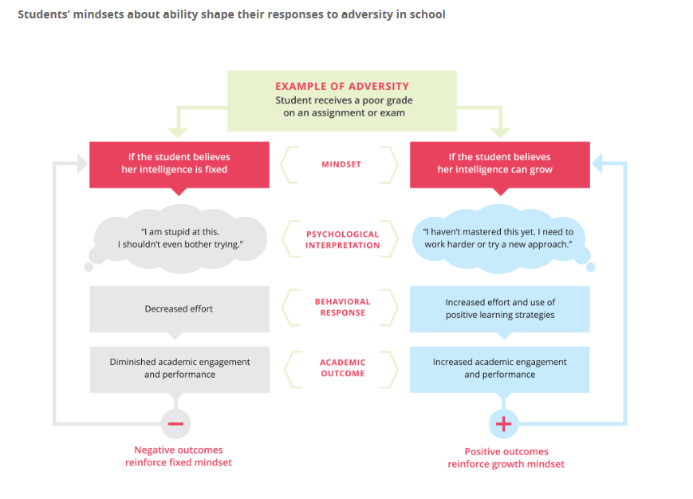
Adversity
Notes:
Facilitator Notes:
- Involve participants in going through the chart on this slide.
Facilitator Talking Points:
Its important to note and remember that growth and fixed mindset is not about kids that do well academically vs. those that struggle. It is about mental attitude and views toward learning and how that view impacts any student when they face adversity, make mistakes, or do not immediately “get it”. Both mindsets affect outcomes. The research shows one impacts outcomes negatively, the other positively.
Explain that this slide shows what fixed vs growth mindset looks like in practice for a student with a bad grade on an assignment or exam.
Ask for volunteers to read the likely self talk of a child with a fixed mindset, then ask for volunteers to read the likely self talk of a child with a growth mindset.
Note that beliefs about intelligence have important consequences for how kids experience school and how they respond to setbacks and adversity.

Slide 10
Growth or Fixed Mindset?
Growth or
Fixed Mindset
You want to encourage your child to keep putting in effort in their schoolwork. Which one of these is a growth mindset statement:
A.) Wow, you make it look easy.
B.) Your practice is really paying off.
Notes:
Facilitator Notes
10 minutes or the remaining amount of the session
This slide and the next three set up this module’s homework. A short 3 minute video is included.
The answer to this first example is B.
Facilitator Talking Points
There is much we as parents/caregivers can do to support a growth mindset at home and encourage learning.
Let’s look at two examples.
Which one is a growth mindset statement? Why? (The growth mindset statement praises effort and hard work)

Slide 11
Growth or
Fixed Mindset
You want to encourage your child to step outside their comfort zone and look at different ways of doing something. Which one of these is a growth mindset statement:
I like how you kept trying new ways to get there. Good job!
Would you make up your mind and get this done.
You keep making mistakes.
I really like how you learned from your mistakes.
A and D
Notes:
Facilitator Talking Points
Which one is a growth mindset statement? Why?
The answer is E. (A and D provide encouragement of the process of learning, of trying, of not getting it right, persisting, and learning from the last thing done).

Slide 12
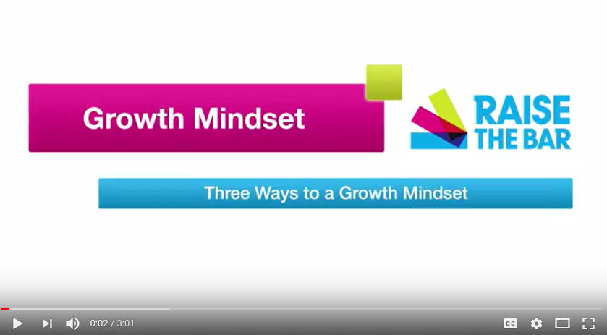
Video
Watch
Notes:
Facilitator Notes:
3 minute video https://youtu.be/d4uKCZTmyy4
Video by Raise the Bar Parents
After the video distribute the typed up notes - Three Ways to a Growth Mindset
Please note the typed up notes can also be used in place of the video in the event of technical issues.
Facilitator Talking Points
Let’s look at a quick 3 minute video that provides 3 things we as parents can do to promote a growth mindset in our kids.

Slide 13

Fixed vs. Growth Mindset quiz
Ten Growth Mindset statements
Practice Growth Mindset statements as a family
Report back next week!
What Next?
Notes:
Facilitator Notes
After asking participants if they know what kind of mindset their child has, distribute quiz and other supporting documents as homework
Facilitator Talking Points
What are your thoughts on the information shared in this session?
Point out that as the video stated, developing a growth mindset takes practice too. So we and our kids are not going to get it right every time. We’re changing long term habits and that’s not easy.
Remind everyone of the opening quote from Robert Frost. Explain that one of the reasons the room was littered with the positive opening message is because we’re often surrounded by messages that say the opposite. Imagine what our children could do if the process of learning was their focus and they believed in the power of yet.
Ask participants, “Do you know what kind of mindset your child has?”
Explain that you have a short take home quiz they can do with their child at home along with some tips for their child on how they can reshape their thinking.
Explain that you’d like each parent to have their child take the quiz, explain what they’ve learned about growth and fixed mindset and as a family practice growth mindset statements.

