Slide 1


Slide 2


The Assessments & Strategies to Support Preparedness
Module 4
Champions For Our Children
The Assessments & Strategies to Support Preparedness
Module 4
Notes:
Facilitator Notes:
Prior to beginning the session, hang poster board around the room for Gallery Walk activity. Label each with the appropriate header.
Will need timer for activity
Facilitator Talking Points:
Welcome participants to the fourth meeting of Champions for Our Children
This module is titled The Assessments & Strategies to Support Preparedness

Slide 3

A Look Back
What action did you do and/or conversation did you have as a result of what you learned about chronic absenteeism?
If you spoke to your child what did he or she reveal?
How did others respond to what you shared if applicable?
Is there a “what next”? Has this prompted a next action or conversation to have or something else you want to do?
Anything else?
Notes:
Facilitator Notes:
5 to 10 minutes
Facilitator Talking Points:
Explain that before moving forward with activities for this meeting’s topic you want to take a few minutes to look back.
Last week ended with a call to action. Ask for volunteers to share what they did and what they learned.
The slide provides some questions to guide them in sharing.

Slide 4

The Assessments
BRIGANCE
Kindergarten entry screener
Screening window: 15 days before the 1st instructional day to the 30th instructional day of school
Kindergarten readiness is reported as: Ready with Interventions, Ready, and Ready with Enrichments
K-PREP (Kentucky Performance Rating for Educational Progress)
Multi-year assessment measuring proficiency in 5 subjects - reading, mathematics, science, social studies and writing.
Testing window: Last 14 instructional days of the school’s calendar
Proficiency is scored as: Novice, Apprentice, Proficient or Distinguished
Notes:
Facilitator Notes:
Spend no more than 5 minutes on this chart and the next two (2 minutes, 2 minutes, 1 minute).
The purpose is just to provide a quick, broad overview of the assessments; the fact sheets provide more detailed information for each assessment.
The final slide for this 3-slide section provides the grade levels tested.
Distribute the Fact Sheets.
Facilitator Talking Points:
As you distribute the Fact Sheets explain that you’ll spend only a few minutes going over the tests because the fact sheets have a lot of details. Also that there are additional assessments schools may use throughout the year to see how students are progressing, but for this session the focus is the state assessments.
There are 4 primary state assessments – BRIGANCE, K-PREP, the ACT and EOC exams
Quickly review the information on the slide for each test:
Brigance – Is a kindergarten screener that helps schools see readiness for school. Testing starts 15 days before school begins to 30 days after.
K-PREP – Is multi-year and tests student knowledge in reading, math, science, social studies and writing. Students take K-PREP tests at the end of the school year and knowledge is measured as either Novice (minimal understanding), Apprentice (basic knowledge), Proficient (has broad knowledge and can apply it), or Distinguished (has extensive knowledge of subject). There is also the Alternative K-PREP for students with moderate and significant disabilities.

Slide 5

The Assessments
ACT
Measures students’ level of readiness for college level work - English, math, reading, and science
Testing window: March
Readiness is measured by student performance in relation to designated benchmark scores in each of the tested areas.
EOC (End of Course)
Specific to students on Early Graduation pathway
Upon completion of credit for Algebra II, Biology, English II and U.S. History
Proficiency is scored as: Novice, Apprentice, Proficient or Distinguished
ACT
Measures students’ level of readiness for college level work - English, math, reading, and science
Testing window: March
Readiness is measured by student performance in relation to designated benchmark scores in each of the tested areas.
EOC (End of Course)
Specific to students on Early Graduation pathway
Upon completion of credit for Algebra II, Biology, English II and U.S. History
Proficiency is scored as: Novice, Apprentice, Proficient or Distinguished
Notes:
Facilitator Talking Points:
ACT – is a national college admissions exam also used by KY schools to determine readiness for college work. There are benchmark scores for each area tested - English, math, reading, and science. The scores a student gets are compared to the benchmark scores to see where they stand readiness wise. The ACT is taken in March.
EOC – Is just for students on the Early Graduation Pathway in grades 9-11. Each exam is taken after the classes listed are taken. The measurement is the same as K-PREP.

Slide 6
Administration By Grade Level
Test | K | 3rd | 4th | 5th | 6th | 7th | 8th | 9th | 10th | 11th
Brigance | X
K-Prep
Reading |  | X | X | X | X | X | X
Math |  | X | X | X | X | X | X
Science |  |  | X |  |  | X |  |  |  | X
Social Studies |  |  |  | X |  |  | X
On Demand Writing |  |  |  | X |  |  | X |  |  | X
ACT |  |  |  |  |  |  |  |  | X | X
EOC (Early Graduation Pathway) |  |  |  |  |  |  |  | X | X | X
Notes:
Facilitator Notes:
The chart provides a quick overview of the varied required state assessments by grade level
Facilitator Talking Points:
This chart shows at what grades students take the tests.
K-PREP - some subjects are tested more than others. For example, math is tested 3rd grade – 8th grades; social studies 5th and 8th only. The Alternative K-PREP follows this schedule and also has an additional reading assessment in 9th grade and math assessment in 10th grade.
ACT - taken by all 11th grade students. The asterisks is because Senate Bill 1 mandates that students in grades 10 also take a college admissions examination, however grade 10 participation is dependent on the Kentucky Department of Education having available funds.
EOC exams - Students may not necessarily take an EOC in each year listed, it depends on when they take the course.

Slide 7
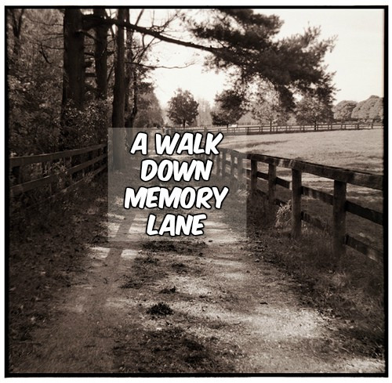


How did you feel about tests when you were in school?
Tests
Notes:
Facilitator Notes:
Spend about 5 minutes on the next 3 slides (1 minute, 3 minutes, 1 minute) - a quick trip down memory lane, and an intro to the need for test-testing strategies
Hand out sheets of paper & pens/pencils in preparation for the next slide (the test) and also get your timer ready.
Facilitator Talking Points:
Invite the group to take a trip down memory lane with you. Ask the group to think back to when they were in school. How did they feel about assessments or tests? What word or words describe how they felt? (You’ll get a variety of responses – nervous, scared, excited, angry, etc.)
How about your child? How does your child respond to testing?
Not surprisingly, most kids are typically around here (CLICK) when it come to tests, and while we may not get them here (CLICK) we want to help our children be prepared to do their best.
Ask them to begin thinking about what they did to help with whatever feelings or thoughts they had back then and what they do now to help their child get prepared. Explain that they are going to pair up shortly and go on a walk.

Slide 8
Can You Follow Directions? Get Out a Sheet of Paper and Take This Test.
Take this Test
This is a timed test you only have 3 minutes!
1. Read everything carefully before doing anything.
2. Put your name in the upper right-hand corner of the paper.
3. Loudly call out your first name.
4. Circle your name.
5. If you have followed directions carefully to this point, call out "I have.”
6. Draw five small squares in the upper left-hand corner.
7. Put an "X" in each square.
8. In your normal speaking voice, count from ten to one backwards.
9. Now that you have finished reading everything carefully, do only sentences one and two.
Notes:
Facilitator Notes:
A few participants may catch on before they get to #9, motion for them to remain quiet.
Facilitator Talking Points:
Explain that you really want participants to understand what students feel, so you’d like everyone to take a test. Tell everyone they will only have 3 minutes!
Set your timer, CLICK to reveal the test and say begin.
Pause
After the test, acknowledge that while this was a “trick” in this setting, not reading the directions fully is something that happens all the time to students and with greater consequences.

Slide 9
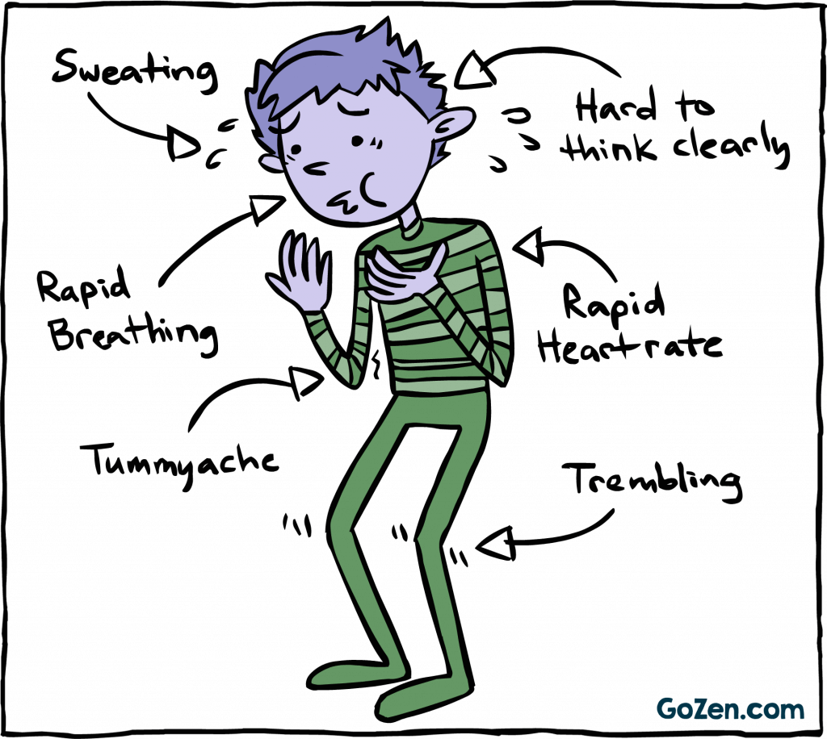
Test Anxiety
Test Anxiety
Test Anxiety
Some anxiety is good!
Until it negatively affects performance!
Preparedness strategies help!
What strategies do you have to support preparedness?
Notes:
Facilitator Talking Points:
Testing can be stressful. They are timed; they have great weight and sometimes weigh our kids down. Tests may determine the classes a student can take, whether they have to be in an intervention class they don’t want to be in, or even get into the college they want.
Tests are a big deal and kids having anxiety about them is not uncommon. (CLICK)
While a small amount of anxiety is a good thing. Adrenaline keeps them alert, up, and at the ready, but when what they’re feeling rather than the test becomes their focus it can hurt their performance.
There are things that can be done leading up to the test, the night before the test, and the day of testing, that can go a long way to helping feel prepared which helps reduce “bad anxiety”. Let’s create a checklist for ourselves of what can help our children feel prepared.

Slide 10
Gallery Walk
Instructions:
Write all current things done & any new ideas
2 minutes per board
Write each item as a bullet item
When time is called rotate to the right
At new board add to the list. If something you do is already listed and its something they already do, add 1 checkmark for one person or 2 checkmarks for 2 persons.
When time is called for the final time, return to the board you started at.
Notes:
Facilitator Notes:
Parents/caregivers will participate in a gallery walk.
Pair in teams of two.
About 20 minutes will be needed – about 2 minutes to explain the activity, 2 minutes per rotation, and 2-3 minutes for each team to report out, and time for participants to add to their respective lists.
Facilitator Talking Points:
Explain that around the room is poster board with the headings “Leading Up to the Test”, “The Night Before the Test”, “Day of the Test”.
In pairs each team will go to the poster board and write down all the things currently done to help their child prepare and any new ideas the pair brainstorms. They’ll have 2 minutes per board. Write each item as a bullet point rather than a sentence to save time. When its time to rotate they’ll move to the poster board to the right and add to the existing list. If an item they would have added is already listed and its something one person already does, add 1 checkmark next to, if both members of the pair already do it, place 2 checkmarks. Every pair will visit all three boards. When time is called for the final time, return to initial board.
Divide into pairs
Give each team a different colored magic marker
Assign first board

Slide 11

Read the suggested items on your list.
Ask for more information about any item that is not clear.
Note those items most persons are already doing.
Is there anything else to add?
Report out
Notes:
Facilitator Notes:
After the last team has reported out distribute the Test-Taking Strategies & Tips handout.
Participant ideas may add new items to the list.
Facilitator Talking Points:
Ask the teams to report out the information on the board.
Review the report out directions. Allay concerns and provide support as needed.
The final question is for all participants as new ideas may be generated from hearing the list. Have the team add any new suggestions from other parent/caregivers to the list.
Ask everyone to return to their table/seat once a fairly comprehensive list is created.
Congratulate everyone on a job well done.
As a group compare the participant generated list to the Test-Taking Strategies & Tips handout.
Participants can add anything that might be missing to the bottom of the handout.

Slide 12

Wrap Up
Accommodations
Understanding the results
Resource reminder:
Speaking with School Staff
Homework
Wrap-up
Notes:
Facilitator Notes:
Use the remaining time to drive home a few points about accommodations, interpreting results and speaking to school staff about both when needed.
Have copies of the Can You Follow Directions handout available.
Facilitator Talking Points:
Direct parents back to the fact sheets and the final section about testing accommodations. If child has an IEP, PSP or 504 plan he or she has the right to receive testing accommodations.
Point out the information under Test Results that shows how students are assessed. Remind parents/caregivers if they do not understand the assessment results or simply have questions to speak to their child’s teacher and get the answers they need.
Remind participants of the resource given in week 2 – Speaking with school staff. There was a section of questions for academics and academic supports.
Ask parents to spend some time this week talking to their child about what it’s like for him or her when it’s testing time. Not just the day of but also in the days leading up to testing. Also ask them to share the list of strategies with their child to see what would be the most helpful and also to find out what else their child suggests they do to help them in getting prepared.
A good opener to the discussion may be having their child take the Can You Follow Directions? Test. They’ll need the handout and 1 sheet of blank paper.

