Slide 1


Slide 2


What’s So Important about the Number 9?
Module 3
Champions For Our Children
Notes:
Facilitator Talking Points:
Welcome participants to the third meeting of Champions for Our Children
This module is titled What’s so important About the Number 9?
The answer to that question is sure to be an eye opener!
This meeting’s focus is school absences and the impact on grades and achievement. There will be a lot of statistics and numbers shared if we remember no other number, let’s remember the number 9. That’ll make sense soon.

Slide 3

A Look Back
What new “value” action did you do?
What happened?
Was the outcome what you expected or did it surprise you?
Is it something you plan to continue doing? Why or why not?
Notes:
Facilitator Notes:
10 minutes maximum
Facilitator Talking Points:
Explain that before moving forward with activities for this meeting’s topic you want to take a few minutes to look back.
Last week ended with a commitment to try something new.
Ask for volunteers to share what they did, the result, and if it’s an activity they will maintain. Why or why not?
The slide provides some questions to guide them in sharing.

Slide 4

Myth or Truth?
“Only unexcused absences create attendance problems.”
Notes:
Facilitator Notes:
5 minutes maximum
Make sure each participant has one Myth and one Truth stick.
The first statement will appear On Click
Facilitator Talking Points
Explain that on their table are Myth and Truth sticks. Make sure you have one of each. Continue by stating that you’re going to make a few statements about school attendance and that you want them to indicate if they believe it is a myth or a true statement by holding up the appropriate sign.
CLICK to reveal first question

Slide 5

Myth or Truth?
“Absences in the early grades don’t affect academics.”
Notes:
Facilitator Notes:
If anyone should ask, early grades refer to kindergarten, or first grade, preschool too

Slide 6

Myth or Truth?
“Absences are only a problem if they’re consecutive.”
Notes:
Facilitator Notes:
This is the final statement
Do not provide any answers
Play the video.

Slide 7

Watch
Notes:
Facilitator Notes:
The next activity is 20 minutes in length and includes the Bringing Attendance Home video, time for participant reaction, and a reveal of research statistics
The video is 6:16 in length (https://youtu.be/YQfDyODmdMA)
Be mindful of time
Go to next slide at video end. Click on slide anywhere outside of picture to advance.

Slide 8
Chronic Absenteeism
What?
What is chronic absenteeism?
After Watching?
What do you think of the video’s statement about the consequences of chronic absence?
Chronic absence is missing 18 days of school over the course of a year, or just 2-3 days each month.
Notes:
Facilitator Notes:
- 2 minutes
What is chronic absenteeism will appear with the slide. The other items are revealed On CLICK.
The definition of Chronic absence is CLICK 1
The second question - consequences - CLICK 2
Facilitator Talking Points:
Ask if anyone had ever heard of the term chronic absenteeism before hearing it in the video. If yes, ask what they know about the term. If no, ask if anyone remembers how chronic absenteeism was defined. CLICK to reveal definition and read, note that 18 days is 10% of the school year.
Continue by explaining chronic absenteeism is not the same as truancy. Truancy usually refers to a certain number or certain frequency of unexcused absences. Explain that chronic absenteeism considers the total days of school missed, both excused and unexcused absences because what is critical is how many days are missed, not why they are missed. A student is chronically absent if 18 days of school is missed in a school year.
Then CLICK to reveal the 2nd question, and ask for thoughts about the video’s statement (the video indicated the consequences of chronic absenteeism can include not reading at grade level, difficulty passing course and possibly dropping out of high school).

Slide 9
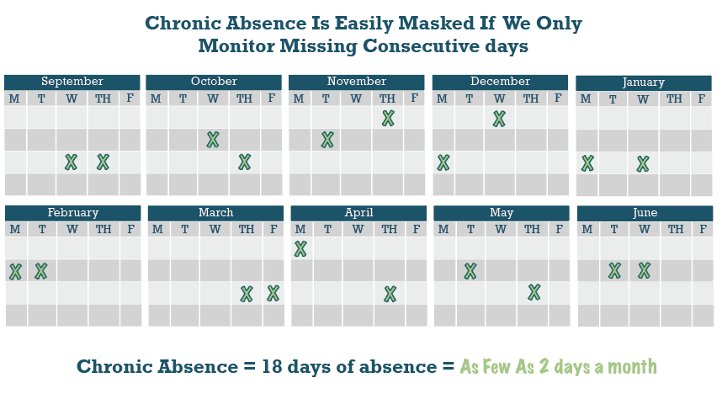
One day Here, One day There
Notes:
Facilitator Notes:
1 minute
Facilitator Talking Points:
The video noted that chronic absenteeism can be hard to see while it is happening, we may think its only one day here and one day there like this calendar shows. This looks pretty harmless, but a day here or a day there can quickly add up to 18 or more absences in a single school year.
Here’s what the research shows about chronic absence and what is does to student success. The data comes from an Attendance Works, a national organization focused on bringing awareness to the importance of attendance.

Slide 10
Students Chronically Absent in Kindergarten and 1st Grade are Much Less Likely to Read Proficiently in 3rd Grade
Reading Proficiency
Percent Students Scoring Proficient or Advanced on 3rd Grade ELA Based on Attendance in Kindergarten and in 1st Grade
Students Chronically Absent in Kindergarten and 1st Grade are Much Less Likely to Read Proficiently in 3rd Grade
No risk | Missed less than 5% of school in K & 1st
Small risk | Missed 5-9% of days in both K & 1st
Moderate risk | Missed 5-9% of days in 1 year &10 % in 1 year
High risk | Missed 10% or more in K & 1st
Source: Applied Survey Research & Attendance Works (April 2011)
Notes:
Facilitator Notes
2 minutes
The source of the charts is Attendance Works
Facilitator Talking Points:
The bottom table shows the no risk to high risk number of absences. High risk is 10% or more/18 days or more, low risk is less than 5% missed days of school or 9 days or less.
Students chronically absent in kindergarten and 1st grade are much less likely to read proficiently (at grade level) in 3rd grade. The bar on the far right shows how students that missed 10% or more school days (18 or more days) scored on English Language Arts exams when compared to students that missed less than 5% of school or 9 days or fewer.
64% of students who missed 5% or less of school in both K and 1 read proficiently at the end of 3rd grade, while only 17% of students that were chronically absent in both kindergarten and 1st grade did. 64% compared to 17%.
One indication of why the number 9 is so important.

Slide 11
Middle School Outcomes
Students Multiple Years of Elementary Chronic Absence = Worse Middle School Outcomes
Chronic absence in 1st grade is also associated with:
Lower 6th grade test scores
Higher levels of suspension
Each year of chronic absence in elementary school is associated with a substantially higher probability of chronic absence in 6th grade
18.0x
Increase in probability of 6th grade chronic absence
7.8x
5.9x
Years of Chronic Absence in Grades 1-5
Oakland Unified School District SY 2006-2012, Analysis By Attendance Works
Notes:
Facilitator Notes:
2 minutes
Facilitator Talking Points:
Explain that the research reveals a snowball effect.
Chronic absence affects elementary school preparedness and performance, then since the foundation is not there the groundwork is laid for poor attendance to continue in middle school. A student with 3 years of chronic absence in elementary school is 18x more likely to be chronically absent in 6th grade.
Not surprisingly test scores are affected, but the research shows there’s an effect on behavior with higher suspensions.
Ask why that would be the case? (One of the reasons may be that the student is frustrated because he or she cannot keep up and therefore acts out).

Slide 12
Middle School Outcomes
The Effects of Chronic Absence on Dropout Rates Are Cumulative
Proportion of Student Dropping Out by Number of Years the Student was Chronically Absent from the 8th-12th Grades.
With every year of chronic absenteeism, a higher percentage of students dropped out of school.
http://www.utahdataalliance.org/downloads/ChronicAbsenteeismResearchBrief.pdf
Notes:
Facilitator Notes:
7 minutes (2 minutes on research, the remaining 5 minutes for participant reactions
Facilitator Talking Points:
This last slide looks at the impact of chronic absenteeism on high school graduation. The numbers on the bottom, 0-4, are the number of years of chronic absences from 8th grade – 12th grade, the percentages on the top are the percentage of students dropping out based on the number of years of chronic absences.
Imagine there were 100 students that had dropped out of school standing in front of us. 10% or 10 of those students would have zero years of chronic absences from 8th – 12th grade; while 61 of those students would have had 18 or more days of absence for four of those five years. Every year of chronic absence increases the likelihood of chronic absence and the odds of a student dropping out.
There’s even research that shows that this pattern of absenteeism affects the odds of students returning to college for their 2nd year. There’s about a 40% difference between those that had high number of absences in school and those that did not.
Ask, did any of this surprise you?
So that was a lot of bad news, the good news is that when students reduce absences, they can make academic gains, their academics can get better, but we can imagine it’s a struggle.

Slide 13

Chronic absenteeism data can be found on Open House in School Report Cards, https://openhouse.education.ky.gov/SRC.
Go to School Report Card - Research Data - Overview - Attendance. There you will find attendance rate and chronic absenteeism data.
The Excel worksheet provides all Kentucky schools, the relevant school simply needs to be filtered and also "All Students".
Our District

Slide 14
Our District
Do We Have an Absenteeism Problem?
SCHOOL NAME | %DAILY ATTENDANCE RATE
Botts Elementary | 94.0
Menifee High School | 93.1
Menifee Elementary | 94.3
---District Total--- | 93.9
Notes:
Facilitator Notes:
5 minutes for next 2 slides
Table is revealed On CLICK
Data is public data from the School Report Card and is available annually after the conclusion of each school year.
National average attendance rate is 95%
Facilitator Talking Points:
Let’s take 5 minutes to look at our numbers
Explain that until recently, the district was like a lot of districts around the state and country and only kept track of how many students showed up every day, (the average daily attendance rate), and how many students were skipping school without an excuse (truancy).
(CLICK_ Here’s the attendance rate in 2017-18 for our district and the individual schools. As a district, 94.3% of our students showed up every day. Not to bad. The national rate is 95%.
95% - 100% is good attendance because its less than 10 days of absence in a year
But schools have learned that average daily attendance can hide high levels of chronic absence because what it shows is how many students are in school on any given day and doesn’t take into account how many individual students are missing so many days in excused and unexcused absences.

Slide 15
Our District
Do We Have an Absenteeism Problem?
SCHOOL NAME | % CHRONICALLY ABSENT
Botts Elementary | 22.3
Menifee High School | 26.9
Menifee Elementary School | 19.5
---District Total--- | 21.6
SCHOOL NAME | % CHRONICALLY ABSENT
Botts Elementary | 94.0
Menifee High School | 26.9
Menifee Elementary | 19.5
---District Total--- | 21.6
Notes:
Facilitator Notes:
The table is revealed On CLICK
Facilitator Talking Points:
Now we’ll look at chronic absenteeism data for the 2017-18 school year and see what that tells us.
(CLICK for table) Ask, What does this table tell us? Is there a chronic absenteeism problem? Allow for participant response.
As a district almost 20% of all students or 1 in 5 had more than 18 days absent last year. In some schools it was far higher.
In how many school’s was it higher? What elementary school had the highest rate? (Duff-Allen) What 3 schools had the highest rates? (Renaissance, Prestonsburg HS, Central Floyd HS) missed 18 or more days of school.
There is something else to consider. When there is high chronic attendance in a school all students may suffer. Why could that happen?
The class is missing so many students that it impacts the flow of teaching
Slows down the teacher from moving on when time has to be devoted to catching students up
A teacher may wait to introduce new material until more students are present, leaving all students to fall behind.

Slide 16
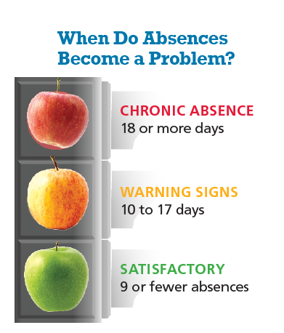
A Call to Action
A Call to Action
When Do Absences Become a Problem?
Chronic Absence
18 or more days
Warning Signs
10 to 17 days
Satisfactory
9 or fewer absences
Have a conversation with your child about attendance barriers and school engagement.
Establish a Student Success Plan with your child.
Tell another parent/caregiver about what you learned.
Speak to a teacher or other school staff about what’s being done to promote good attendance.
Ask for help if help is needed!
Have a conversation with your child about attendance barriers and school engagement.
Establish a Student Success Plan with your child.
Tell another parent/caregiver about what you learned.
Speak to a teacher or other school staff about what’s being done to promote good attendance.
Ask for help if help is needed!
Notes:
Facilitator Notes
5 minutes
Facilitator Talking Points:
As Champions for our children we already know we have a powerful impact on our child’s attendance and success in school. The data also shows that even if our child has perfect attendance, the effects of chronic attendance may still be impacting their learning.
What are some things we as parents/caregivers can do? Pause for responses and encourage the action steps/plans that are provided.
Distribute the 2 resources to support goal setting:
Pay Attention to Attendance offers suggestions under What You Can Do: having a conversation with child about attendance barriers, their thoughts about their classes (are they engaged with them and with learning), whether they feel safe at school, and making sure they are involved with school activities and extracurricular activities.
The Student Attendance Success Plan is an activity to do with your child to show them that attendance is a priority. The plan provides strategies to reach attendance goals like figuring out a help bank and actions that our children and we can commit to doing to support good attendance. Complete the top first – finding out the number of days present, the number of days absent and establishing an attendance goal for the remainder of the year. It may be a good idea to think about the 2019/20 school year too.
Ask that everyone commit to doing at least 1 action and reporting back next week.
Lastly, state that knowledge is power and many parents believe the myths about attendance to be true, lets all also commit to sharing what we just learned with another parent.
Wrap up by thanking everyone for attending.

