Slide 1


Slide 2


Setting the Example
Walking the Talk of What We Value
Module 2
Champions For Our Children
Notes:
Welcome participants to the second meeting of Champions for Our Children
This module is titled Setting the Example: Walking the Talk of What We Value

Slide 3

A Look Back
What is the value of education?
Notes:
Facilitator Notes:
10 minutes maximum
Typical responses to the value of education question include it’s the path to a good job, it’s a way out, it’s the way to not have to work so hard, to make money, to learn.
Facilitator Talking Points:
Explain that before moving forward with activities for this meeting’s topic you want to take a few minutes to look back.
Remind everyone of the last session’s final question – What is the value of education?
Ask for participants to share their response.
Thank everyone for their responses and state that this question along with the two on the next slide are the foundation of this week’s session.

Slide 4

Tell me, But Also Show Me
Does your child know the value you place on education?
How do you demonstrate that value to your child?
Notes:
Facilitator Notes:
- Take no more than 2 minutes to set the stage by providing an overview of the session.
- Introduce 20 minute Reading activity - Give 10 minutes for reading/group discussion and 10 minutes for reporting out.
Facilitator Talking Points:
State that in this session we’re going to take a look at the value of education, what it means to us personally and how we demonstrate that value and encourage our children to do the same. These two questions (read them, can paraphrase) provide the framework of the conversation.
Ask the first question of the group by a show of hands.
Continue by telling the group that you found two interesting articles that you’d like to share with them. Group 1 will read one article; group 2 the other. (Divide with 3 per group if possible)
State that the next slide provides discussion items for the group once everyone has read their article. Explain that after the brief group discussion each group will share the main points/takeaways of their article with the entire group. No worries, you’ll be here to guide and support them.

Slide 5

Small Group Talk
What?
Was the writer saying to the readers? What are the main points?
So what?
Is there anything that you connected with? What and why?
Notes:
Facilitator Notes:
Ideally, 20 minutes will be enough time for this activity, however timing may be tight depending on reading speed.
Provide 10 minutes to read and briefly discuss the assigned articles in small groups before giving each group 3-5 minutes to report out.
If timing becomes an issue what is most important is that each parent/caregiver reads their respective article.
If the reading runs the full 10 minutes, use the remaining 10 minutes for a large group discussion.
Spend 5 minutes per article - ask the small group questions (what and so what).
Each article slide lists the main points. (On click)

Slide 6
Article One
Article title
Group takeaways & connections
Introductions:
“How do my Parents Value Education”
There’s more than one way to value education
Talk continuously about the value we place on education to our children
To stay determined
School is a valuable place
An “educated” parent is not defined by a degree, but how they demonstrate the value of education to their child
Notes:
Facilitator Notes:
5 minutes
Have Group 1 report out to the larger group. Have them use the format provided – state title and group takeaways & connections
Allow the group to report out as they wish, while encouraging quieter members to share too. You want to encourage each parent/caregiver to use their voice. There are no wrong answers or reactions. If the group designates a spokesperson, but the other members of the group give a head nod or other indication of agreement ask if they also agree with what is being said or ask if there is anything they’d like to add once the spokesperson is done. Or they may decide to split up the duties which would be ideal. Encourage this, but don’t force it.
The article’s main points are a CLICK away, use these (and/or add your own) as needed, being sure to tie it back to what participants have shared:
There is more than one way to value education (value is personal, note that was demonstrated earlier as we shared the value placed on education)
To share our values continuously (through conversations and sharing of life experience; its not a one time conversation)
Family & friends may not feel as strongly as we do, but to stay determined
The experience of school is valuable all by itself – a place to gain wisdom, knowledge, understanding, social skills (there are children that never get to experience school that desperately want to)
An “educated” parent is not defined by a degree, but how they demonstrate the value of education to their child (the only requirement to pass on the value of education is to value education)

Slide 7
Article Two
Article title
Group takeaways & connections
“Parents Need to Demonstrate How Much They Value Education”:
Wanting is not the same as doing
There’s more than one way to demonstrate value
There is a responsibility to reinforce learning
Even if we don’t understand the subject there are other things we can do to support learning
Reach out to and use our teachers and schools as resources
Notes:
Facilitator Notes:
5 minutes
Have Group 2 report out to the larger group.
See additional directions on previous slide.
The article’s main points are a CLICK away, use these (and/or add your own) as needed, being sure to tie it back to what participants have shared:
Wanting is not the same as doing
There is more than one way to demonstrate value
There is a responsibility to reinforce what is happening in the classroom
Even is we don’t understand the subject (have the math skill or science knowledge) there are other avenues to support learning (the writer used the example of a guitar, he can’t play one, but he can encourage his children to practice, listen to them play, and support their interest)
Reach out to and use teachers and schools as a resource
Facilitator Talking Points:
You can note that this article was edited to make it shorter. One of the key points the author included is that he and his wife are fortunate there are two of them and that their schedules are flexible and acknowledges that is not the case for all parents and families. However, despite obstacles we can still encourage our children to succeed, and praise their efforts.

Slide 8

Resource 1 – Six Surprising Ways to Teach the Value of School
Resource 2 – Money & Employment Facts
Resource 3 – Speaking with School Staff
Resources
Notes:
Facilitator Notes:
Five minutes
The answer to “positive communications with school staff” may be positive or negative. In either case the Speaking with School Staff will be helpful. If positive note the resource will help and strengthen needed conversations. If negative the resource will serve to support parents/caregivers in making those conversations easier and getting their questions answered.
Provide a brief overview of Speaking with School Staff
Facilitator Talking Points:
(Distribute the three resources) State that what you’re handing out are three resources.
Note that one value many people place on education is higher wages and better job opportunities, and that the author of the 2nd article really encouraged communicating and viewing teachers and our schools as partners, and both articles suggested ways to help our children.
These resources will help with those three things. One offers suggestions for things we can do at home to teach the value of education, the other money and job facts about education, and the last tips for reaching out to and having conversations with teachers and the school when we have questions or need support.
Continue by stating let’s focus on the resource for speaking with school staff for a few minutes.
Ask participants if their experiences speaking with school staff has been positive or negative. (Validate those responses)
Provide an overview of the resource. Three columns - what to ask, who the appropriate staff person is, and when to ask the question. The resource has topic headings like classroom performance or academic supports. It a useful tool for reminding us who we can turn to and keeping us on task of when. For example (read 2 questions under 2 topic headings as examples).

Slide 9
“Money”
Facts About Education
What the research tells us:
College graduates, on average, earned 56% more than high school grads, about $17,500 more per year.
College graduates earn $1 million more than high school graduates over their lifetime.
Notes:
Facilitator Notes:
Money & Employment Facts to be used only if time allows.
No more than 5 minutes total
The first fact studied the salaries of individuals aged 25 – 32 and comes from the Pew Research Center, 2014.
The second fact takes into consideration a typical work life span of 25-64 years old and comes from a report by Georgetown University Center on Education and the Workforce.)
Facilitator Talking Points:
Here are some facts about education and money. (read or paraphrase) Perhaps you’ve seen them before. On average a person with a 4-yr college degree will earn $1 million more than a person without a degree over their working lifetime. For some careers like engineering it can be far more.
Continue by stating the next slide provides another way to look at this money fact that brings it down to scale and may make it more meaningful.

Slide 10

69 hours
at minimum wage earnings of $7.25 per hour
32 hours
$15.28, average wage of a high school graduate
18 hours
$28.28, average wage of a college graduate
9 hours
$54.58, average for a lawyer
6 hours
$85, average wage for a doctor
Imagine the time they’d have for all the other things they like to do!
Notes:
Facilitator Notes
- Per Bureau of Labor Statistics. $500 is divided by the average per hour wage
Facilitator Talking Points:
State that if you wanted to share this with your child you could ask them to imagine they needed to add $500 per week to their household budget. Here’s the reality of the number of work hours needed to get that $500 a week based on earnings which we know with few exceptions is directly linked to education level. Someone earning minimum wage would need to work 51 more hours or more than a full week more than a person with a college degree to earn $500.
Ask your child to imagine all the time they’d have for all the other things they like to do with the extra 5, 6, or 7 days.

Slide 11
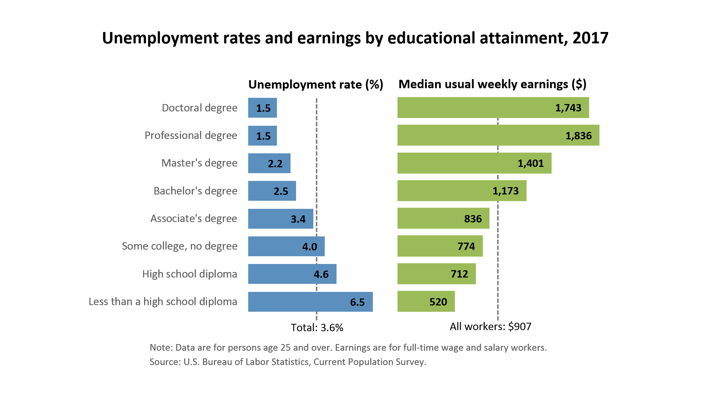
“Employment” Facts About Education
Notes:
Facilitator Talking Points:
Now let’s look at employment. It tells a similar story. The greater your education level the better the chance of finding a job.
Ask, What group has the highest unemployment? (less than high school, 6.5%)
Ask, What groups has the lowest? (those with education beyond high school, from 4% down to a little over 1%).
Ask, Did any of the facts surprise you?
Continue by saying a lot of children want to be athletes, and there’s nothing wrong with that. But some of the things we know are 1) that a professional career is rare; 2) injuries happen; 3) sports’ careers are typically short; 4) you can earn a lot of money but also lose it if you don’t know how to take care of it. If that is truly what they want, how are they showing that its their value? Education and school plays a significant role with athletic careers too!

Slide 12

Now What?
Article Three
Notes:
Facilitator Notes:
5 minutes or the remaining time
Use this slide to set up the homework
Facilitator Talking Points:
State that “Article Three” hasn’t been written yet, it’s the group’s article. When we started I asked – what value does education have for you. Now its time to consider the next step.
Imagine we were writing an article to other parents/caregivers about the importance of education and showing its value. What would we want in our article?
Distribute copy of How I Value Education

Slide 13
Now What?
Walking the Talk
What are 1 or 2 things you can add to what you already do in showing education’s value?
What 1 thing can you commit to doing before next week?
The result …..
Notes:
Facilitator Notes:
5 minutes
Give participants 3 minutes to complete questions 1 & 2
Use the remaining time for each parent/caregiver to share what they have written.
Assign homework
Facilitator Talking Points:
Remind participants of the module’s title – Setting the Example: Walking the Talk of What We Value.
Continue by saying the homework assignment will help us walk the talk as “How I Show Value” speaks to what we do not what we say.
Ask participants to complete questions 1 & 2 now, thinking back to the readings, discussions, resources or even a new idea to guide them.
Provide if needed – having a conversation with one of your child’s teachers using a question from the resource, start a new education routine for child or family, be more attentive to child’s school work, share family story about education, ask child to tell one thing he/she learned each day, or have a conversation with your child about the money or employment value of college.
Ask each participant to share what they commit to doing
Finish by asking each parent/caregiver to use the form to write down the result for sharing out at the next meeting.
Wrap up by thanking everyone for attending.

