Slide 1


Slide 2


Defining Family Engagement
Facilitator Training Day One Morning Session
Defining Family Engagement The Spectrum of Family Engagement Back to the Basics EdOptions Resource PlayBook Setting the Stage at Back-to-School Basecamp

Slide 3

Provide families with relevant information about KY public education to increase the number of families who report greater confidence in making decisions about their child’s education.
Goals

Slide 4

Objectives
Understand how Kentucky’s Statewide Family Engagement Center defines family engagement
Become familiar with the EdOptions Resource Playbook-How to use it and working knowledge of resources
Learn how to host a Back-to-School Basecamp

Slide 5
Materials and Resources Needed
Digital Playbook Link Basecamp Planning Document

Slide 6
Day 1 CIPL Facilitator Training
Introductions: Create your Bio in 250 Words or less
What do you know about family engagement?
What do you hope to learn about family engagement?

Slide 7

“Family engagement is not a program, it’s a practice.”
-Michele Brooks

Slide 8
Create
your ladder or spectrum of engagement
What does it look like for a parent to begin engaging? Describe some of the activities they may be involved in.
Complete 6 levels of engagement describing the category of engagement and 3-4 descriptors for each.

Slide 9

Let’s look at a couple of examples

Slide 10
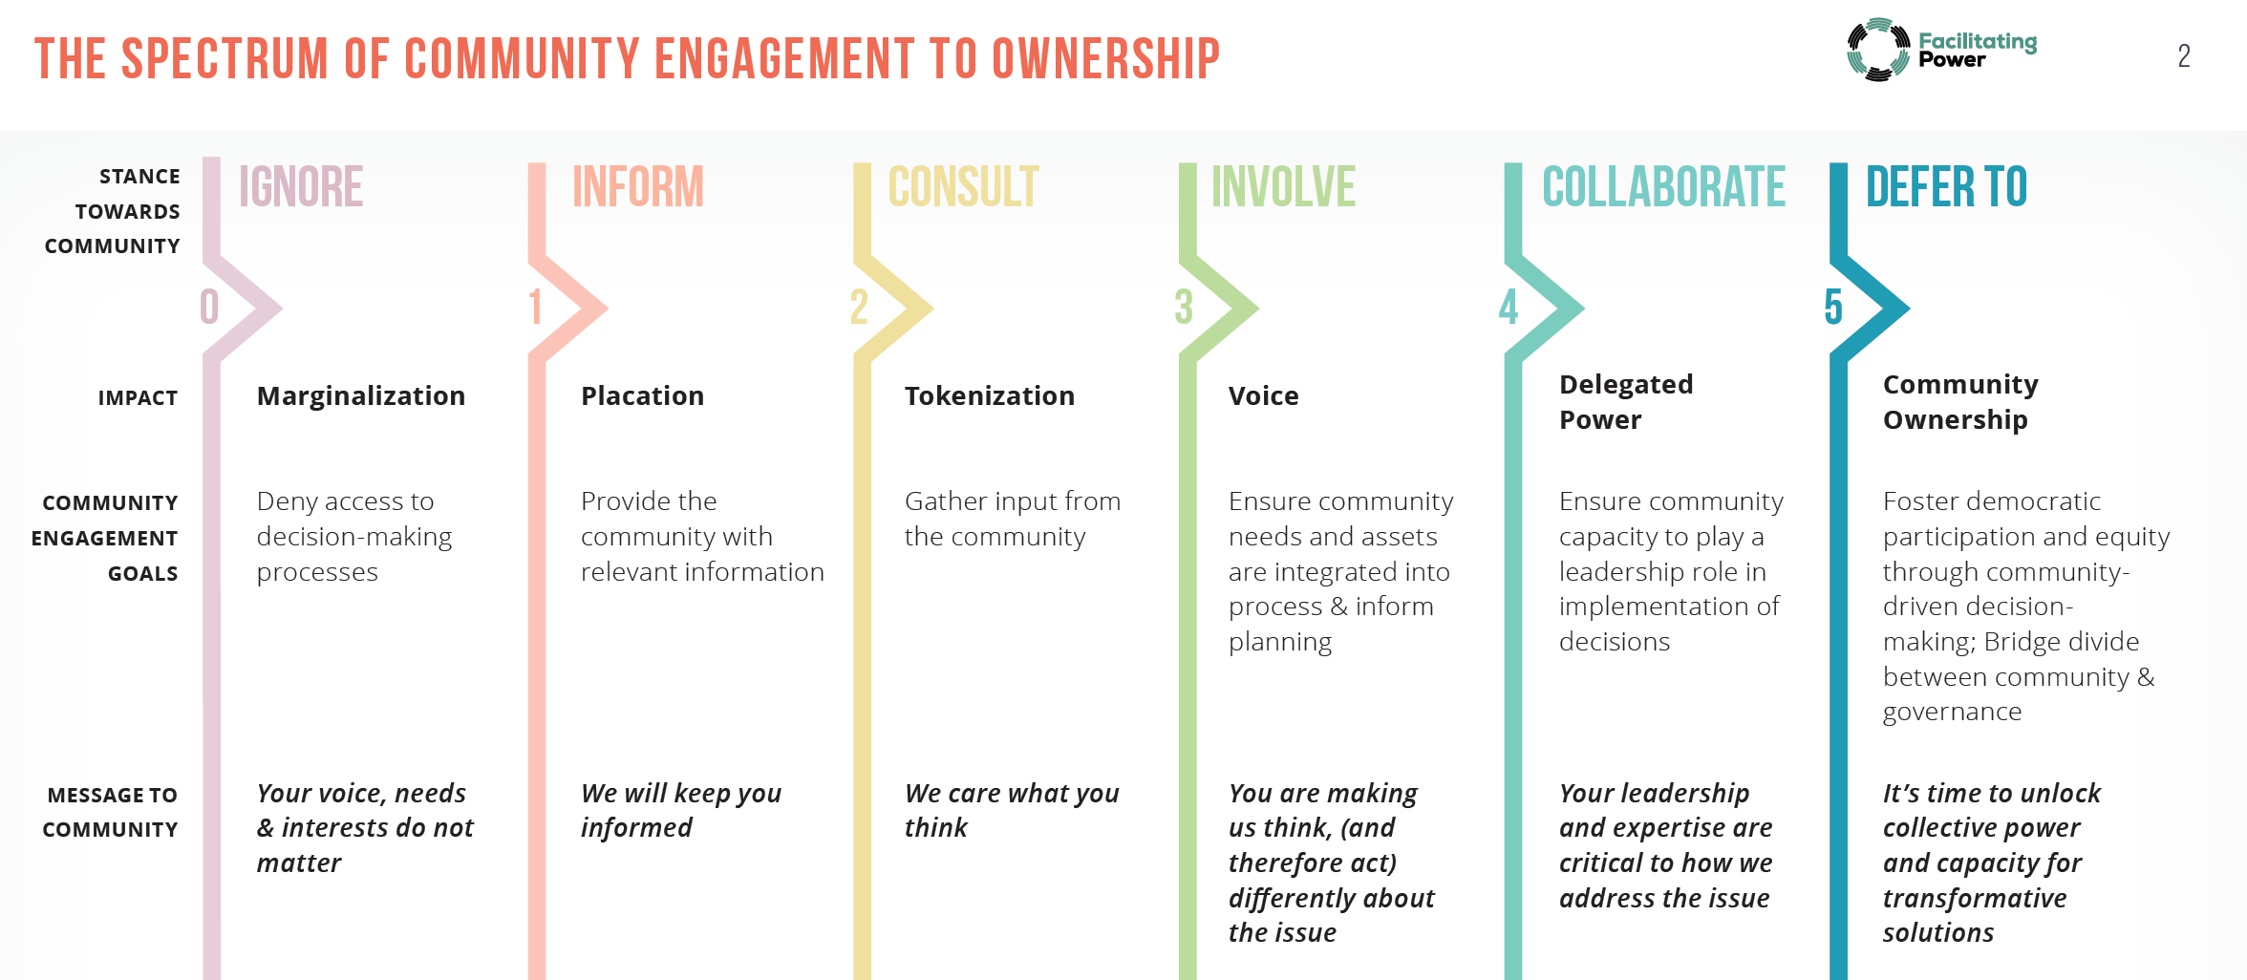

Slide 11
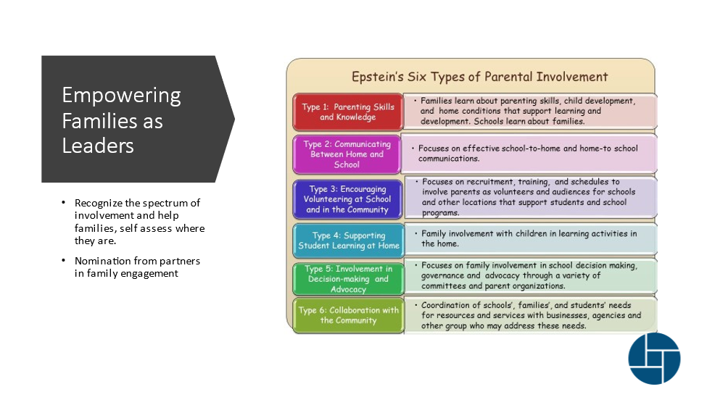

Epstein's Six Types of Parental Involvement
Type 1: Parenting Skills and Knowledge | Families learn about parenting skills, child development and home conditions that support learning and development. Schools learn about families.
Type 2: Communicating Between Home and School | Focuses on effective school-to-home and home-to school communications.
Type 3: Encouraging Volunteering at School and in the Community | Focuses on recruitment, training, and schedules to involve parents as volunteers and audiences for schools and other locations that support students and school programs.
Type 4: Supporting Student Learning at Home | Family involvement with children in learning activities in the home.
Type 5: Involvement in Decision-making and Advocacy | Focuses on family involvement in school decision making. governance and advocacy through a variety of committees and parent organizations.
Type 6: Collaboration with the Community | Coordination of schools’ families’, and students’ needs for resources and services with businesses. agencies and other groups who may address these needs.
Empowering Families As Leaders
Recognize the spectrum of involvement and help families, self assess where they are.
Nomination from partners in family engagement

Slide 12

How do we construct our ladder/spectrum?

Slide 13
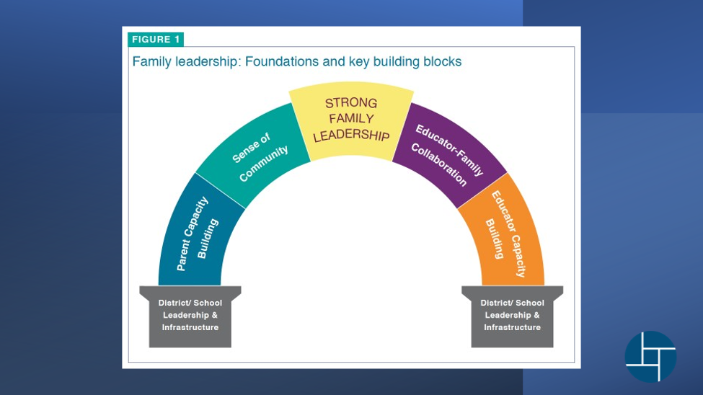
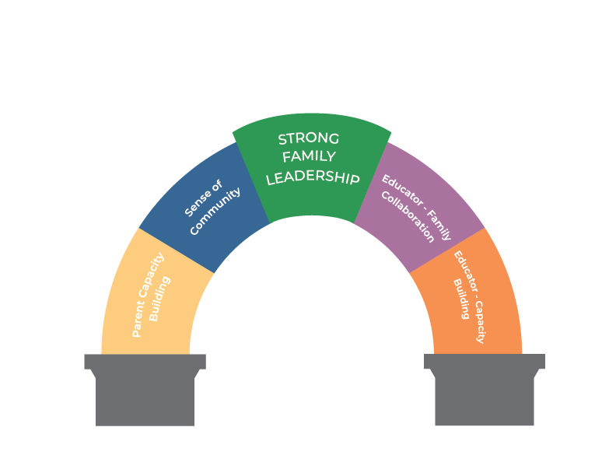
Family Leadership
Foundations and key building blocks

Slide 14
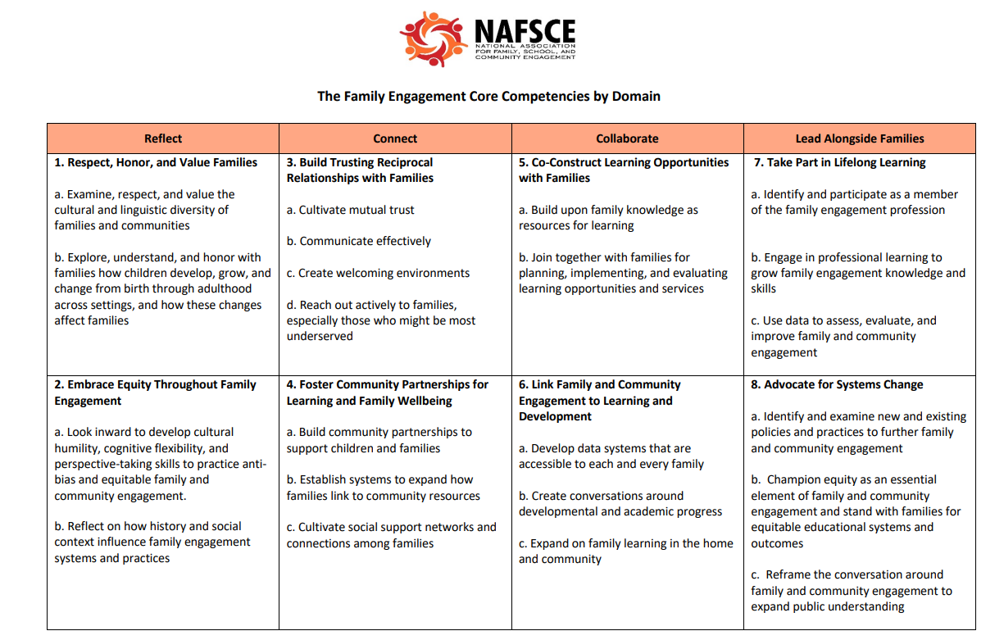

Slide 15

Back to Basics
Both families and educators report challenges to two-way communication, disseminating necessary information for at-home-learning and clarifying school policies and procedures. While many schools have student/parent handbooks and send home several pieces of information as school begins, there continues to be discussion on improving the access families have to important resources.
EdOptions and Back to School Basecamps support families with the basic knowledge to navigate the education system and make informed decisions about their student’s future. A few topics are listed below.
Who’s who in the school Terms/acronyms and their meanings
What’s expected for Kindergarten How to plan for college
Planning for an IEP meeting Effective family school conferences
Transition resources Dual credit and advanced placement
Family Wellness How to choose an early learning center

Slide 16

EdOptions
What information is missing? by October 15th
What do you need to promote this resource?
Add resource to your ladder
Back to School Basecamp
What will it take to change the way we engage at the beginning of the year?
Add resource to your ladder

Slide 17
Conversations that Matter
Facilitator Training Day One Afternoon Session
Parents and Teachers Talking Together (PT3)
Education Cafés
Goals:
Create networking opportunities for families and schools to build authentic trusting relationships and deepen the family-school partnership.
Objectives:
Understand the benefits of the family-school partnership
Learn effective communication strategies
Explore and honor with families how children develop, grow, and change from birth through adulthood
Materials and Resources Needed:
PT3 Facilitator Guide
Flip Chart Paper
Education Café Cards

Slide 18

Linked to Learning
Facilitator Training Day Two Morning Session
Champions for Our Children
Goals:
Increase partnerships between schools and families to improve students’ grades, attendance, persistence, and motivation.
Objectives:
Understand how learning can be reinforced at home Gain an understanding of fixed and growth mindset Recognize the value of education
Materials and Resources Needed:
Champions for Our Children Facilitator Handbook
Handouts
PowerPoint
Video Links
Meeting space with access to screen and projector

Slide 19
Advocate for System Change and Equity
Facilitator Training Day Two Afternoon Session
Family Friendly Schools
Groundswell Gatherings
Community Profiles
Goals:
Reframe the conversation around family and community engagement to expand public understanding.
Objectives:
Identify and examine new and existing policies and practices to further family and community engagement.
Champion equity as an essential element of family and community engagement and stand with families for equitable educational systems outcomes
Materials and Resources Needed:
Five Step Process for FFS Certification
Introduction script for families
Groundswell Gathering Facilitator Handbook
Community Profiles for District
Optional School Report Card

Slide 20

Day 3 The CIPL Fellowship
Morning Session:
Meet the current Facilitators and the new Class (Application Review)
History of CIPL and evolution to online class and Fellowship Tracks
How it works to host locally
Webinar Series
Development of facilitator questions
Afternoon Wrap-Up:
Edits, suggestions and next steps

