Slide 1

CPE Updates
Dawn Offutt, Ed.D.
Executive Director of Initiatives for Diversity, Equity, and Inclusion
Kentucky Council on Postsecondary Education

Slide 2
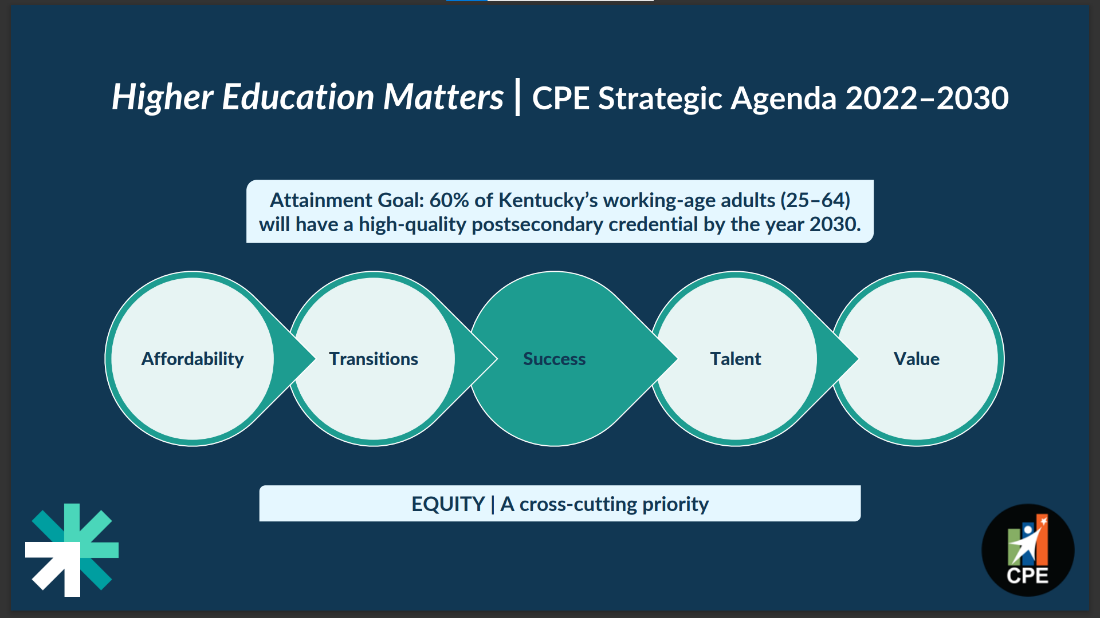
Strategic Agenda

Slide 3
Applying an Equity Lens to the Strategic Agenda
How is equity defined?
How is equity implemented within the focus area?
How is success measured?

Slide 4
Diversity, Equity and Inclusion Unit Initiatives
Institutional Diversity, Equity, and Inclusion Reports Evaluation Process
Academic Leadership Development Institute (ALDI)
Higher EDquity Campaign
Cultural Competence Certification

Slide 5
Institutional Diversity, Equity, and Inclusion Reports Evaluation Process
The purpose of the institutional diversity plan is to outline goals and strategies within the three focus areas (Opportunity, Success, Impact) that the institution will use to promote diversity, equity and inclusion on campus and to outline an appropriate plan for assessment.
Plans are submitted for review annually in March. Institutions that do not meet the standards of the rubric (24/36-universities; 22/34-community colleges) will lose automatic eligibility to offer new academic programs.

Slide 6

Academic Leadership Development Institute
ALDI is a professional development opportunity designed to develop more campus leaders among early career, underrepresented minority faculty and staff who aspire to leadership positions.
The goal is to provide participants with a comprehensive view of postsecondary education from both national and statewide perspectives and connect with colleagues who share similar goals.

Slide 7
Higher EDquity Campaign
Higher EDquity Symposium
Higher EDquity Webinar Series
DEI Resource Hub
DEI Listserv & Newsletter

Slide 8
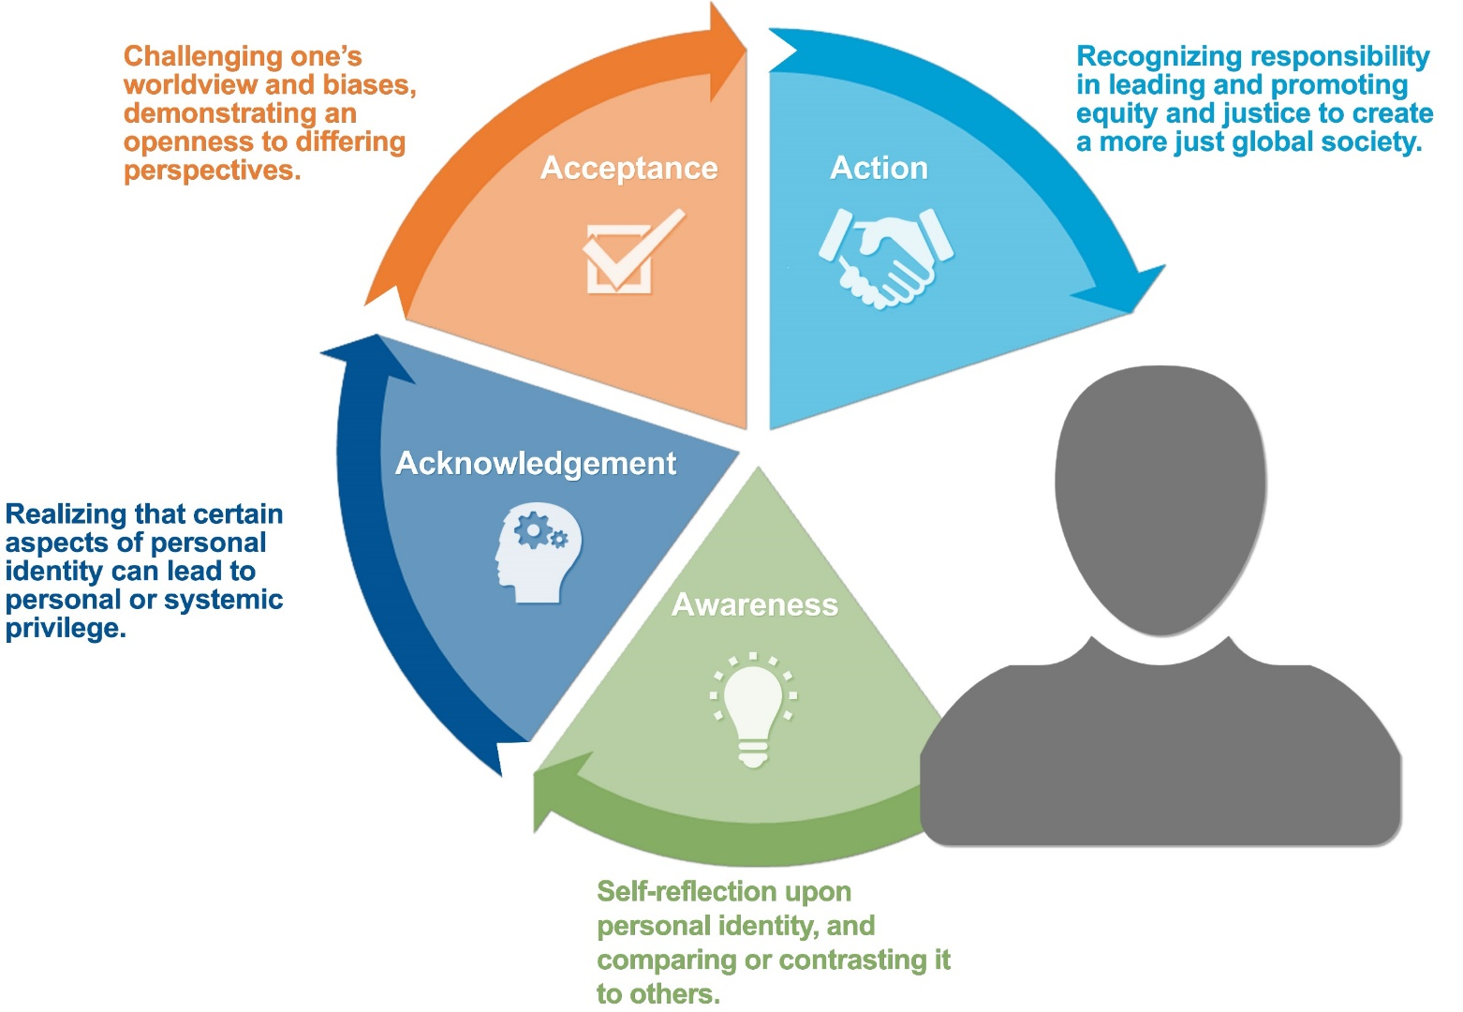
Cultural Competency Certification Framework
Mission - that students, faculty, staff, administrators, and Kentucky’s public post-secondary institutions and communities will recognize their own responsibility to lead in a global society that promotes equity and justice.
Cultural Competency Credential Certification - Ky. Council on Postsecondary Education

Slide 9
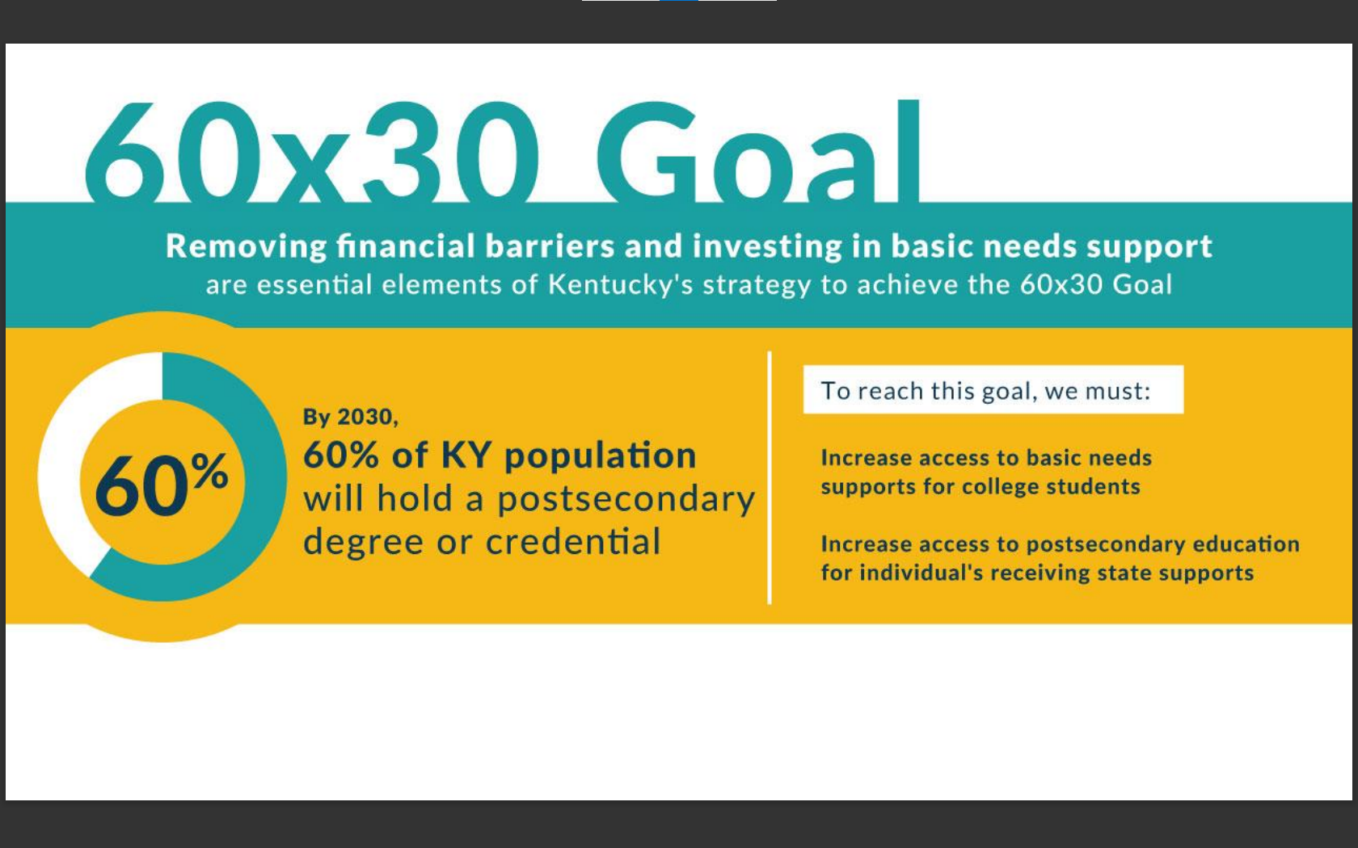
Kentucky’s Equity Audit
Kentucky’s Equity Audit seeks to increase the financial stability of adult learners, students of color, and students with low income by streamlining access to public benefits through enhanced partnerships and embedded processes.

Slide 10
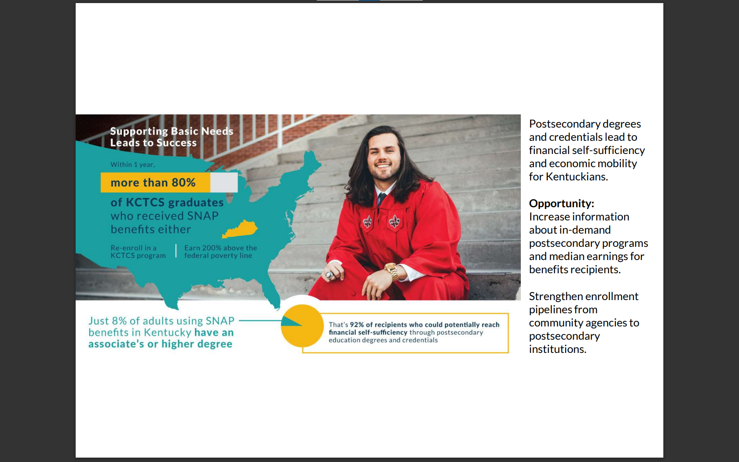
Kentucky’s Equity Audit
Objective 1: to increase access to basic needs supports for college students
Objective 2: to increase access to postsecondary education for individuals receiving state supports.
PARTICIPATING INSTITUTIONS
Bellarmine University
Eastern Kentucky University
Jefferson Community and Technical College
Maysville Community and Technical College
Murray State University
Owensboro Community and Technical College
Northern Kentucky University
Southeast Kentucky Community and Technical College
University of Kentucky

Slide 11
Questions or comments
about CPE’s diversity efforts?
Contact:
Dr. Dawn Offutt
dawn.offutt@ky.gov
502-892-3048

