Slide 1


Equity Coalition Study, Inform, and Engage
Notes:
This is both a presentation and a toolkit that can be used and modified in support of Equity in public education.

Slide 2
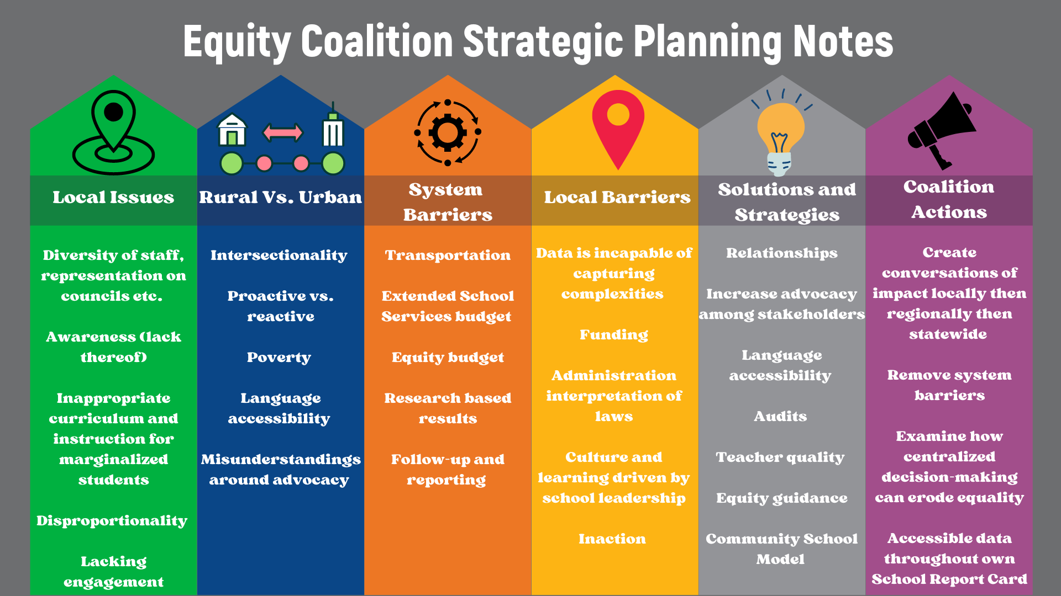

Slide 3
Questions for today:
Are you aware of local investment with an intentional focus on strategies to address equity gaps using ARP dollars?
If yes, how are student outcomes informing strategies?
If no, what messaging needs to take place at the local level? What can you do? How can this coalition assist and support you?

Slide 4
These are words written by the Prichard Committee’s founding chairman, Edward F. Prichard Jr., for Kentucky’s Governor Breathitt in 1964.
“Ours is the vision and ours the growing reality of a great society in which the accidents of race and color, parentage and poverty, location and geography will not be allowed to dim the light of human hope and to cripple the possibilities of human growth.” — Ned Breathitt
Notes:
These are words written by the Prichard Committee’s founding chairman, Edward F. Prichard Jr., for Kentucky’s Governor Breathitt in 1964. It is just a reminder of the importance of Equity work, as well as the fact that this has been long-standing work. Remain diligent and keep working to ensure big, bold futures for all of Kentucky’s students.

