Slide 1


Equity Coalition Toolkit: Study, Inform, and Engage
Notes:
This is both a presentation and a toolkit that can be used and modified in support of Equity in public education.

Slide 2
Equity Toolkit Table of Contents
Definitions of Equity
Prichard Definition
Council on Postsecondary Education Definition
Modified from Center for Assessment and Policy Development
Prichard Demographic Data- K Prep through 2019
Kentucky Summative Assessment Data; 2021
Kentucky Summative Assessment Comparison- Novice Performance
Stand Up- Meeting Talking Points
Write- Form letter for legislators
Connect- Partner Organization in Kentucky; Nationally
Organize- Kentucky School Board Association recommendations for running for a school board in Kentucky
Leadership Training- Commonwealth Institute for Parent Leadership
Social Media Campaign- Equity Lens Campaign
Facebook
Twitter
Instagram
LinkedIn
School District Diversity, Equity and Inclusivity Video
Kentucky State Profile
COVID Equity talking points
Legislative Strategies
Kentucky Commission on Race and Access to Opportunity
Links to Kentucky State Legislators
Notes:
This table of contents will take you directly to links and resources located both directly in the presentation and online. All the material referenced in this Table of Contents is referenced in this presentation as tools for use in this toolkit.

Slide 3
Study- What is Equity?
“Equity- Students in the groups that have historically had less opportunity to excel – students with low family incomes, African American students, Hispanic and Latino students, Native American students, students with learning differences, and students learning English – will catch up with their peers.”
Courtesy Excellence with Equity: It’s Everybody’s Business, 2016
Notes:
Equity definition from Prichard Committee created in 2016 listing specific groups that have been historically marginalized in terms of education in Kentucky.

Slide 4
Study- What is Equity?
Equity - The creation of opportunities for historically underrepresented populations to have equal access to and participate in educational programs.
Courtesy Kentucky Council on Postsecondary Education: Diversity, Equity, and Inclusion
Kentucky Public Postsecondary Education Policy for Diversity, Equity and Inclusion, 2016
Notes:
This definition from the Kentucky Council on Postsecondary Education doesn’t list specific groups. When vocabulary around the names of groups becomes problematic, this definition may fit the situation.

Slide 5
Inform- How does Equity impact Kentucky public education?
This is Equity!
Special Education
Social-Emotional Learning
Free and Reduced Lunch
School Transportation
SEEK Funding Model
Notes:
There have been long-standing equity-based programs in Kentucky public education. These include Special Education, school counseling and social-emotional learning, free and reduced lunch, school transportation, and SEEK funding (which is the funding model for all Kentucky school districts).

Slide 6
Inform- Where are there gaps in Equitable opportunities?
Equity is the condition that would be achieved if one’s identity no longer predicted, in a statistical sense, how one fares.
Modified from Center for Assessment and Policy Development
Notes:
Before diving into statistics, this definition of Equity has a statistical basis, meaning that if one could predict performance based on an identity metric, then inequity is present.

Slide 7
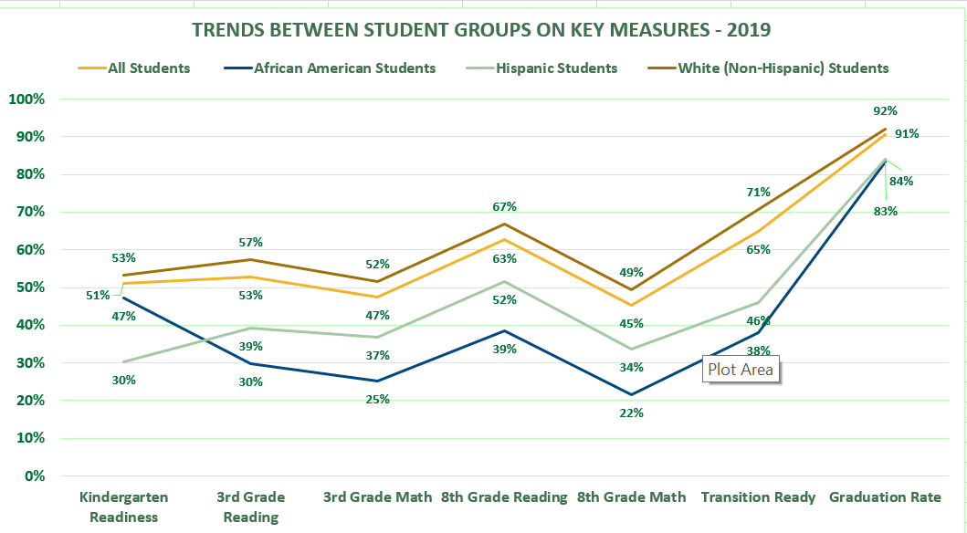
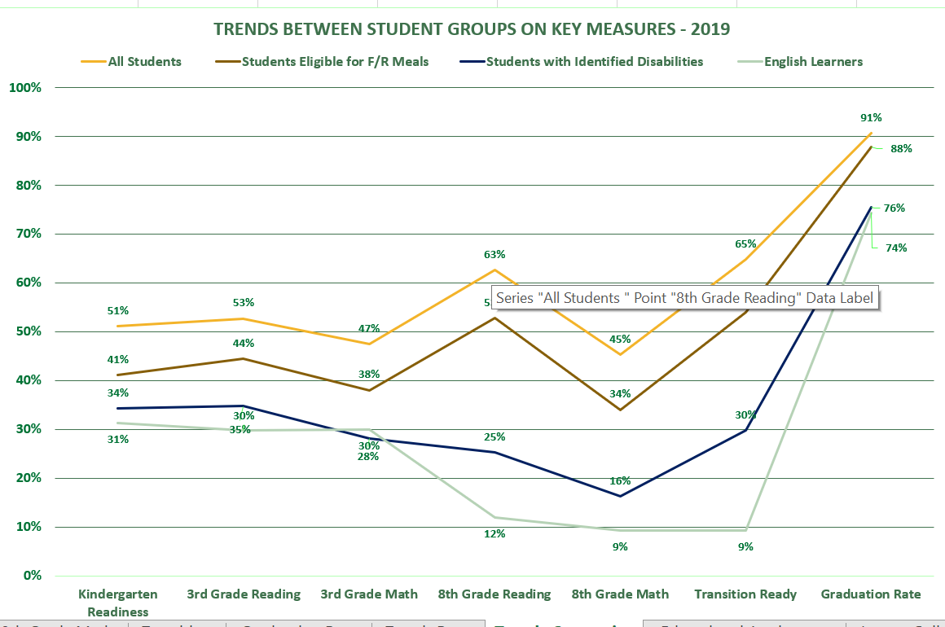
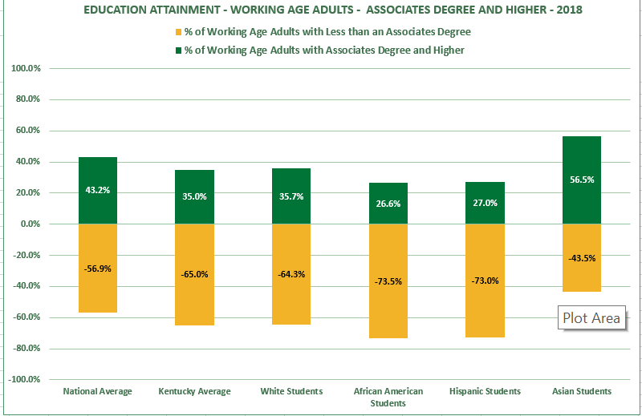
Inform- Where are there gaps in Equitable opportunities?
Click Here for Prichard Committee Data Walk
Click here for 2021 Summative Assessment Data
Click here for Novice Data Comparison- Summative Assessments
Notes:
This slide highlights some of the achievement gaps in Kentucky. Ultimately, we would want all Kentucky students to be at 100% proficiency in these metrics. However, we are quite far away from that goal. We have gaps in performance between different demographic groups in important metrics like Kindergarten Readiness, 3rd Grade Reading and Math Proficiency, 8th Grade Reading and Math Proficiency, transition readiness to higher education or career post high school, and high school graduation rate. These gaps show up in higher education degree attainment of an Associate’s Degree or higher. There are links to further data illustrating these gaps. The Prichard Committee Data Walk looks at the gaps through 2019. The Summative Assessment Data links to students' performance on the 2020-2021 end of school year summative test results. Finally, there is a comparison of summative data as to students and Novice performance on summative tests, which is the lowest score a students can receive.

Slide 8
Engage- What can you do locally? *Source- Brandyn Campbell Communications
Show Up
Show up and speak up at school board meetings in your community
Write
Voice your support and commitment to Equity work to your legislators, superintendent, and school board
Connect
Find out what groups are already coordinating a response where you live
Organize
School board races are at the forefront of this fight; learn who is running in your district and familiarize with their platforms
Notes:
The next several slides are focused on actions. This slide outlines how advocates can show up for equity, write to support equity, connect with other equity advocates and organizations, and run for school boards to lead on equity initiatives from this position. This framework was created by Brandyn Campbell, an authority on how communities can support equity initiatives. Her full framework is linked to this slide. Under “Show Up”, there is a link to a list of talking points that are data focused and can be used in public meetings, like school board meetings. Under “Write”, there is a link to a form letter that can be used to write to a legislator. This letter could be copied and adjusted to fit another leader. Under “Connect”, you will link to a list of organizations supporting equity in schools, both in Kentucky and nationally. Under “Organize”, you will link to the Kentucky School Board Associations webpage outlining recommendations for those interested in running for a school board position.

Slide 9
Engage- What can you do locally?
Commonwealth Institute for Parent Leadership (CIPL)
CIPL Fellowship- click here to learn more
CIPL Nominations- who do you know that wants to engage but needs support?
Notes:
The Commonwealth Institute on Parent Leadership (CIPL) is a program for those that would like to influence educational initiatives in their community but aren’t sure how to be effective leaders and would like training to become better change facilitators. CIPL will help to provide tools and strategies that can be used regardless of which issue may be your passion. Those passionate about Equity in schools can use this experience to strategize and develop their practice moving forward.

Slide 10
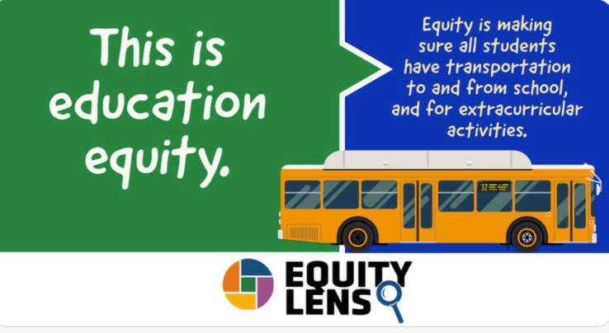
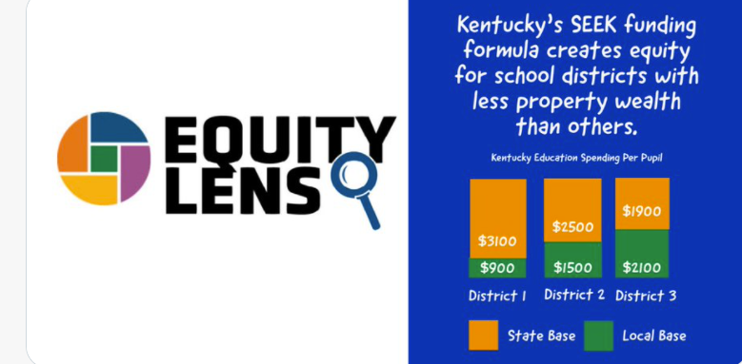
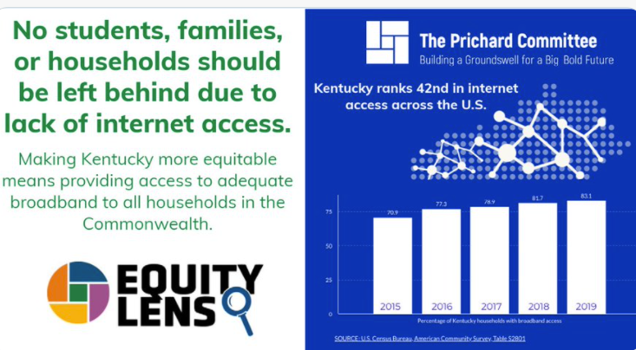
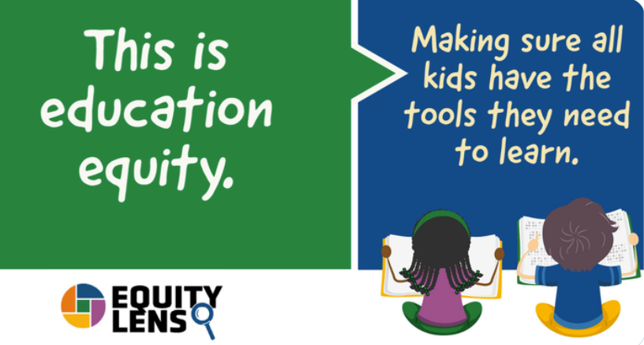
Engage- How can you support Prichard Committee efforts?
Equity Lens Campaign
Social Media releases every Thursday
Social Media posts will link to in-depth resources such as blog posts or interviews
Twitter, Facebook, Instagram, LinkedIn
Like, comment, share these posts far and wide
Notes:
The Equity Lens Campaign was created by Prichard Committee to help define Equity in education, as well as to highlight how Equity initiatives appear in public schools, This campaign is social media based, via Facebook, Twitter, Instagram, and LinkedIn. Some areas that have been highlighted include school funding, transportation, broadband access, and summative test performance.

Slide 11
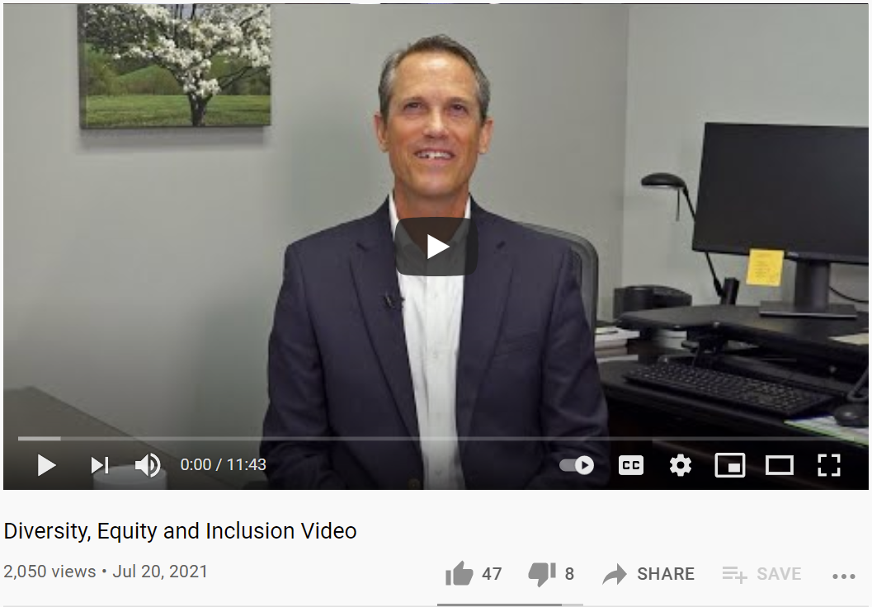
Engage- What can you ask for locally?
A great example of defining the “why” behind equity initiatives in school districts is this video from Dr. Matthew Turner, superintendent of Boone County Schools.
Can your local superintendent do something like this?
How can this increase empathy around equity in your local community?
Notes:
One great strategy to consider implementing is to meet with district leadership, like your superintendent, and ask for the district to make overt and clear their stance on diversity, equity, and inclusivity in schools. A great example of how this can be done is Boone County, where superintendent Dr. Matthew Turner created the video above (click on the picture to watch the video as the picture is linked). Boone Country clearly defined diversity, equity, and inclusion. The diversity of the county is highlighted. The rationale behind diversity, equity, and inclusion programs is explained. This video is on the district’s website and easily accessible to the community. Any district could do this or something similar. Meet with your district leadership and ask them if they would commit to the district being transparent in a similar way.

Slide 12
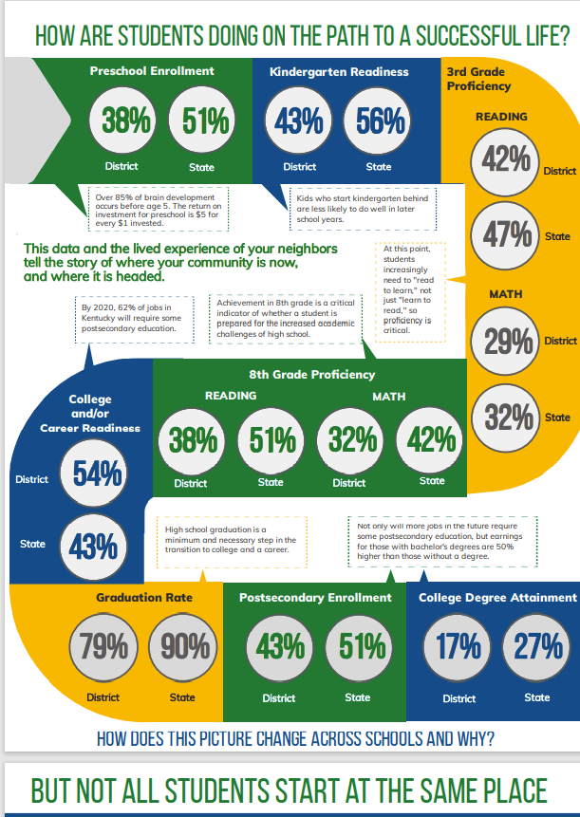
Engage- What about the focus on long-standing issues in education in Kentucky?
Notes:
Using the Community Profiles that are developed in partnership by Prichard and K Y Stats, this data can highlight education metrics for the state and can be used to compare to your local community. As you look at the state profile, what is surprising? What is concerning? What is worth celebrating? How closely do you predict your local community will align with the state on these metrics?

Slide 13
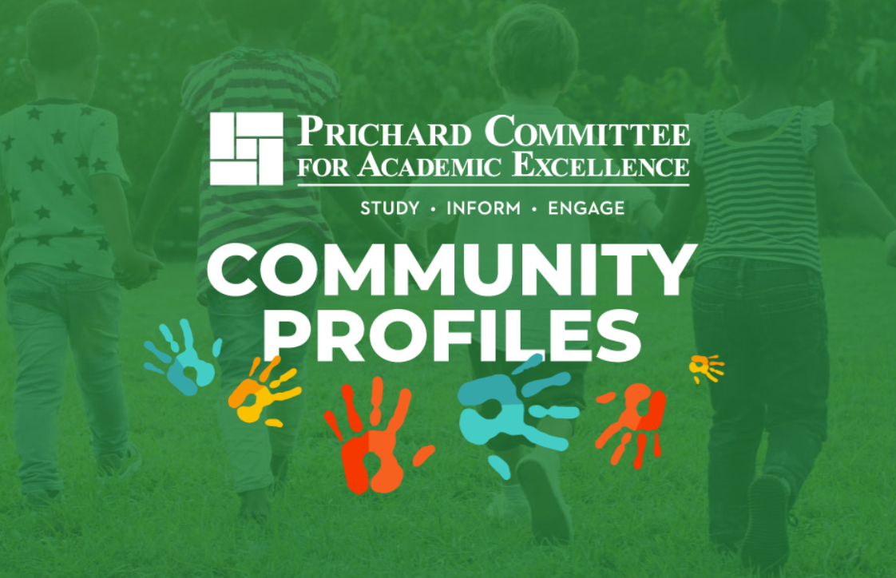
Engage- What about the focus on long-standing issues in education in Kentucky?
Notes:
Now, let’s look at your local profile. What is surprising? What is concerning? What is worth celebrating? How closely do you predict your local community will align with the state on these metrics? As we consider the metrics for diverse populations, locally, what is most surprising? How can this work support closing achievement gaps locally?

Slide 14

Engage- What about supporting our students as we return to in-person schooling?
We need more high-quality childcare options for families of all income levels
The childcare system and its workers are essential
In K-12 schools & colleges, inequities based on student groups remain starker than ever
Built-in mental health supports need to be funded & prioritized for K-12 & college
The digital divide must be closed at all costs
Notes:
Kentucky has had long-term issues in raising and maintaining educational outcomes for our students across the Bluegrass. We can not afford a distractions on the path to addressing these long-standing concerns and closing these achievement gaps. If there is an issue that should get our immediate energy and concern, however, it is supporting students and schools as we deal with global pandemic and work to accelerate student learning. COVID has revealed some glaring issues, including a lack of quality, affordable healthcare options that systematically works well across the state. Including inequities in the outcomes at all levels of education for diverse student populations. Including the need to support the social and emotional growth of students and teachers in our K-12 institutions, as well as at the higher education level. Including a digital divide between who has high speed internet access and who does not. If we take any energy away from our long-standing concerns, it should be to address these issues in the immediate that COVID has exposed.

Slide 15
Engage- What about supporting our students as we return to in-person schooling?
How do we support students:
In high school with less time to recover from 2020-2021 impact?
Ready to transition to a new level of schooling after their 2020-2021 school experience
Transition to College
Transition to HS
Transition to MS
Notes:
COVID has created a situation in which we need to act in the immediate to support the most vulnerable students. Historically, we can look at demographics to support this need. COVID has created several categories of students that need extra supports, as well. Students that are in high school have less time in the school system to make up for any learning loss that happened due to COVID. Also, consider students that had a transition to a new level of schooling during non-traditional instruction. These students didn’t get the usual support before their transition. These are students that need immediate focus to support successful transition to new levels of schooling, including higher education transition and career readiness transition.

Slide 16
Engage- Are there opportunities to engage the legislature?
YES!!!
Kentucky Commission on Race and Access to Opportunity
Chairs:
Senate President Pro-tem David P. Givens
Rep. Samara Heavrin
Lawmakers on the commission:
Sen. Whitney Westerfield
Rep. George Brown Jr.
Rep. Nima Kulkarni
Rep. Killian Timoney
Sen. Karen Berg
Citizen members;
Dr. OJ Oleka
Erwin Roberts
Dr. Ricky Jones
Sen. Givens invited engagement with the Commission on issues in the form of 10-minute speech to Commission
Dr. Oleka is a Prichard Committee member
Notes:
We should work within our spheres of influence to ensure that Equity work continues to be at the forefront of education conversations. The spheres can be local among a group of parents, within the school board and school-based decision-making councils, and even at the legislative level. One legislative audience is the Kentucky Commission on Race and Access to Opportunity. This committee is co-chaired by Senator David Givens, who asked for organizations to contact the Commission and present information to inform the Commission in their work. Dr. OJ Oleka, who is a Prichard Committee member, also serves on this Commission. This opportunity is one to keep in mind should it make sense based on you personal sphere of influence or that of your organization.

Slide 17
Mobilize- What are the strategies to keep in mind?
The CRT bills instigated the reaffirmation, but they are a distraction to the work the we need to do in the Commonwealth
Our focus is on keeping our Equity in education work at the forefront- and we can’t afford any distractions as there is plenty left to do
No
distractions
This can be done ASAP
Ask local superintendents re: DEI video
Share the message of the Equity Lens campaign
We have a shared commitment to Equity
Department of Education has pledged its commitment to Racial Equity work
KRS 158.649 outlines the commitment from the legislature to closing Achievement Gaps
Notes:
In summary, what brought us here are the pre-filed legislative bill request around Critical Race Theory and Kentucky public K-12 school and colleges. The realities are simple, though. The Commonwealth has identified educational priorities that we have focused on for years only to see COVID not only stifle progress but set student’s backward in many instances. We can’t afford distraction in the work of closing achievement gaps and improving educational outcomes for all Kentucky students. That includes maintain our Equity focus to help accelerate the learning for students that are the furthest behind. In the immediate, actions that can be taken are as simple as interacting with the social media posts of the Equity Lens campaign. Reaching out to district leaders and communicating support for equity initiatives is another tactic in the immediate. Overall, the Department of Education has pledged to keep Equity at the forefront of their work. Legislators have written achievement gap closure into statute to prioritize this work. This shared focus on Equity in education needs to be at the core of decisions made in support of Kentucky students. No distractions; we need all hands on deck to help students accelerate their learning through this pandemic, and beyond.

Slide 18
These are words written by the Prichard Committee’s founding chairman, Edward F. Prichard Jr., for Kentucky’s Governor Breathitt in 1964.
“Ours is the vision and ours the growing reality of a great society in which the accidents of race and color, parentage and poverty, location and geography will not be allowed to dim the light of human hope and to cripple the possibilities of human growth.” — Ned Breathitt
Notes:
These are words written by the Prichard Committee’s founding chairman, Edward F. Prichard Jr., for Kentucky’s Governor Breathitt in 1964. It is just a reminder of the importance of Equity work, as well as the fact that this has been long-standing work. Remain diligent and keep working to ensure big, bold futures for all of Kentucky’s students.

