Slide 1
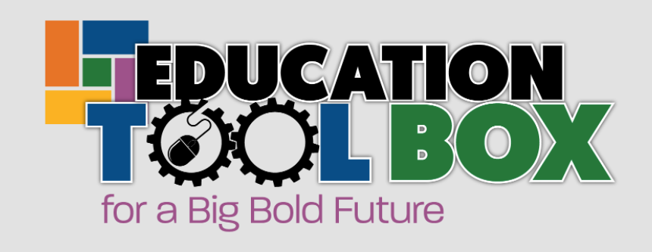
Building Solid Reading & Math Skills by 3rd Grade

Slide 2

Why is this important?
Research shows that by the end of 3rd grade
16% of students not reading proficiently do not graduate high school on time
That rate rises to 26% for non-minority students who live in poverty
That rate rises to 25% for African American and Hispanic students
That rate rises to over 30% for African American and Hispanic students in poverty
Courtesy Teaching Matters Most: Student Success in the Early Grades

Slide 3
Why is this important?
The performance of Kentucky’s students has also declined relative to the nation
Only 35% of public school fourth graders scored proficient or above on the 2019 National Assessment of Education Progress (NAEP)
That put Kentucky’s ranking at 26th among the 50 states, a decline from 17th in 2018
Courtesy Teaching Matters Most: Student Success in the Early Grades

Slide 4
What does Kentucky data look like?
Kentucky Summative Assessment Data: 2020-2021 School Year
60.5% of all Kentucky elementary student are not proficient in Reading
79.9% for Black students
72.1% for LatinX students
69.6% for economically disadvantaged students
74.5% for students with identified disabilities
85.6% for English language learners.

Slide 5
What does Kentucky data look like?
Kentucky Summative Assessment Data: 2020-2021 School Year
68.6% of all Kentucky elementary student are not proficient in Math in 2021.
88.7% for Black students
80% for Latino students
78.6% for economically disadvantaged students
82.3% for students with identified disabilities
87.8%% for English language learners.

Slide 6
How do I find out how schools in my district are performing?
The Prichard Committee Community Profiles
Click this link and select your district from the drop-down menu at the top of the page
Kentucky Department of Education
School Report Card and enter your school’s name on the homepage. Scroll to Academic Performance and click on Assessment Results.

Slide 7
Create a groundswell of action.
Act by creating local campaigns to raise awareness about the issue
Accelerating Learning – McCracken County
Read Ready Covington – Kenton County
Literacy Kits for Hispanic Families – Kenton County

Slide 8
Create a groundswell of action.
Evidenced-based Solutions Districts can Implement
The Education Trust recommends:
Extended learning time
Targeted, intensive tutoring
Building strong relationships between faculty and students

Slide 9
Use our
Toolbox.
https://prichardcommittee.org/building-solid-reading-math-skills-by-3rd-grade/

