Slide 1

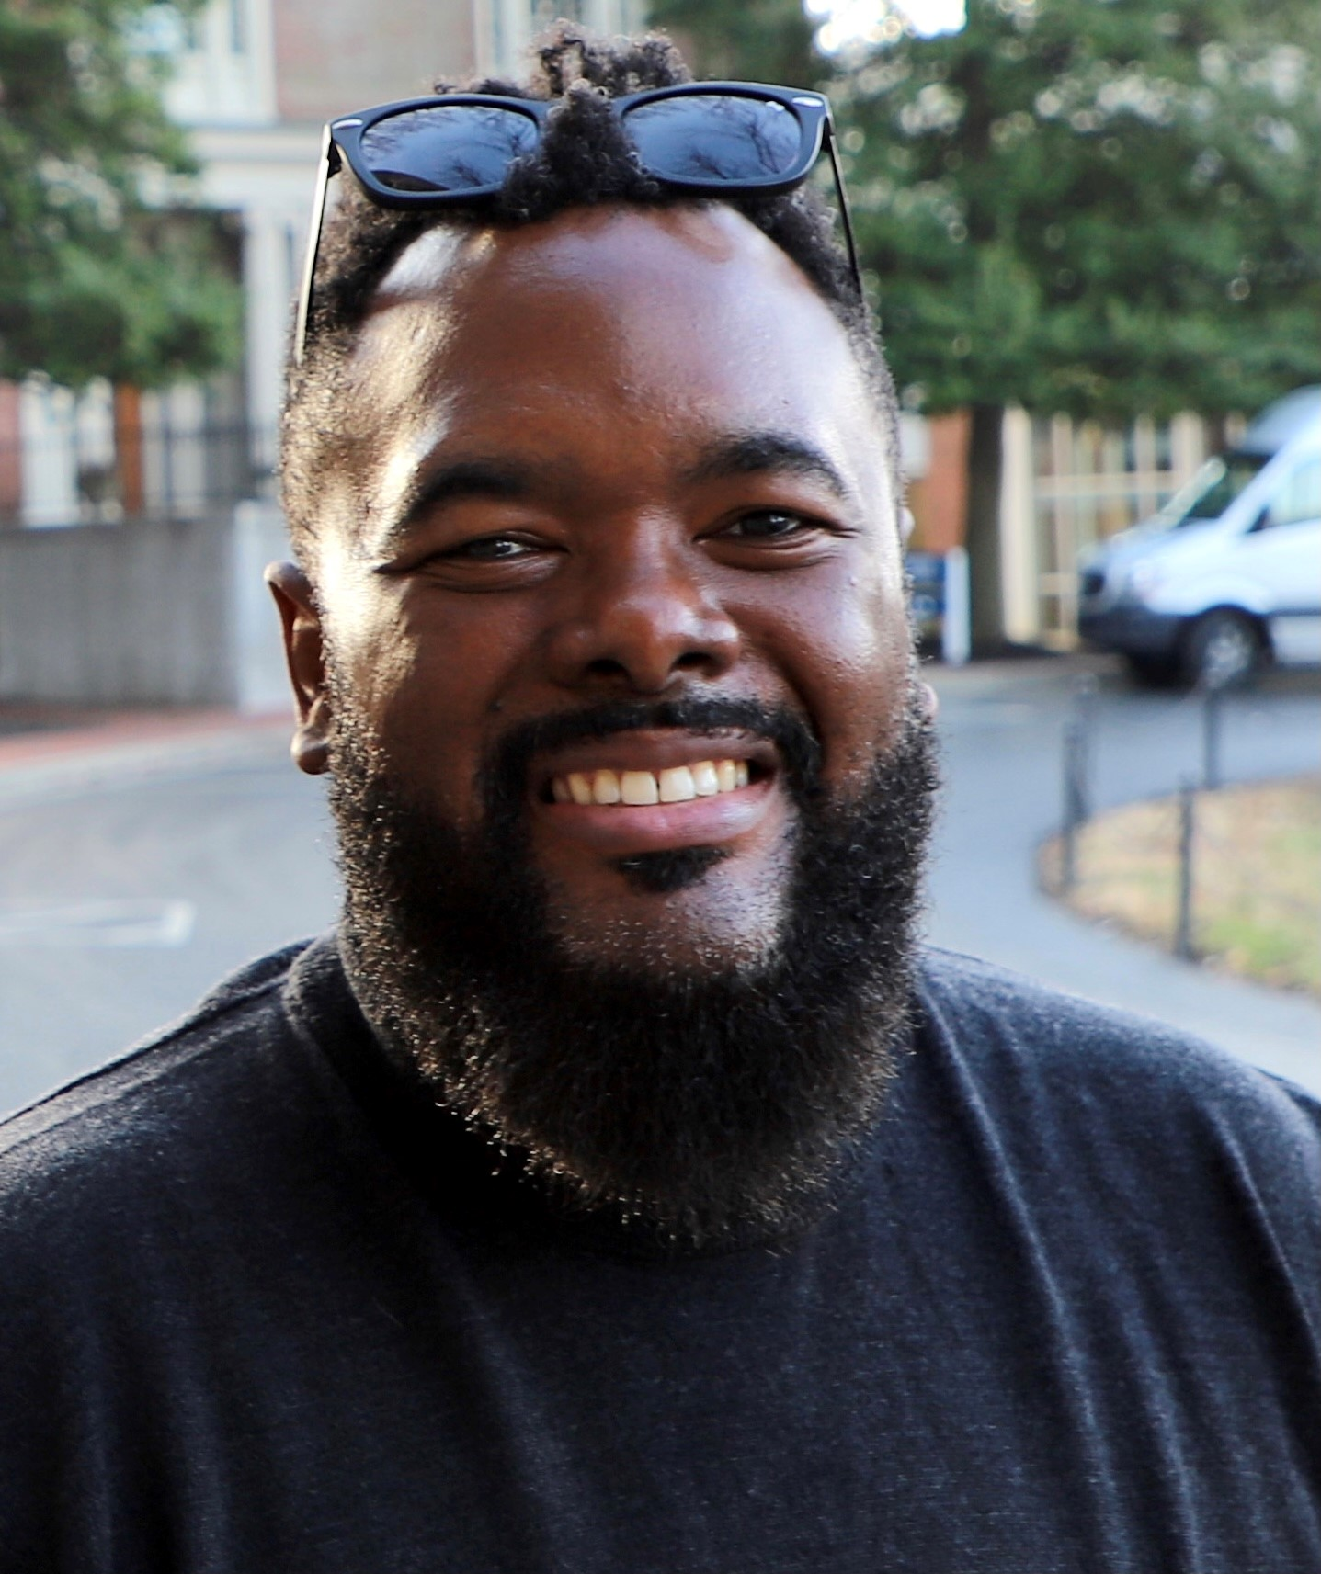
Chaka Cummings
Educator- 16 year; teacher, asst. principal, principal, coach
From NYC; lived in Kentucky for 9 years
BA- Berea College; MBA- UK; pursuing PhD- UK
Avid sports fan and Disney freak

Slide 2
What we will do today- 6/16
Discuss Bill Requests 60 and 69
Begin identifying possible actions we can take in our local communities to contribute to these conversations
Understand how we can activate our EC subcommittees to make solutions-oriented recommendations regarding curriculum analysis and design at the district level

Slide 3
Part 1- Bill Requests 60 and 69
Bill Request 60 (Education Non-Discrimination Act)
Bill Request 69
Kentucky Tonight- Debating Critical Race Theory
BREAKOUT ROOM QUESTION TO CONSIDER:
How do you believe this type of legislation will impact Kentucky students
In your city?
In Kentucky, broadly?

Slide 4
Local Response
BREAKOUT ROOM QUESTIONS TO CONSIDER:
What has the local response to discussions around Critical Race Theory been like, in your experience?
What has the local response to pre-filed Bill Request 60 and 69 been like? What has the local response to legislation like this that is appearing throughout the United States?

Slide 5
EC Subcommittees
My understanding (correct me if I am wrong, here):
Equity Coalition has subcommittees
Those subcommittees are based, in part, around interest at specific educational levels
Early Childhood
K-12
Post-Secondary
BREAKOUT ROOM QUESTIONS TO CONSIDER:
How can we activate these subcommittees to make actionable, solutions-oriented recommendations around teaching race in schools?

Slide 6
Our time has together has come to an end…
NEXT STEPS:
Reflect upon conversations and recommendations from this meeting
Upload the PowerPoint to Equity Coalition page of website
Next meeting:
Wednesday, July 21 10:30 AM- 12:00PM

