Slide 1


Welcome Class of 2021

Slide 2
Housekeeping
Sign in by putting your name in the Chat box
Please put your phone or computer Audio on Mute
A short survey will follow the webinar please make sure to complete it

Slide 3

Introductions
Name
County
One thing you hope to get from the Fellowship

Slide 4
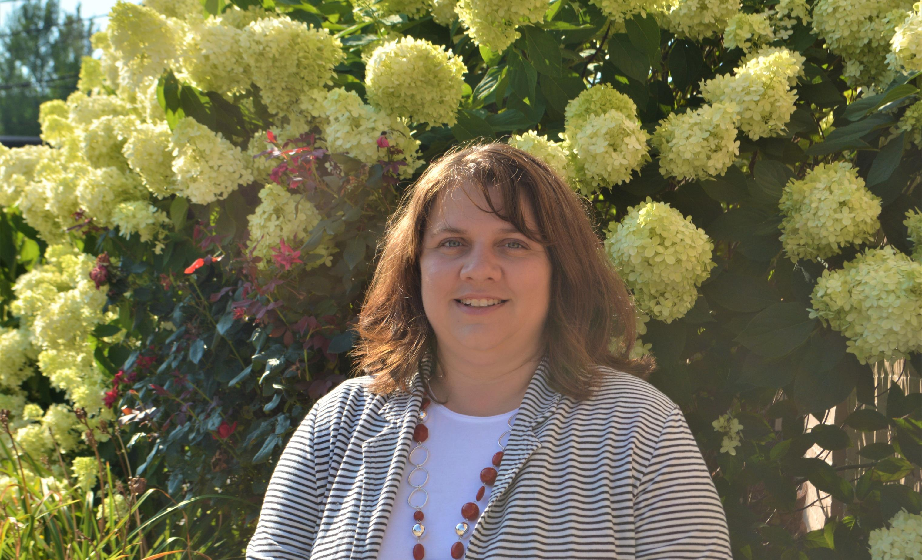
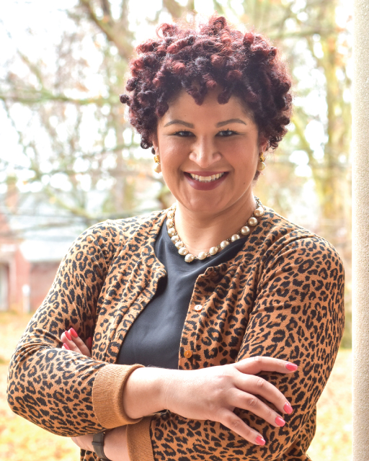
Laura Beard-Family Engagement Coordinator
Andria Jackson-Community Engagement Coordinator

Slide 5

Leadership and Learning Goal
Graduates are able to provide leadership in parent-school-community partnerships that enhance student achievement

Slide 6
Beliefs of CIPL
All parents have hopes and dreams for their children
All parents have the capacity to support their child’s learning
Families and schools should be equal partners (Dual Capacity)
High-quality, equitable and inclusive education is the shared responsibility of families, schools and communities
Relationships with Leadership are essential for system change
Families, students and communities are owners in the schools and therefore hold incredible power and influence
-4 Core Values from Beyond the Bakesale

Slide 7
Authentic Participation
A community of parents committed to school improvement
Relationships of trust between parents and schools
Development of parent participation and leadership skills
Parent opportunity to influence the process and outcomes of an issue

Slide 8
What you are responsible for…
Virtual Orientation
Webinars
Community Leadership-Project
Two NetWorking Cafes
Groundswell Gathering
www.prichardcommittee.org/fellow Password 2021class

Slide 9

Webinars
First one is Tuesday Oct. 27th
6:30-7:30pm ET
The History of Public Education in Kentucky

Slide 10

Community Leadership Project
Innovation in Education
Equity in Education
1 page Report and 5 powerpoint slides

Slide 11

Networking Participation
2 Café Conversations led by CiPl Fellows

Slide 12
In return you will receive…
Foundational information in deep Dive webinars
January retreat
April Summit
A letter of recognition
Graduation
Opportunities within the Groundswell initiative to increase education advocacy

Slide 13
Let’s get started-Andria
Join Us on Social Media
Sign up for Groundswell
Read the Big Bold Future Report

Slide 14

Questions in the Chat Box
Thank you for joining us!!!!

