Slide 1


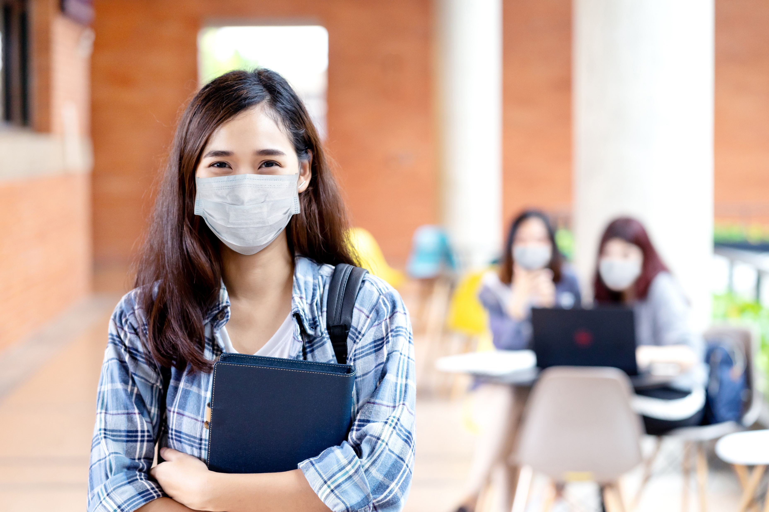


CIPL Webinar #1
The History of Public Education in Kentucky
Parent Leadership - The Journey

Slide 2
Welcome to CIPL Webinar #1
Guest Speakers for the Evening
Brigitte Blom Ramsey, President and CEO of The Prichard Committee
Larry Holladay-CIPL Fellow
Penny Christian-CIPL Fellow
Followed By
Action Items
Q & A

Slide 3
The History of the Prichard Committee
Video

Slide 4
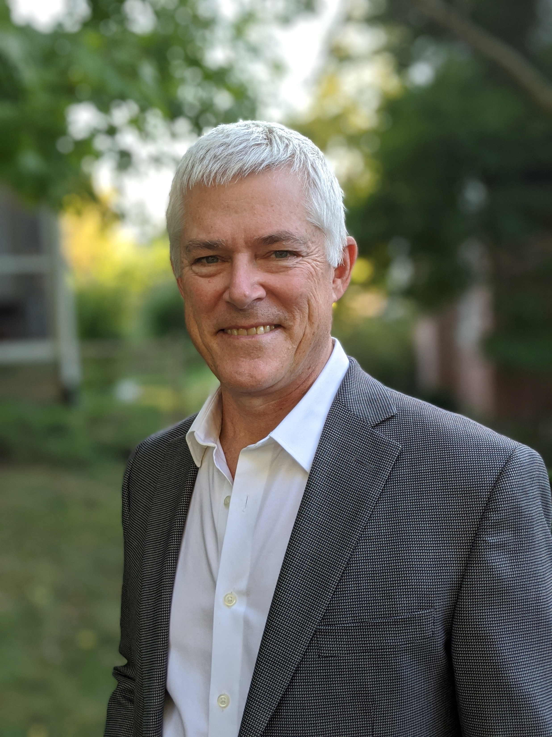
Larry Holladay
Parent Engagement-Then
CIPL Fellow
Former School Board Member
Prichard Committee Member
Community Engagement

Slide 5
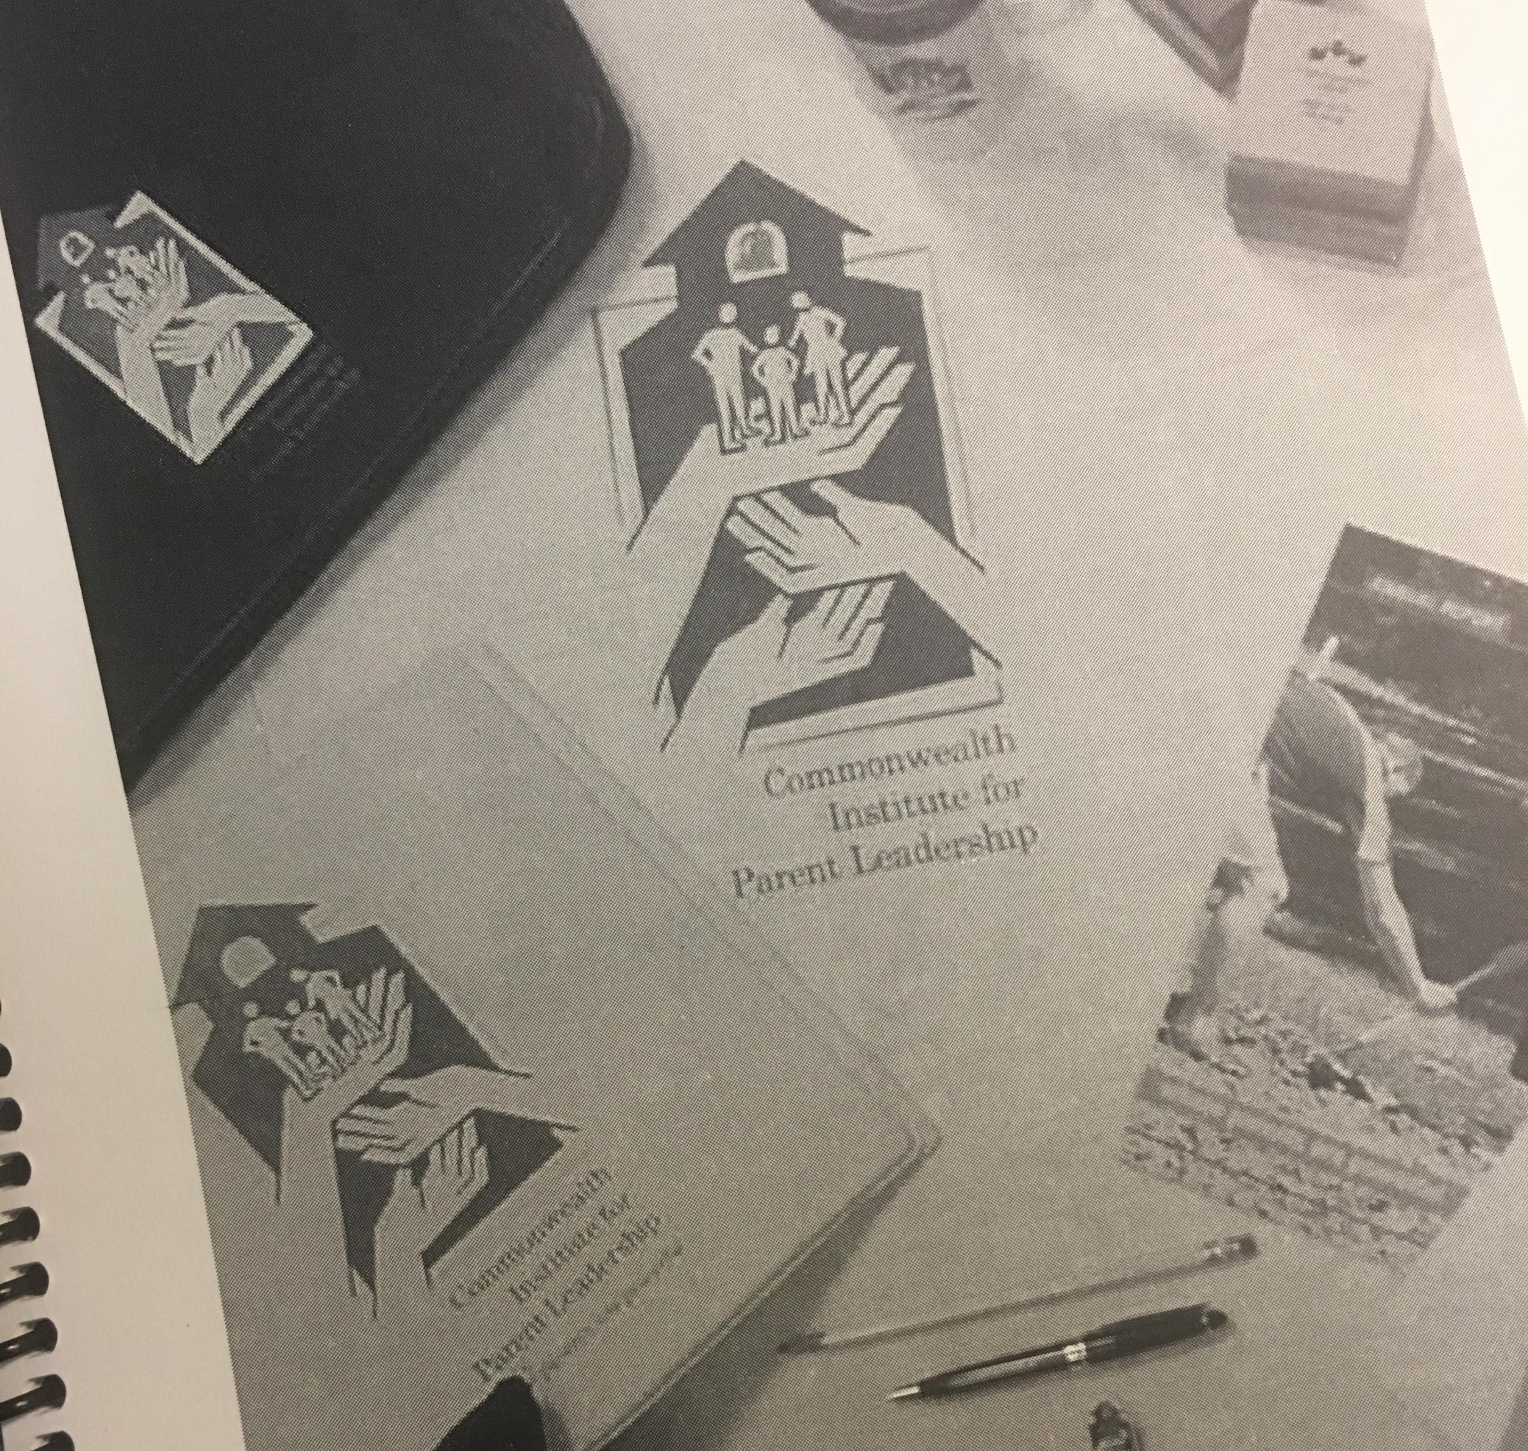
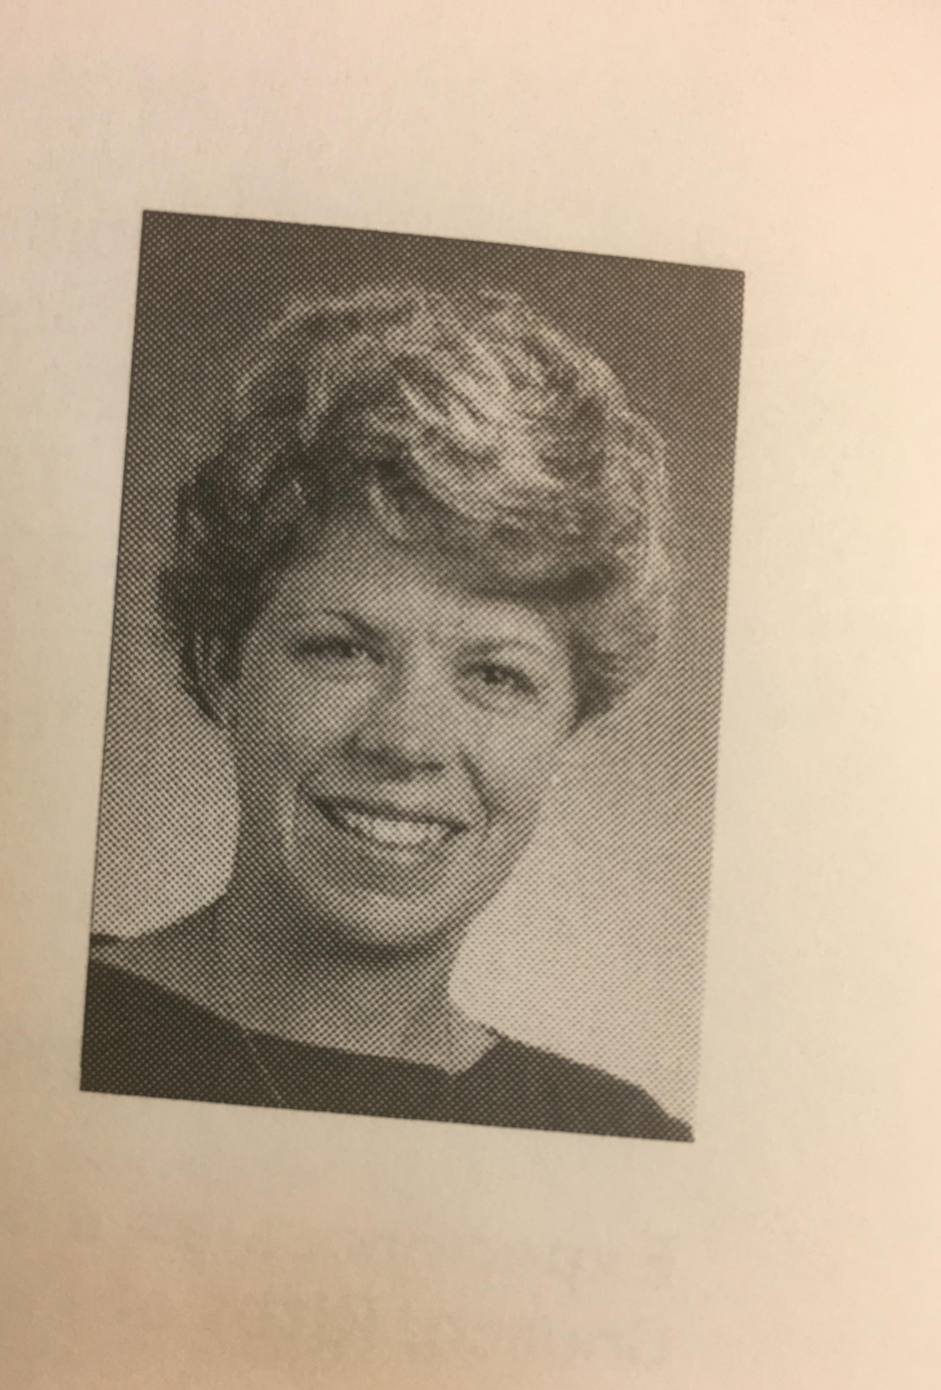
Welcome To CIPL
Brigitte Ramsey
President & CEO of the Prichard Committee
CIPL Class of 2000
@Brigitte_Blom

Slide 6
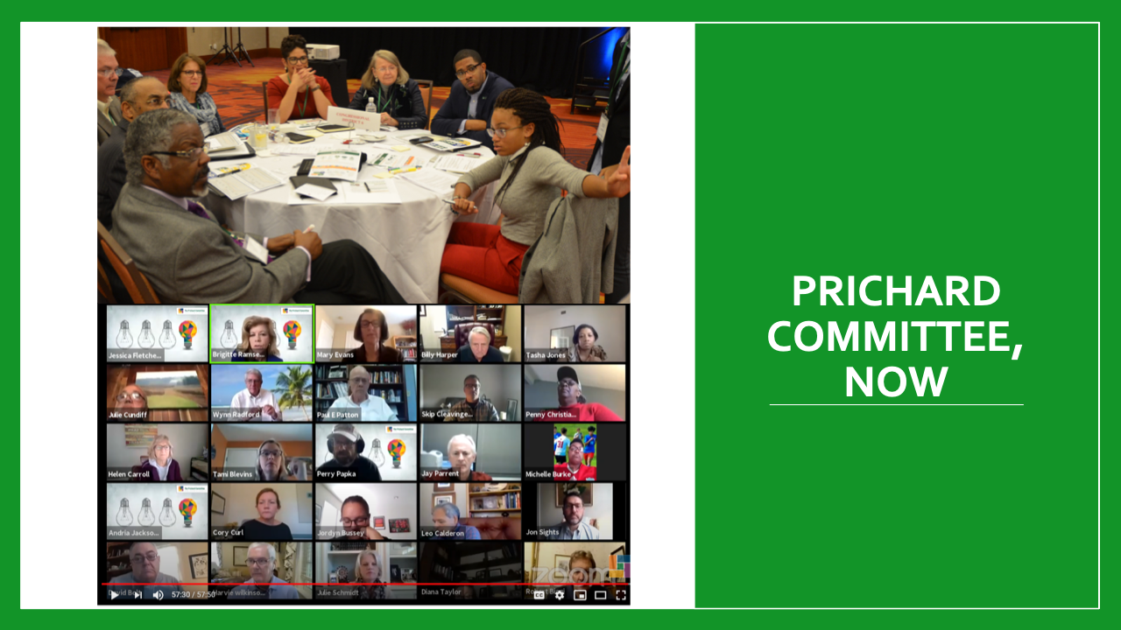

Slide 7
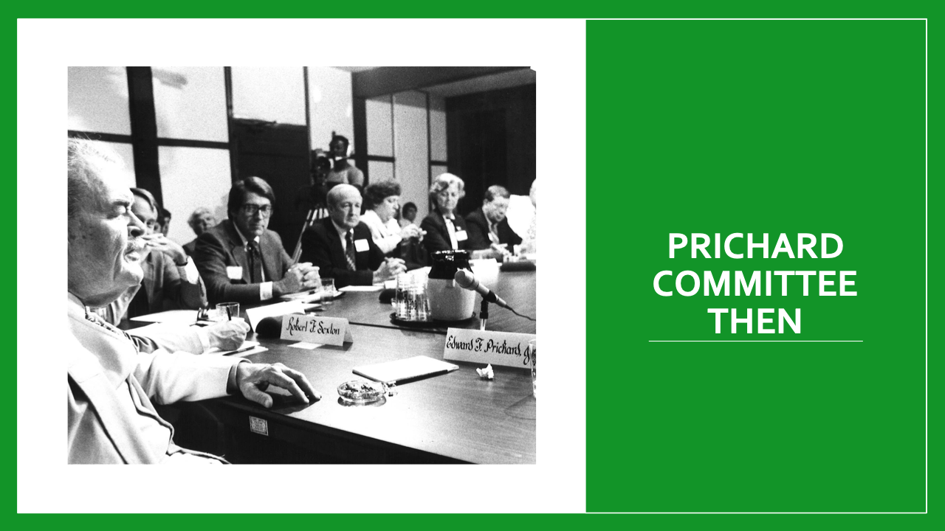

Slide 8
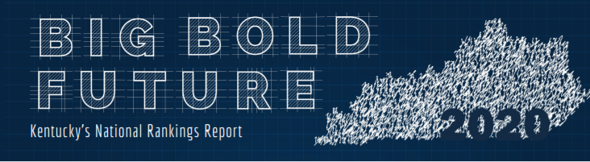
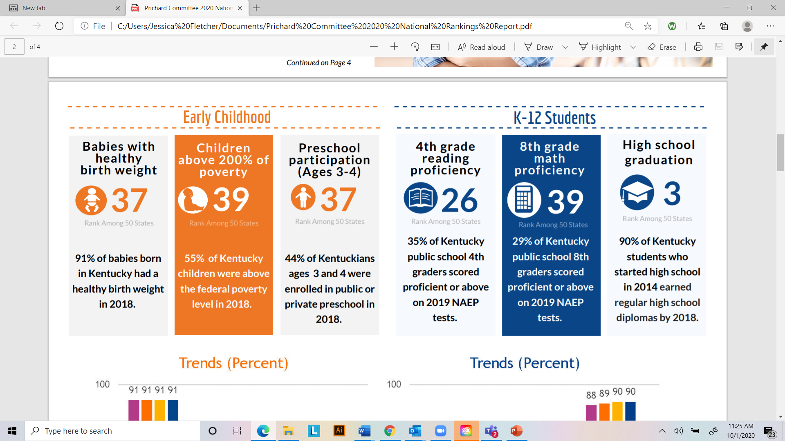
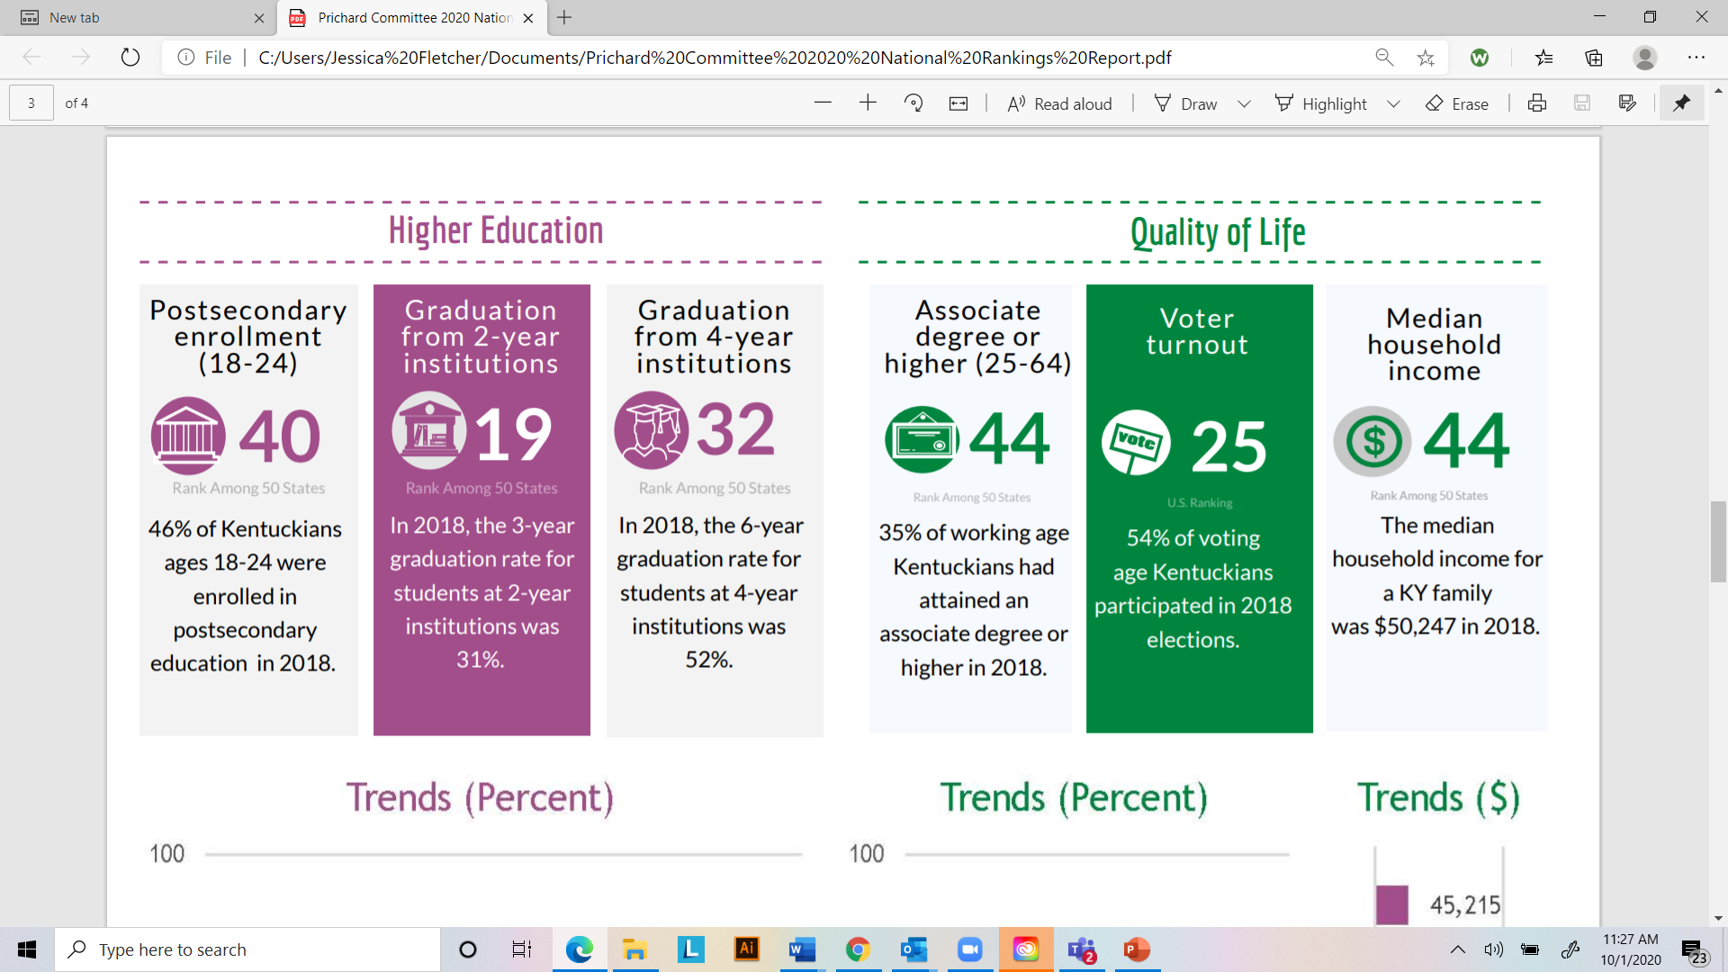

Slide 9
From nearly four decades of focus we can say:
  Kentucky has climbed from the bottom of the national rankings on key indicators of success in education.
  We still linger in the bottom quarter on far too many others.
  We have failed to deliver for African American students and families on each of these indicators and have important work ahead to serve Hispanic Kentuckians well.
  And, Kentucky still languishes 5th from the bottom of the nation for families living in poverty.

Slide 10
Are there things local communities/local businesses can do to more holistically support early childhood efforts?

Slide 11
If you were to pick one measure of success of our K-12 system,
what would it be?

Slide 12
What do you ultimately want out of Kentucky's system of postsecondary education?

Slide 13
What needs to improve for the quality of life of Kentuckians to increase?

Slide 14
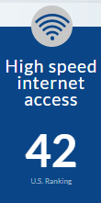
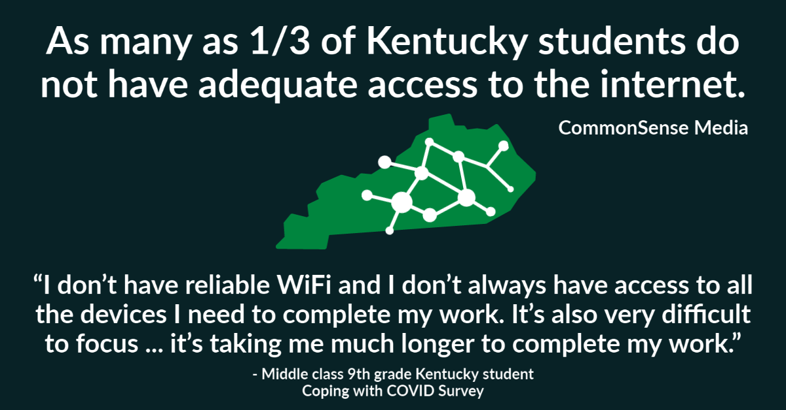
Closing the Digital Divide
SOURCE: U.S. Census Bureau,
American Community Survey
  Research demonstrates access to the internet is increasingly a necessity for communities’ innovation and productivity, as well as students’ and families’ ability to be fully engaged and maximize their quality of life. No student, no family, no household in Kentucky should be left behind due to lack of this basic infrastructure.

Slide 15
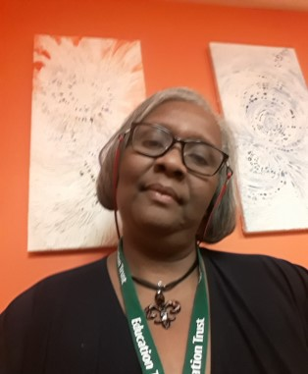
Penny Christian
Parent Engagement Now
Parent Leader
Ed Trust Fellow
CIPL Fellow
PC Member
16th District PTA President

Slide 16

Action Items
1. Groundswell Membership
2. Family Engagement Certificate

Slide 17
Closing
Upcoming Events
  CIPL Networking Café-Nov. 10th
  Kentucky Collaborative for Families and Schools Networking Call-Nov. 11 (Email Brooke Gill to be added-Brooke.Gill@prichardcommittee.org
  Webinar #2
  Dec. 1st Project Forms are Due
  www.prichardcommittee.org/fellow
  Password-2021class

