Slide 1

Louisville Pilot
Supporting Spanish-Speaking Family Child Care Homes

Slide 2

Desired Outcomes
Quality improves in Spanish-speaking Family Child Care Homes in Louisville
Supply of Spanish-speaking Certified Family Child Care Homes Increases
Families choose high quality Spanish-speaking Certified Child Care Homes

Slide 3

Funded by:
Prichard Committee for Academic Excellence though a grant from the Kellogg Foundation
Metro United Way through grants by C. E. and S. Foundation and the Lift a Life Foundation

Slide 4

Steering Committee Members include:
Community Coordinated Child Care
Cori Gadansky
Dawn Thompson – Project Coordinator
Metro United Way – Ashley Brandt
Passport Health Plan – Liz McCune
Child Care Aware
Torri Klain
Dawn Urrutia
Community Volunteers
Bonnie Lash Freeman
Terry Tolan

Slide 5
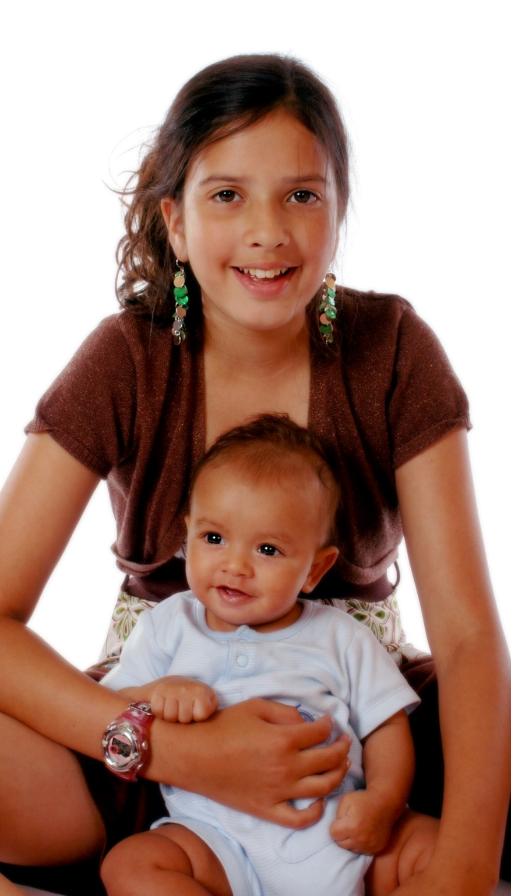
Community Partners
Americana Community Center
La Casita
Doors to Hope

Slide 6
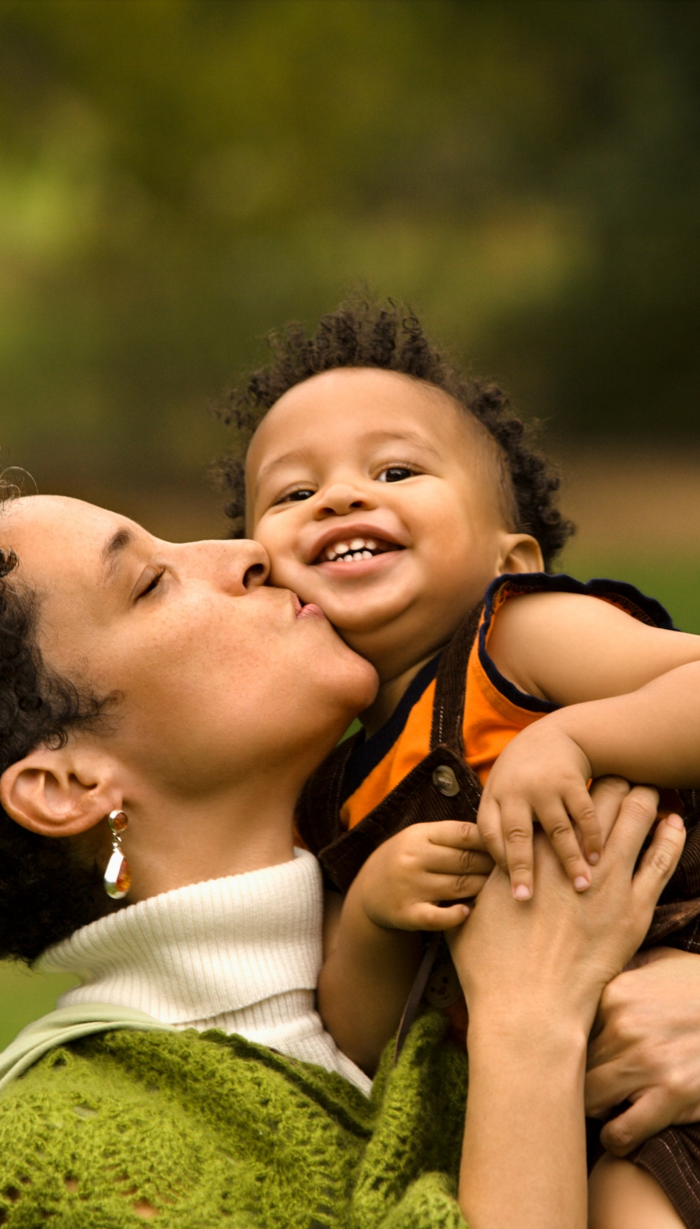
Dawn Thompson Community Coordinated Child Care (4-C)
Recruiting and Convening the Spanish- Speaking Provider Community

Slide 7
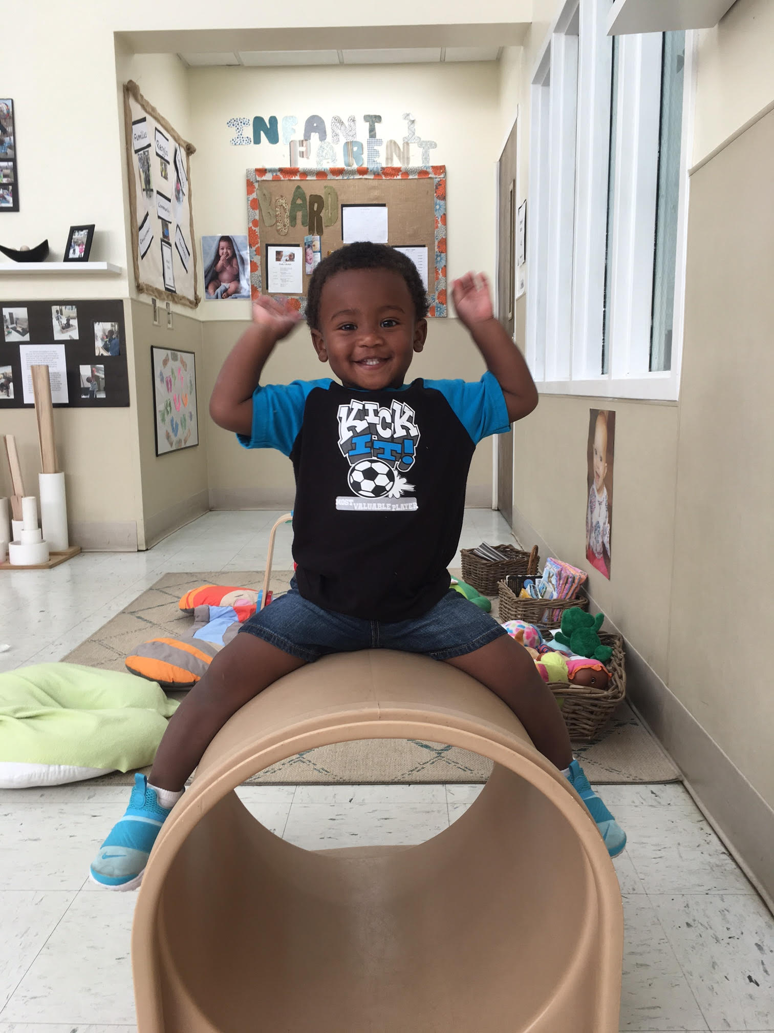
Focus Groups
Initial focus group was held on 12/4/2018 with 9 FCCH providers
Spanish Family Child Care Home focus group held on 6/25/2019 with 9 FCCH providers
Additional Spanish Family Child Care Home focus group held on 8/7/2019 with 5 FCCH providers

Slide 8
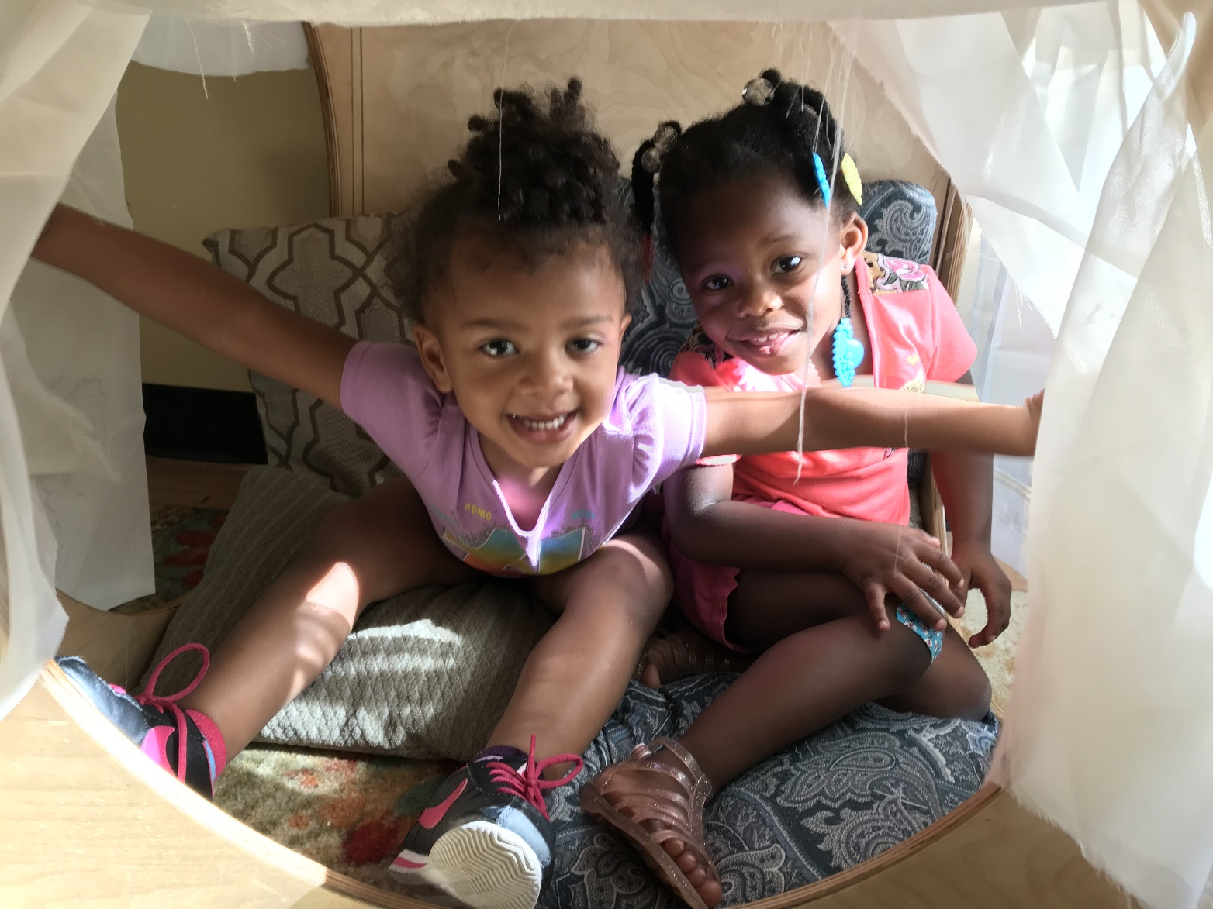
Common Ground
All three focus groups shared some thoughts and concerns including:
Family Child Care Home Providers choose to provide care in their home because they love kids, they want to be able to work at home, and they like being able to stay home with their own children.
Providers feel that parents choose a Family Child Care Home Provider because they want their children cared for in a home environment.
Family Child Care Providers consider themselves professionals in their field and want others to understand that a Family Child Care Home is not a child care center.
One of the most difficult things a FCCH provider does is communicating with parents

Slide 9
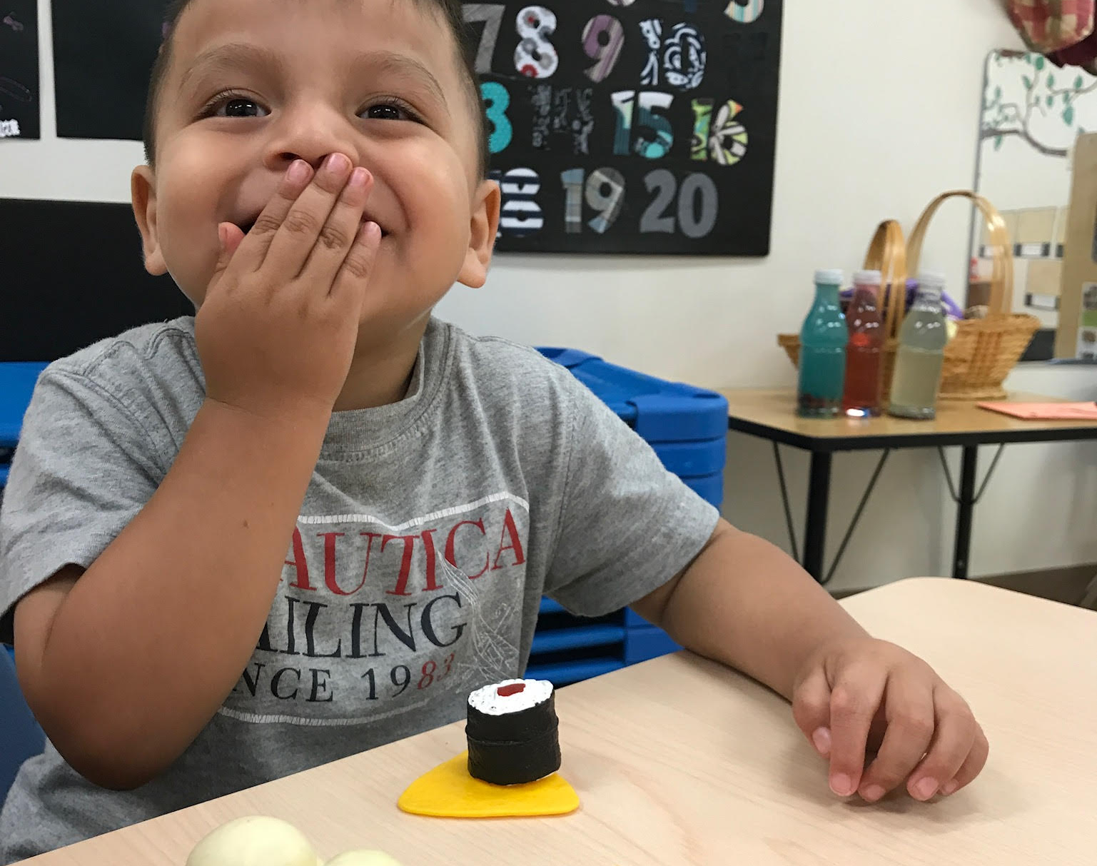
What We Learned from the Spanish FCCH Providers
Parents choose these providers because they know the provider, so the children can develop their language, and the children like being there
Children like their Spanish Family Child Care Home provider because they cook good food
Language is not the biggest barrier
Translating materials is not always the answer

Slide 10
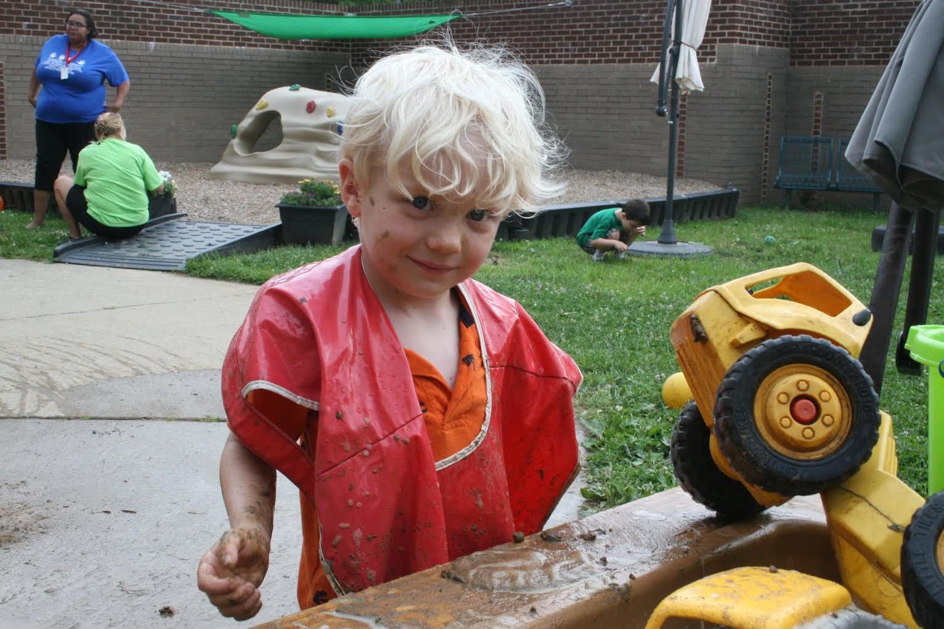
Identified Needs
A native Spanish speaking trainer
Ages & Stages Questionnaire (ASQ) in Spanish
Someone to professionally interpret when there are issues with DRCC, CCAP, STARS etc.
Assistance with computers & computer applications
Figuring out what “School Readiness” is
Business issues (taxes, marketing, etc.)
Translation of child care regulations

Slide 11
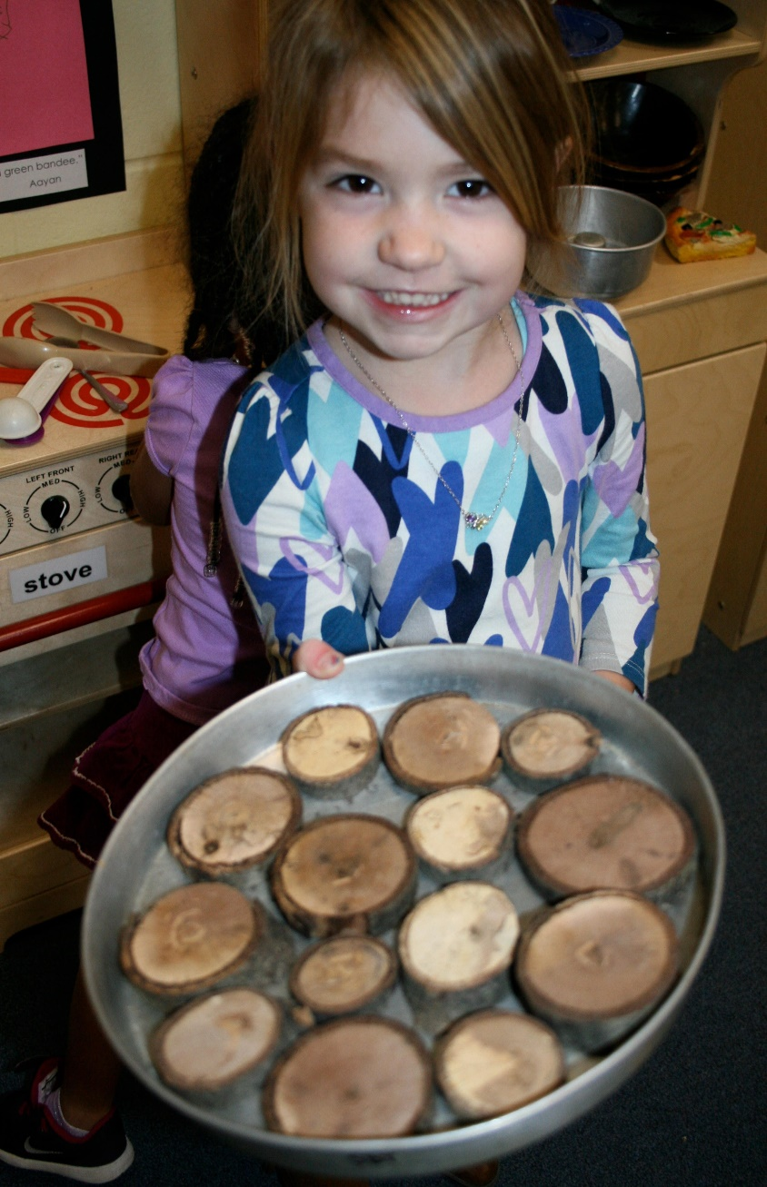
Big Wins
A native speaking interpreter is key
Valuable documents were translated by the Division of Child Care including the application and renewal forms
A library of translated documents including Child Care Aware’s Walk Through Tool now available
Peer to peer support and networking through the Community of Practice
Opportunity to familiarize providers with the Kentucky Shared Services website
Providing each provider with an ASQ kit
Providing children’s books to providers that attend

Slide 12
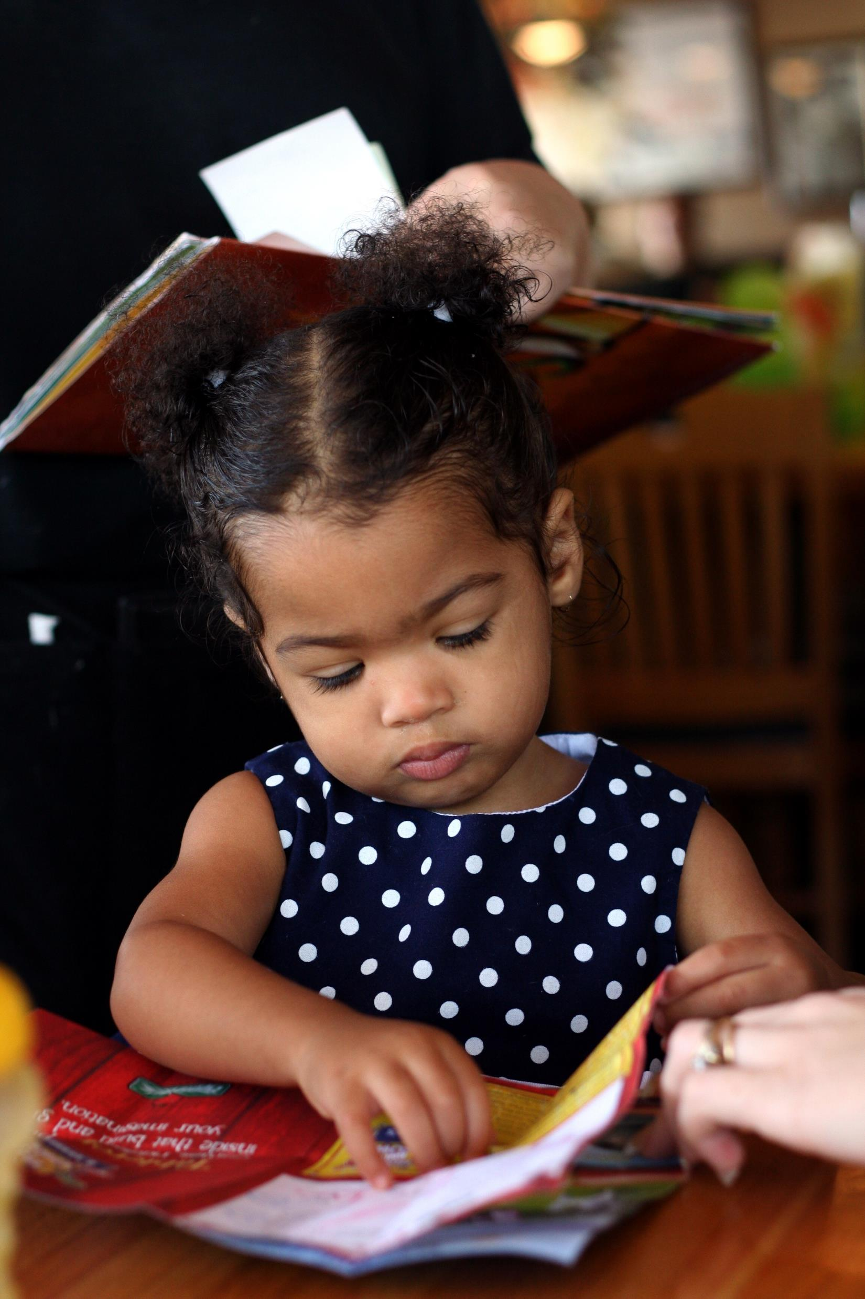
Kathy King Community Coordinated Child Care (4-C)
Community of Practice

Slide 13
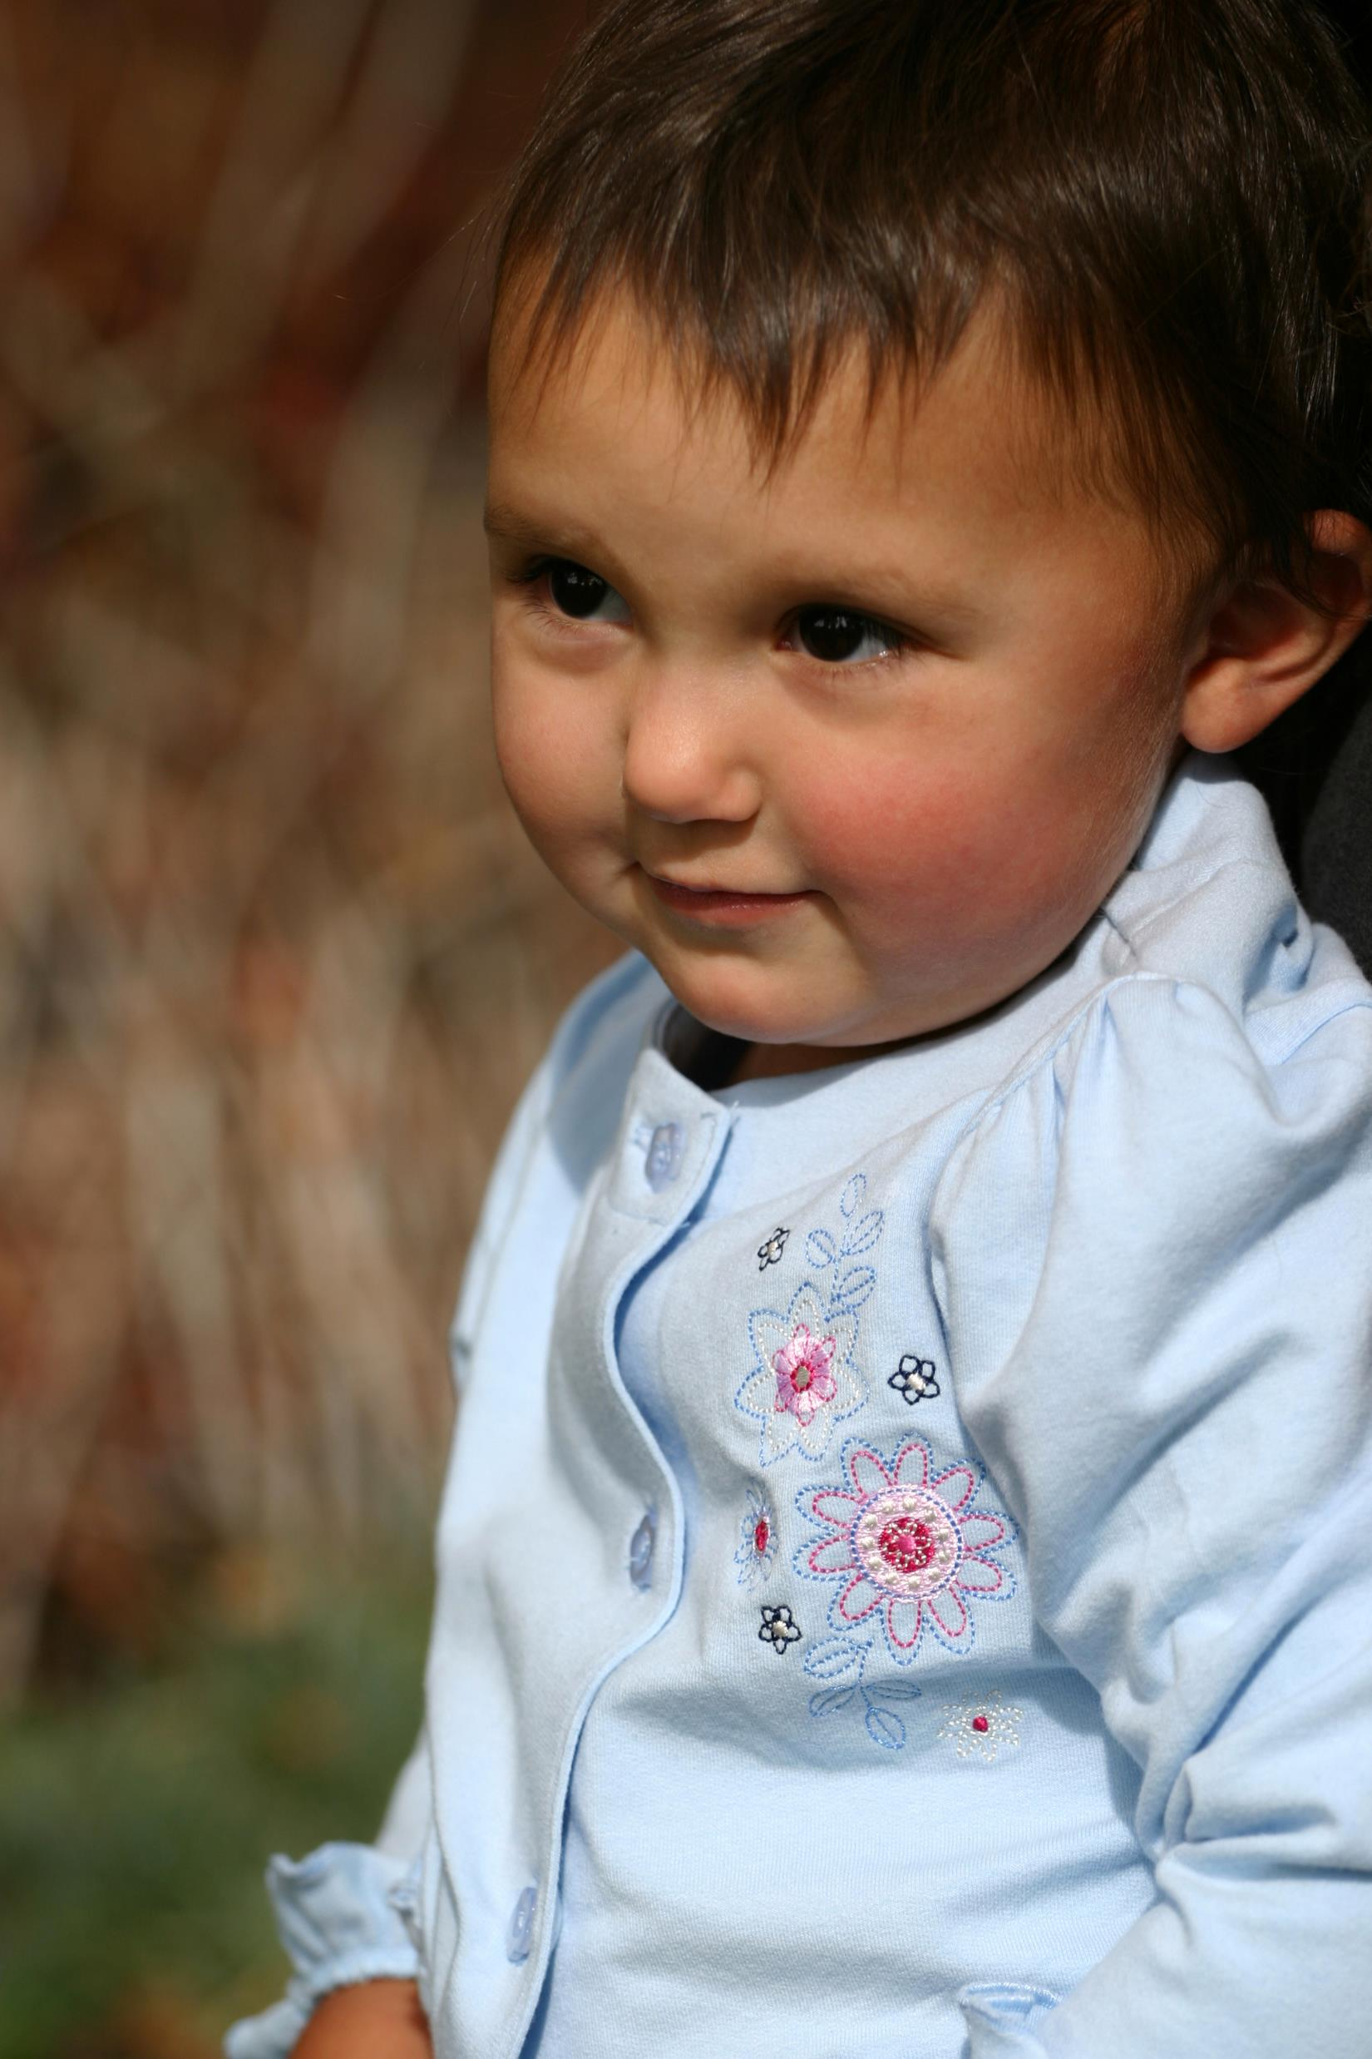
Ashley Brandt
Metro United Way
Next Steps: Families and Community Partners

Slide 14
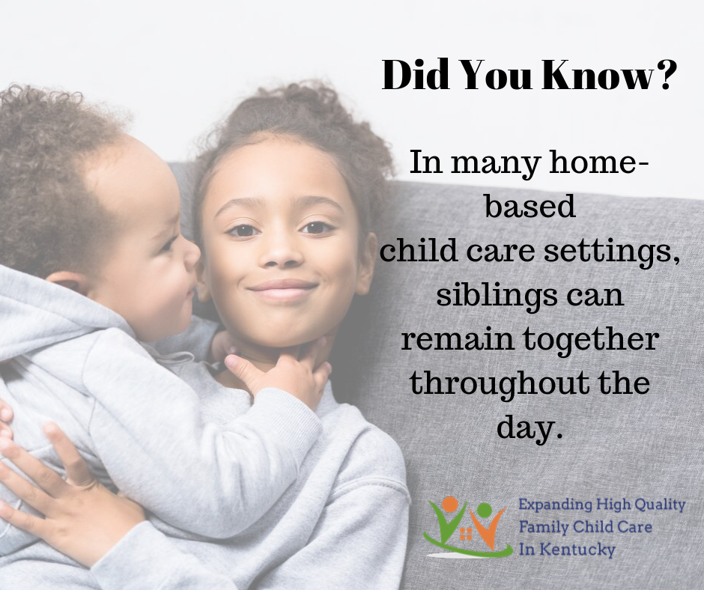
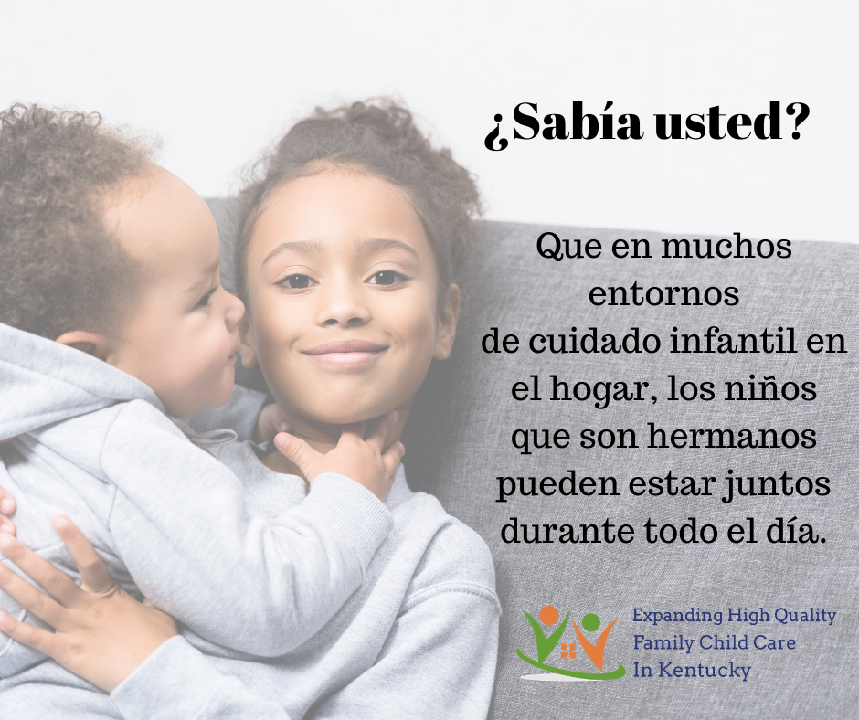

Slide 15

Thanks to our partners
Division of Child Care – translations
Child Care Aware
Staff support
Rounding up Materials in Spanish
Outreach
Prichard Committee - convening

Slide 16
Questions? tolanterry@gmail.com

