Slide 1
Notes:
Welcome and introductions.

Slide 2
KDE Updates | Strong Start
January 9, 2020

Slide 3
Review Items
2019 Kindergarten Readiness Results
Preschool
  Accountability – GMAP
  December 1 Count
Preschool Partnership Grants

Slide 4

True or False?
Children who turn 5 by August 1 must score 65% ready or higher on the Brigance before they can enroll in Kindergarten.
False
Notes:
All children start school with an ability to learn. The Brigance K Screen is intended to help schools identify and narrow gaps as quickly as possible.

Slide 5
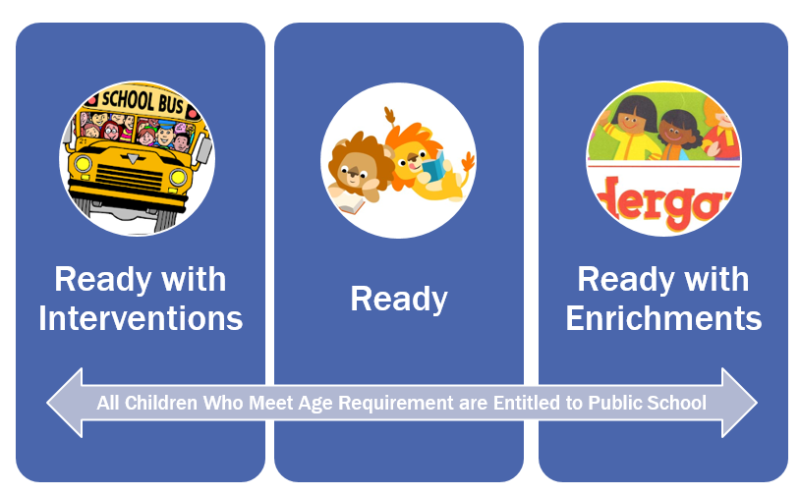
Levels of Readiness
Notes:
All children start school with an ability to learn. The Brigance K Screen is intended to help schools identify and narrow gaps as quickly as possible.
Ready with Interventions describes students who received a score below 61 (5.o through 5.5) or below 70 (5.6 through 5.11). These children demonstrated minimal skills and behaviors and may need additional diagnostic assessment, interventions and supports based on Kentucky’s standards.
Ready describes students who received a score of 61-88 (5.0 through 5.5) or 70-91 (5.6 through 5.11). These children demonstrate skills and behaviors that prepare them for instruction based on Kentucky’s standards.
Ready with Enrichments describes students who received a score above 88 (if age 5.0 through 5.5) or above 91 (age 5.6 through 5.11). These children demonstrate skills and behaviors that prepare them for enriched instruction based upon Kentucky’s standards.

Slide 6
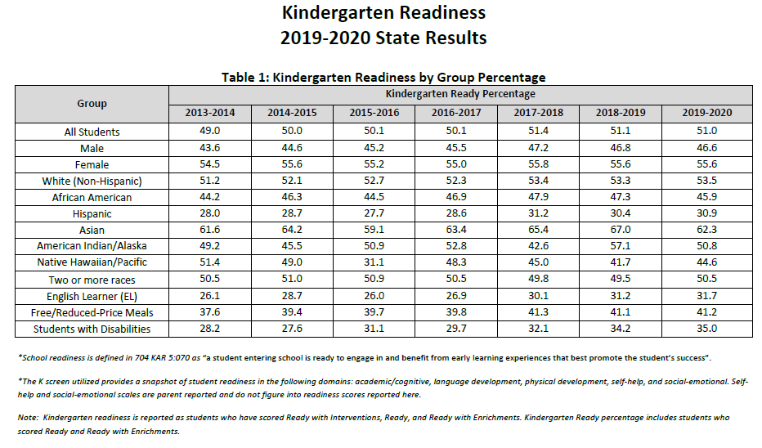

Slide 7
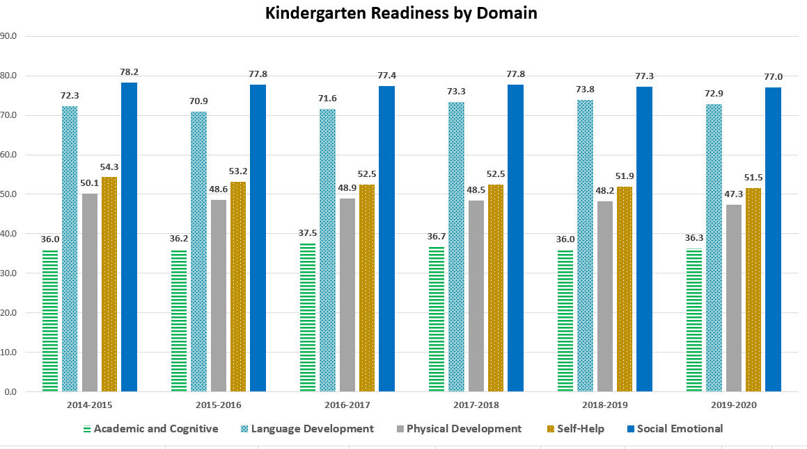

Slide 8
Preschool Accountability
By the 2020-2021 school year, an annual evaluation and grant application system for preschool programs statewide will be implemented (GMAP).

Slide 9
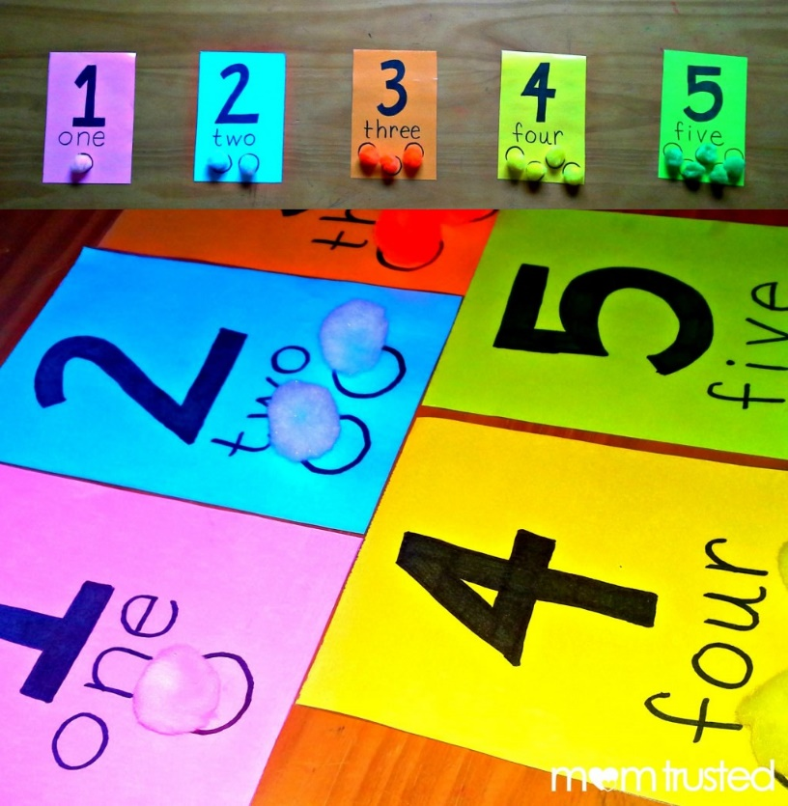
Preschool Count
December 1, 2019 Preliminary Count
  9,941 At-Risk
  10,941 Disabilities
Notes:
These are preliminary counts are not final. They are shared with Strong Start for informational purposes only.
AR – 9,941
SWD – 10,941

Slide 10
Preschool Partnership Grant
Interim Joint Committee on Health, Welfare, and Family Services, December 9, 2019
  Dr. Ryan Alverson, Assistant Professor, NKU
  Dr. Kara Davies, Principal, Clark County
  Kevin Middleton, President, United Way of KY
Mid-year reports are due January 15, 2020.
In the spring, NKU will conduct individual partner interviews instead of focus groups.
Notes:
Ryan Alverson made the case for high quality early childhood partnerships, reviewing brain research and basic information about grant implementation. Kara Davies discussed the benefits of Clark County’s partnership with Bluegrass Children’s Academy, referencing improved alignment of curriculum and instruction, professional learning and child outcomes. Kevin Middleton requested consideration of separate funding for PPG and state-funded preschool, along with restoration of full funding for preschool.
Interim Joint Committee on Health, Welfare, and Family Services
Meeting 8 Agenda
Monday, December 9, 2019

Slide 11
Contact
Bill Buchanan, Program Consultant II
School Readiness Branch
Division of IDEA Implementation and Preschool
Office of Special Education and Early Learning
502-564-4970 extension 4702
Bill.Buchanan@education.ky.gov

