Slide 1

American Rescue Plan Funding for Child Care
July 2021
Division of Child Care

Slide 2
Kentucky Funding from ARP
The Commonwealth of Kentucky has been awarded over $763 Million specifically dedicated to child care.
Over $470 Million is designated for sustainability payments.
Over $293 Million is designated through one-time CCDBG funds.

Slide 3
Goals of Federal Funds
The federal goal of the Stabilization Funds is to support the programs that have survived the hardship of the past 16 months.
The federal goals of the one-time CCDBG funds are:
Increasing Provider Payments
Improving Payment Policies
Increasing Wages for Early Childhood Educators (in centers and family child care homes)
Building the Supply of Child Care for Underserved Populations

Slide 4
Stabilization Funds - Dispersement
Nine stabilization payments to child care programs throughout Kentucky beginning in October 2021 when the CRRSA payments run out.
Payments would be made quarterly for October 2021, January 2022, April 2022, July 2022, October 2022, January 2023, April 2023, July 2023, and September 2023.
$49.6 Million would be reserved for each grant period for the programs that apply for each funding round.

Slide 5
Stabilization Payments - Requirements
Child care programs must have been open and serving children by March 11, 2021 (licensed, certified, or registered providers)
Licensed and certified child care programs must participate in the All-STARS program in order to receive stabilization grants.
Child care programs must be eligible to accept children on the Child Care Assistance Program in order to receive funding from the American Rescue Plan.

Slide 6
Stabilization Funds - Requirements
Child care programs must be OPEN and serving children, unless they have been temporarily closed by the health department due to a COVID outbreak and quarantining.
Half-day child care programs (that are only open for less than five hours daily) will receive funding that is pro-rated at 50% of the allotment for full-day child care programs.
Programs that operate on the school year calendar and close temporarily in the summer will miss the July 2022 and July 2023 payments.

Slide 7
Stabilization Payments - Requirements
Child care providers receiving the American Rescue Plan funds must sign a contract outlining the requirements of the funding and must fill out the federally mandated form regarding estimated income.
Child care providers receiving the American Rescue Plan funds must complete a monthly data sheet and send it to the contract agency by the 5th of each month. The data sheet will include data on enrollment, staff turnover, and other key data points.

Slide 8
Stabilization Payments – Tier System
Tier 1 (introductory pay rate based on program capacity):
Meets minimum labor cabinet requirements
Meets minimum child care regulatory requirements
Participates in the All-STARS program
Tier 2 (pay rate based on capacity with an additional 10% funding):
Starting pay at $10/hour or higher
Tier 3 (pay rate based on capacity with an additional 20% funding):
Starting pay at $13/hour or higher

Slide 9
Stabilization Payments – Tier System
Child care programs in Tier 2 or Tier 3 for funding must provide payroll documentation to prove the base pay for all child care staff employed at the program.
If providers are not currently using the pay scale they apply for (Tier 2 or 3), then they have four months after receiving the award to provide documentation that raises have been provided and the requirements of the tiered system are in place.

Slide 10
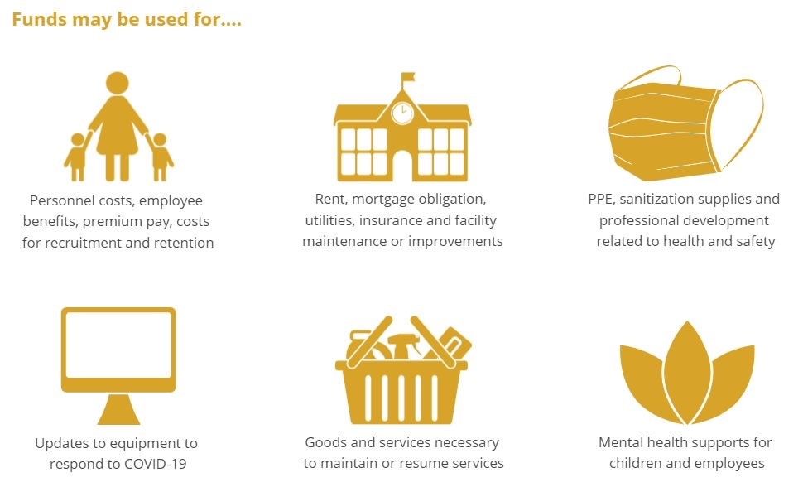
Stabilization Funds – Allowable Expenses

Slide 11
Stabilization Funds – Allowable Expenses
Personnel costs including salaries, benefits, premium pay, or recruitment and retention;
Facilities costs including rent, mortgage payments, utilities, maintenance, improvements or insurance;
Cleaning supplies or services, personal protective equipment, and training and technical assistance on health and safety practices;
Purchases of or updates to equipment and supplies to respond to the public health emergency; or
Mental health supports for children and child care employees.

Slide 12
Stabilization Funds – Allowable Expenses
Funds can be used for expenses acquired at any point during the pandemic and state of emergency.
Funds can be utilized to pay off debt acquired during the state of emergency related to keeping the child care program operational.
Documentation of expenditures will be required.

Slide 13
Stabilization Payments - Administration
Due to the workload involved with the contract process, dispersing 9 payments, and auditing programs to assure funds are spent on allowable expenditures, DCC will be partnering with a 3rd party company to supervise the stabilization payments.
CHFS will issue a Request for Proposal (RFP) to find a company that can assist with issuing the payments.

Slide 14
Stabilization Payments - Applications
The cut-off date for application would be 30 days prior to the beginning of the funding month.
The per-child amount will be determined 15 days after the application period ends.
Once a child care program applies, it will not need to reapply unless it wishes to move to a higher tier.

Slide 15
CCDBG Funds – Preschool Partnerships
Continuation of the Public School Preschool Partnership Program for the spring of 2021-2022, 2022-2023, and 2023-2024 School Years.
This would be a collaborative with KDE Division of IDEA Implementation and Preschool Services.
This partnership will support children who qualify for CCAP and children with special needs to get IEP services through 3-hour public school preschool and still get full-day child care services so that families can work.

Slide 16
CCDBG Funds – Preschool Partnerships
School districts must submit the application after selecting child care program(s) to partner with on this project.
Child care programs must be 3, 4, or 5 STAR programs.
There will be a focus on social/emotional supports and special education training.

Slide 17
CCDBG Funds – Preschool Partnerships
Provide or supplement salaries to extend program hours or open new classrooms
Provide or supplement salaries to provide social and emotional supports to all children enrolled in the program
Travel and participate in regional, state or national early childhood training or meetings for the purpose of improving early childhood quality
Purchase supplies related to trainings and/or meetings, such as paper, pens/pencils, etc.
Conduct marketing and recruitment activities

Slide 18
CCDBG Funds – Preschool Partnerships
DCC will issue a Request for Application (RFA) for interested school districts to apply.
Notification with be sent out through the DCC listserv, social media, and communication through partner agencies.

Slide 19
CCDBG Funds - CCAP
Increase to CCAP Reimbursement Rates
Cliff Effect
3 Months of Additional Reimbursement at 50% of typical rate upon graduation from the CCAP program

Slide 20
CCDBG Funds – Infant Toddler Project
This pilot project would be used to combat the decrease in programs currently accepting families using CCAP and to increase infant and toddler care for our most vulnerable population.
Require participating centers to pay all staff members at a certain floor, in order to continue to raise compensation through the contract program.
The CCAP program will pay the center each month for a certain number of slots. Enrollment will be audited to make sure that paid slots are not being wasted.

Slide 21
CCDBG Funds – Infant Toddler Project
Incentives will be awarded each time an audit shows 90% enrollment or higher.
Participating programs must be 3, 4, or 5 STAR programs.
Centers and Family Child Care (FCC) homes are both allowed to participate in pilot program.

Slide 22
CCDBG Funds – Facility Repair
Facility Repair Grants for Child Care Programs Currently in Operation
Child care programs in need of essential facility updates including roofing, HVAC systems, structural repairs, hot water heaters, plumbing, major appliances, and fencing.
Centers that want to apply must send in a current labor quote along with a completed application.

Slide 23
CCDBG Funds – Trainer Academies
Two training academies will be offered: one focusing on working with children with special needs & one focusing on director skills.
Fifty KY credentialed trainers will participate in a training academy focusing on helping child care providers work with high risk populations of children.
Trainers will be accepted from all 8 DCC regions of the state.

Slide 24
CCDBG Funds – Trainer Academies
Trainers will be obligated to complete trainings in their areas of the state through 2024 after completing the training academy.
Trainings curriculum and support materials will be provided to all trainers participating in the academy.
Higher level trainers will be prioritized in the application process.

Slide 25
CCDBG Funds – KY Apprenticeships
Supporting mentor teachers/host programs to train apprentice candidates in the preschool, infant/toddler, or director apprenticeship program
Pay fees for adult apprenticeship candidates for their CDA fees, Orientation fees, First Aid/CPR fees, or any other certification during the course of their internship
The cost of college coursework for adult apprenticeship
Funding to developing coaching model for training all apprentices with same curriculum/coaching for all KY candidates

Slide 26
CCDBG Funds – KY Scholarship Programs
Full coverage of the CDA program costs for employees working at least 20 hours per week in a child care program
Full tuition (above our typical scholarship limits) for AA or BA in Early Childhood Education at a KY state community college or university for employees working at least 20 hours per week in a child care program
Full tuition for Master’s Degrees in Early Childhood Education or Early Childhood Special Education at a KY state university for Directors or Administrators working at least 20 hours a week in a child care program

Slide 27
CCDBG Funds – FCC Start-Up Grants
$2,500 grants to start certified child care homes
Workforce development offered through the Family Child Care Network
Must care for children for at least 12 months.
Must accept children on the child care subsidy program.
If funding has not been used in the third year, then FCCs could apply for materials and fencing.

Slide 28
CCDBG Funds – Employee Child Care Grants
Businesses interested in starting on-site employee-based childcare can apply for up to $100,000 grant match to open new child care facility.
Business must prove they have the matching funds available.
Center must accept children using the Child Care Assistance Program
Center must go through licensing and All-STARS process. Must reach a 3 STAR rating within two years.
Center must stay open for a minimum of two calendar years.

Slide 29
CCDBG Funds – Child Care Desert Grants
Can apply for up to $100,000 grant match to open new child care facility
Must be in one of the 65 counties in KY considered a child care desert
Center must accept children using the Child Care Assistance Program
Center must go through licensing and All-STARS process. Must reach a 3 STAR rating within 2 years.

Slide 30
CCDBG Funds – Technology Systems
New technology platform that will link all of the DCC databases in order to close data holes and find necessary data to support child care programs in the state.
Provide all family child care homes and centers in Kentucky with a three-year subscription to computerized enrollment and billing system.
Provider new computers to child care programs throughout the state for enrollment, billing, and other business practices.

Slide 31

Questions

