Slide 1
Mission
Provide leadership and direction for the Commonwealth by
providing a comprehensive and sustainable prenatal to age five
system that will ensure a strong foundation for all children.

Slide 2
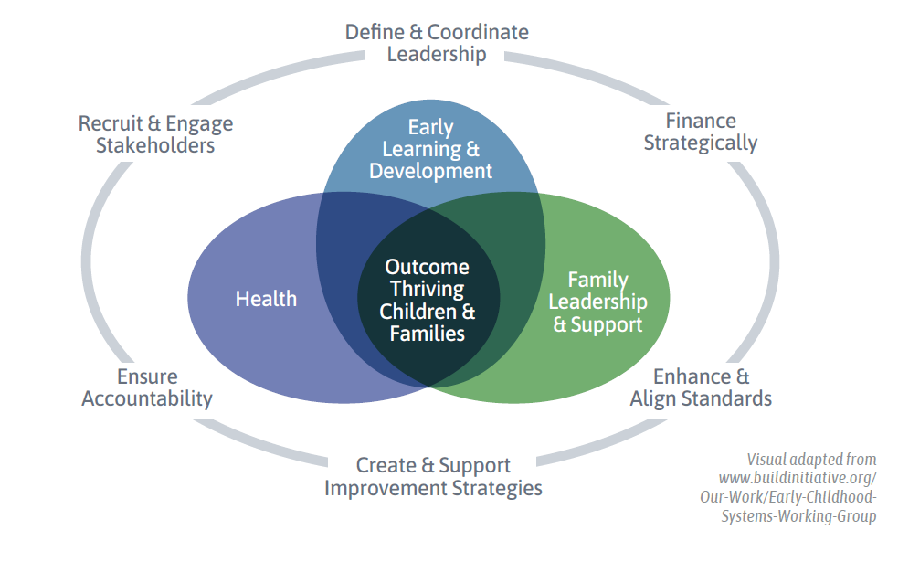
Early Childhood Systems Building
Preschool Development Grant—Planning Year
Grants issued in 2019 by United States Administration for Children and Families
Goal was to help states complete planning exercises to focus systems building
What does building an early childhood system mean?
Blended funding streams
Visionary leadership
Feedback communication loops
Information systems
Interconnected management
Infrastructure
Adaptability
Accountability

Slide 3
Major Lessons
Focus
There are a lot of steps that we could take—what shoud we focus on now?
Efficiency
How do we reduce duplication and use resources in more efficient ways?
Accountability
How might we unite stakeholders to ensure children are on track before they enter kindergarten in every community?
Capacity
How do we build cross-sector systems to increase coordination and support?
Sustainability
How do we ensure the system will last?
Service
How can we ensure the system responds to the needs of families with young children?

Slide 4
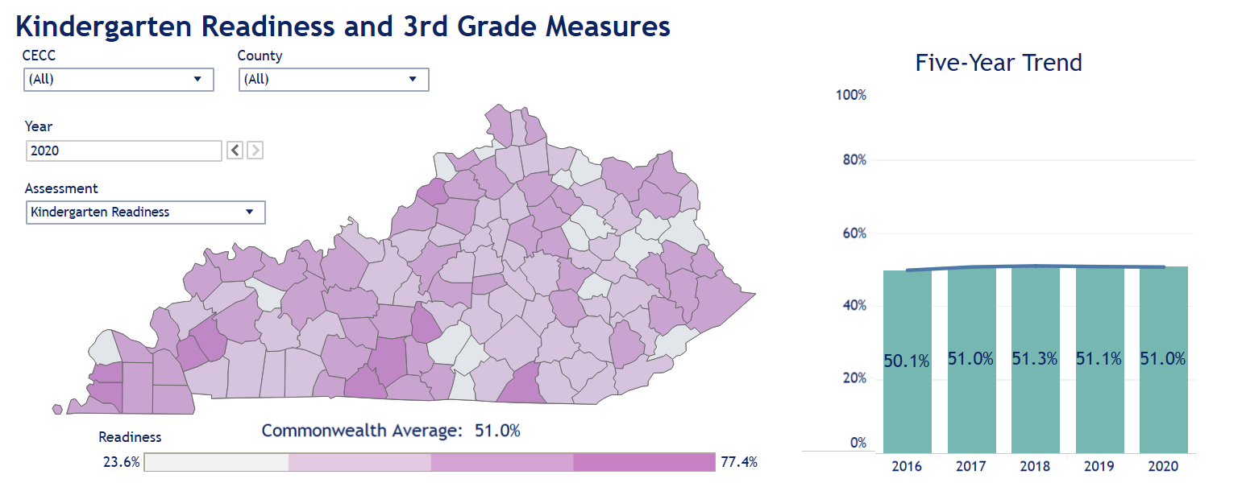
Next Steps
High quality early childhood education is a critical component of K-12 success
Focus must be on outcomes and shared accountability at the state and local level

Slide 5
Kentucky Governor’s Office of Early Childhood
Priorities
#1:
Unification and Accountability of the Early Childhood System
Priority #2:
Strengthening and Cultivating Strategic Partnerships

Slide 6
Amy L. Neal
Executive Director
amy.neal@ky.gov
502.782.0204
www.kyecac.ky.gov

